Slide 1


Module 2
ADDING VALUE TO PLANT-BASED AT THE FARM AN PROCESSOR LEVEL
www.plantpowerproject.eu
Plant Power OERs Modules © 2025 by Plant Power Partnership is licensed under CC BY 4.0. To view a copy of this license, visit https://creativecommons.org/licenses/by/4.0/

Slide 2
Contents
01
Technologies and novel strategies to produce safe, sustainable and healthy plant-based products.
02
Non-thermal technologies- high hydrostatic pressure (HHP)- for safe, sustainable and healthy plant- based products.
03
Controlled sprouting: bridging ancestral process with modern innovation.
04
Labelling of plant-based products: regulatory aspects and market perspectives.
05
Nutrition: clinical training on gaps and opportunities in plant-based diets – best practices for diagnosis and recommendation

Slide 3
Contents
06
Learning Summary

Slide 4

Module Overview: Learning outcomes
This module explores how modern technologies and traditional methods enhance plant-based foods.
Understand the main drivers and opportunities associated to technology can contribute to produce better and safer plant based foods.

Slide 5
01
Technologies & Novel Strategies to Produce Safe, Sustainable and Healthy Plant-based Products

Slide 6
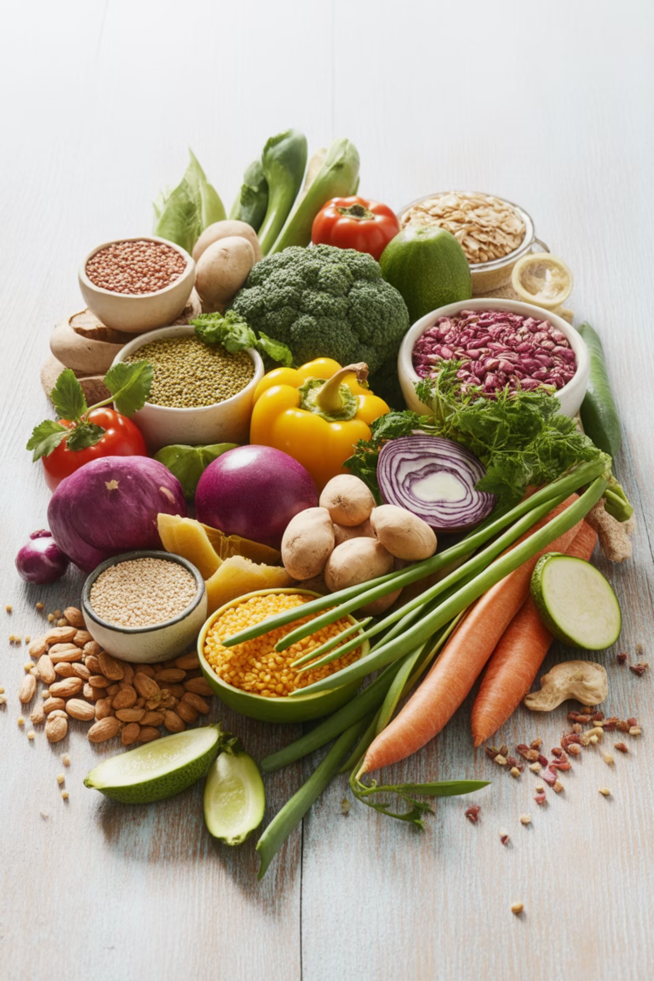
Learning Journey Overview
Explore the multifaceted role of plant-based foods in nutrition, food technology, and public health through innovative processing methods and sustainable practices.

Slide 7
Key drivers of food and technology
01
02
03
Nutritional Foundation
Technological Innovation
Critical Analysis
Understand the nutritional quality and functional bioactive compounds in plant-based food sources
Recognize innovations like extrusion, high hydrostatic pressure, sprouting, fermentation, and nanoencapsulation
Identify limitations including nutritional gaps, allergenicity, processing concerns, and regulatory issues
04
05
Cultural Integration
Sustainable Impact
Compare traditional and emerging products, exploring how cultural foods can be nutritionally enriched
Evaluate the role of plant-based foods in promoting sustainable diets and transforming food systems

Slide 8
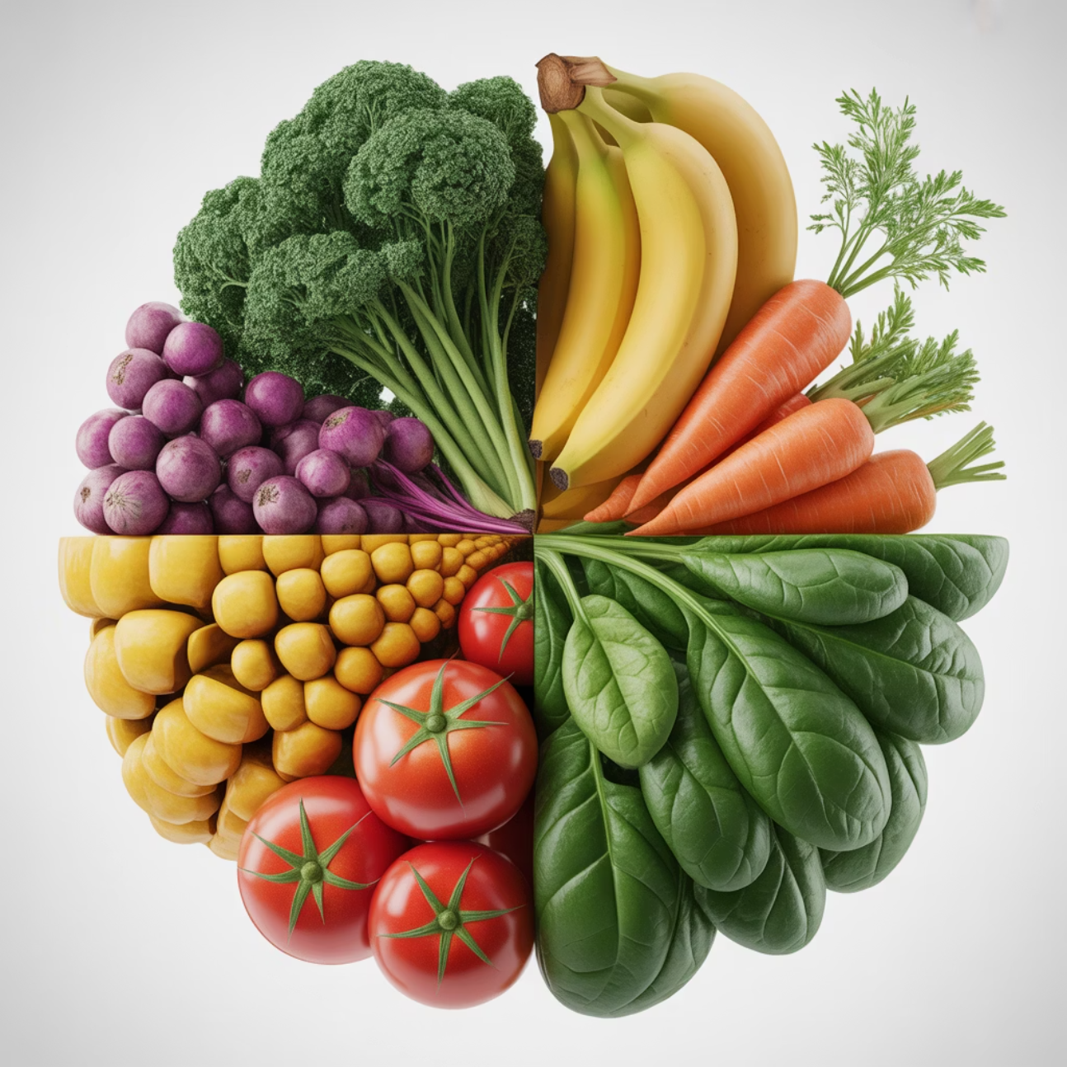
Plant-Based Food Sources: Nutrition and Health Potential
The growing popularity of plant-based diets reflects significant changes in how people think about health, environmental responsibility, and animal welfare. Plant-derived foods provide an extensive array of micronutrients essential for cellular function, enzymatic activity, and physiological homeostasis.
Key Nutritional Components
Vitamin C: Found in citrus fruits, red peppers, and strawberries—supports collagen synthesis and antioxidant regeneration
Folate (B9): Present in spinach, lentils, and leafy greens—crucial for DNA synthesis and embryonic development
Iron: Available in pulses and whole grains—absorption enhanced by vitamin C-rich foods
Magnesium: Abundant in amaranth leaves, legumes, and whole grains—essential for ATP-dependent enzyme reactions

Slide 9
Phytochemical Power
Polyphenols
Carotenoids
Phytosterols
Glucosinolates
Quercetin in apples, onions, and berries; epicatechin in green tea and cocoa; ferulic acid in whole grains—influence redox-sensitive signaling cascades
β-carotene, lutein, and zeaxanthin in carrots, sweet potatoes, spinach, and kale—support visual function and demonstrate immunomodulatory potential
Found in cold-pressed oils, seeds, and nuts—interfere with cholesterol absorption, leading to lower plasma LDL-cholesterol levels
Present in broccoli, Brussels sprouts, and kale—produce bioactive isothiocyanates like sulforaphane with epigenetic effects
At worldwide level, nutritional shift is clearly visible and almost half the population regularly includes plant-based products in their diet—especially women. Innovation in agrifood industry is mandatory to meet consumer demand.

Slide 10
Traditional Enhancement: Sprouting and Fermentation
Sprouting
Fermentation
A traditional, low-cost technique that activates endogenous enzymes and initiates biochemical transformations to enhance nutritional quality.
Microorganisms metabolize plant substrates, producing bioactive compounds including vitamins, bioactive peptides, and short-chain fatty acids.
Benefits:
Benefits:
Reduces anti-nutritional factors (phytic acid, tannins, enzyme inhibitors)
Increases bioavailability of minerals by degrading phytates and tannins
Increases bioavailability of iron, zinc, calcium,
and magnesium
Transforms polyphenols into more bioaccessible forms
Releases isoflavones in aglycone form in soy products
Enhances protein and carbohydrate digestibility
Improves protein digestibility
Promotes synthesis of essential amino acids like lysine
Confers prebiotic and probiotic properties
Accumulates antioxidants including vitamin C, polyphenols, and GABA
Reduces bitterness while developing complex flavor

Slide 11



Advanced Processing Technologies
These technologies offer powerful tools to create shelf-stable, nutrient-dense, and highly palatable foods that align with performance, recovery, and wellness goals while supporting sustainable food processing.
High Hydrostatic Pressure (HHP)
Extrusion
Nanoencapsulation
High-temperature, short-time process combining mechanical shear, pressure, and thermal energy to shape plant-based ingredients into meat analogues, snacks, and fortified foods. Reduces anti-nutritional factors, improves mineral bioavailability and protein digestibility, creates fibrous meat-like textures.
Works at 100–600 MPa at low or ambient temperatures, inactivating pathogenic microorganisms while preserving heat-sensitive nutrients and bioactive compounds. Maintains nutritional integrity, enhances shelf-life, and improves protein digestibility.
Enhances stability and delivery of sensitive compounds like curcumin or probiotics, protecting bioactive ingredients and improving their bioavailability in the digestive system.

Slide 12
Challenges in the Plant-Based Sector
Formulation Concerns
Many commercially available products are highly processed with elevated levels of salt, saturated fats, refined oils, or added sugars—undermining perceived healthfulness and creating gaps between consumer expectations and actual nutritional profiles.
Allergenicity Issues
Key ingredients like soy, wheat (gluten), nuts, and legumes are common allergens, presenting barriers for sensitive populations and complicating universal formulation. Cross-contamination and inadequate labeling increase risks.
Sensory Disconnect
Texture, taste, and appearance may not meet consumer expectations, particularly among those accustomed to animal-derived foods, reducing repeat purchases and overall trust.

Slide 13
Challenges in the Plant-Based Sector
Processing Impact
High-temperature treatments can degrade thermolabile nutrients including vitamins, polyphenols, omega-3 fatty acids, and bioactive peptides. Protein quality and amino acid bioavailability may be negatively affected without careful control.
Consumer Skepticism
Growing resistance toward "ultra-processed" foods with long, unfamiliar ingredient lists. Use of GMOs, synthetic additives, or novel proteins can trigger public resistance without transparency and education.
Regulatory Inconsistencies
Different jurisdictions vary in definitions, approvals, and labeling of plant-based products. Challenges in product standardization, labeling clarity, and cross-border marketing limit communication of nutritional and environmental advantages.

Slide 14
Key Takeaways
Nutritional Richness
Functional Bioactives
Legumes, whole grains, nuts, and seeds provide protein, fiber, healthy fats, and protective phytochemicals including polyphenols, flavonoids, and lignans
Isoflavones, phytosterols, β-glucans, and omega-3 fatty acids contribute to cardiovascular, metabolic, and immune health
Enhancement Methods
Sustainability Impact
Traditional techniques (sprouting, fermentation) and advanced technologies (extrusion, HHP) improve digestibility, reduce anti-nutrients, and increase bioavailability
Plant-based diets support environmental goals and public health when paired with nutrient-dense, minimally processed foods
Future Direction: Continued innovation must balance functionality, safety, cultural acceptance, and transparent communication to support a healthier, more sustainable food system. Almost half the global population now regularly includes plant-based products in their diet, making industry innovation essential to meet growing consumer demand.

Slide 15
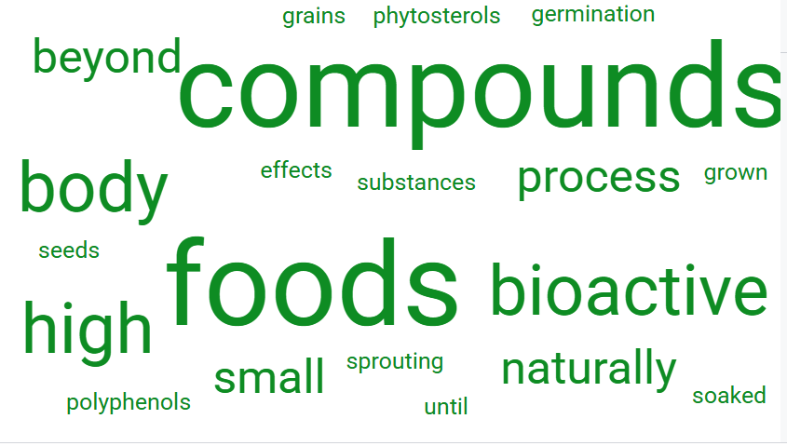
GLOSSARY

Slide 16

LEARN WATCHING

Slide 17

If You Want To Know More
European Food Safety Authority (EFSA). (2023). Plant-based alternatives: Nutritional composition and implications for health (EFSA Supporting Publications 2023: EN-7912). https://doi.org/10.2903/sp.efsa.2023.EN-7912
World Health Organization (WHO) & Food and Agriculture Organization of the United Nations (FAO). (2003). Diet, nutrition and the prevention of chronic diseases (WHO Technical Report Series 916). https://www.who.int/publications/i/item/924120916X

Slide 18
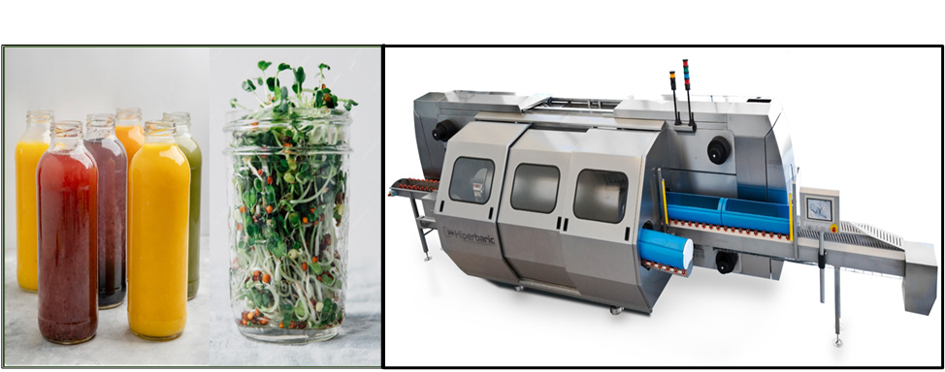
02
Non-thermal Technologies-HHP for Safe, Sustainable & Healthy Plant- based Products

Slide 19
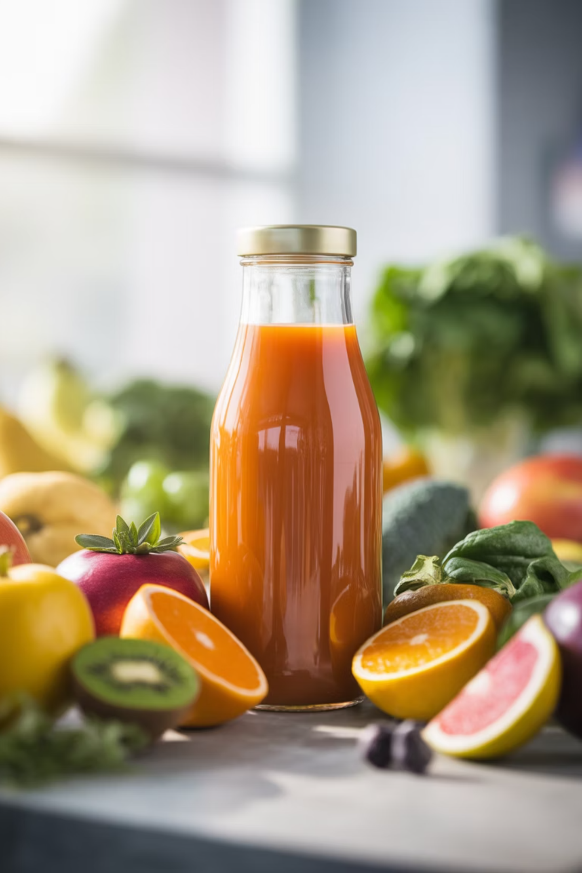
Learning Journey Overview
High Hydrostatic Pressure (HHP) is a revolutionary non-thermal technology that applies uniform isostatic pressure to inactivate microorganisms and enzymes while maintaining nutritional and sensory quality. This module explores HHP's principles, equipment, applications, and role in creating clean-label, sustainable plant-based foods.

Slide 20
What is High Hydrostatic Pressure?
High Hydrostatic Pressure (HHP) is a non-thermal preservation technology that applies extremely high pressures—typically between 100 and 600 megapascals (MPa)—to food products. Unlike conventional heat-based methods, HHP operates at ambient or chilled temperatures, preserving the fresh-like qualities of plant-based foods.
100-600
Pressure Range
MPa applied during processing
The technology works through isostatic pressure transmission, meaning force is distributed evenly in all directions regardless of product shape, size, or composition. This uniform treatment ensures every part of the food receives identical conditions, avoiding the uneven results of conventional heat processes.
5+
Log Reduction
Pathogen inactivation achieved

Slide 21
How HHP Preserves Food Safety
01
02
Cellular Disruption
Protein Unfolding
High pressure disrupts microbial cell membranes, causing loss of integrity and halting essential metabolic processes.
Intracellular proteins unfold under pressure, resulting in irreversible inactivation of pathogenic bacteria, yeasts, and molds.
03
Enzyme Inactivation
04
Enzymes like polyphenol oxidase and pectin methyl esterase are reduced or eliminated, preventing browning and texture degradation.
Nutrient Preservation
Small molecules like vitamins, minerals, and bioactive phytochemicals remain intact at levels comparable to fresh foods.

Slide 22




Key Benefits of HHP Technology
Superior Nutrient Retention
Preserves heat-sensitive vitamins, antioxidants, and bioactive compounds that thermal
methods destroy.
Fresh-Like Sensory Quality
Maintains natural colors, aromas, and textures without Maillard browning or pigment
breakdown.
Clean Label Appeal
Eliminates need for chemical preservatives, meeting consumer demand for natural,
minimally processed.
Environmental Sustainability
Reduces food waste through extended shelf life and can consume less energy than thermal
processing.

Slide 23

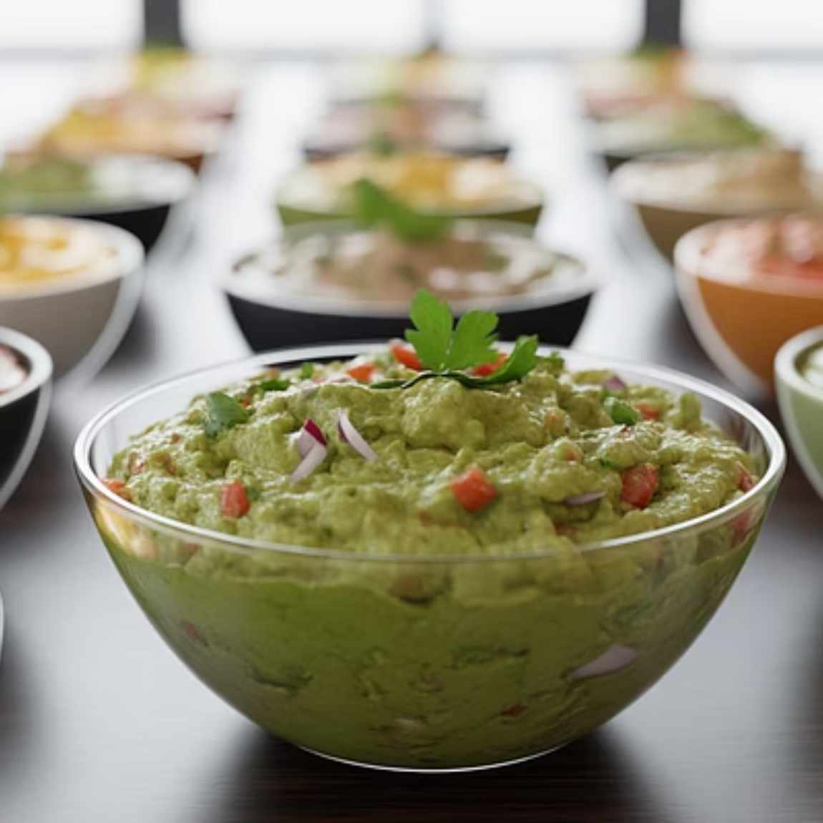

Applications in Plant-Based Products
Liquid Products
Solid & Semi-Solid Products
Cold-pressed juices and smoothies
Fruit and vegetable purees
Plant-based milks (almond, oat, soy)
Plant-based spreads and dips
Functional beverages
Ready-to-eat legume dishes
Plant-based broths
Meat analogues

Slide 24









Optimization Parameters
Holding Time
3-6 minutes typical for most applications, adjusted for safety levels
Pressure Level
100-600 MPa depending on product matrix and microbial targets
Packaging Selection
Flexible materials that withstand compression and provide barrier protection
Temperature Control
Room temperature or chilled to minimize adiabatic heating

Slide 25

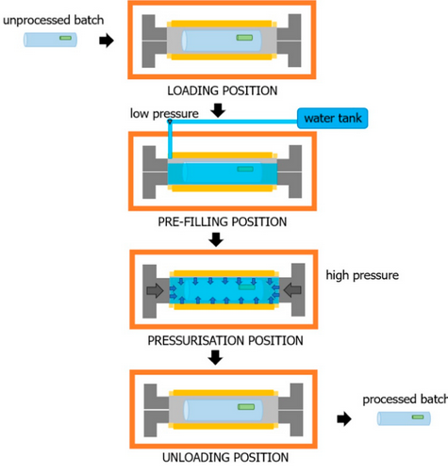


Effects on Nutritional Composition
Protein Modification
Carbohydrate Changes
Bioactive Enhancement
Antinutritional Factor Reduction

Slide 26
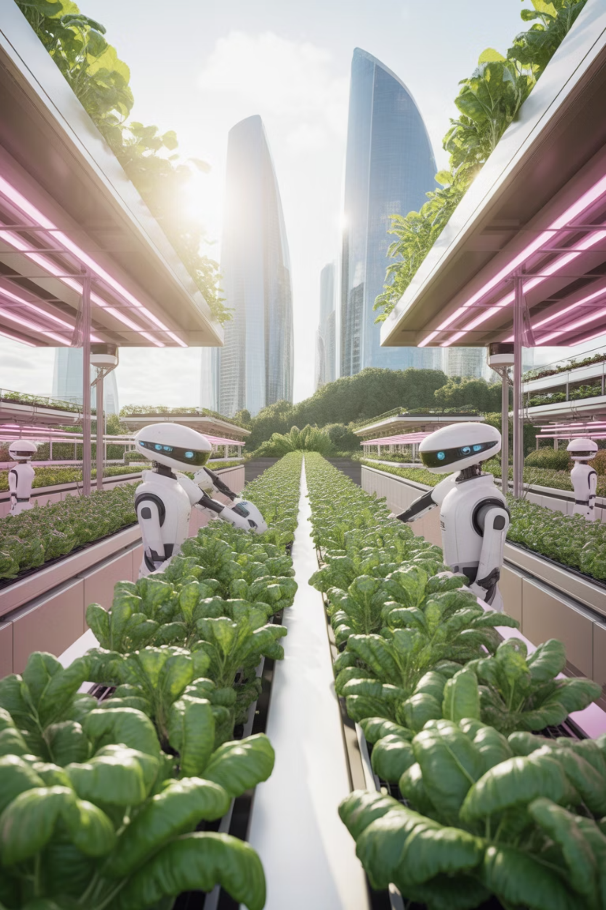
The Future of Plant-Based Food Processing
Market Growth
Innovation Potential
Rising demand for plant-based foods driven by health, sustainability, and ethical considerations creates opportunities for HHP differentiation.
Enables novel products: nutrient-dense cold-pressed juices, high-protein beverages, raw-style nut milks, and gourmet plant-based dips.
Sustainability Impact
Reduces food waste, minimizes energy consumption, and supports clean-label trends aligned with consumer values.

Slide 27
Key Takeaways
Nutritional Richness
Functional Bioactives
Legumes, whole grains, nuts, and seeds provide protein, fiber, healthy fats, and protective phytochemicals including polyphenols, flavonoids, and lignans
Isoflavones, phytosterols, β-glucans, and omega-3 fatty acids contribute to cardiovascular, metabolic, and immune health
Enhancement Methods
Sustainability Impact
Traditional techniques (sprouting, fermentation) and advanced technologies (extrusion, HHP) improve digestibility, reduce anti-nutrients, and increase bioavailability
Plant-based diets support environmental goals and public health when paired with nutrient-dense, minimally processed foods
Future Direction: Continued innovation must balance functionality, safety, cultural acceptance, and transparent communication to support a healthier, more sustainable food system. Almost half the global population now regularly includes plant-based products in their diet, making industry innovation essential to meet growing consumer demand.

Slide 28
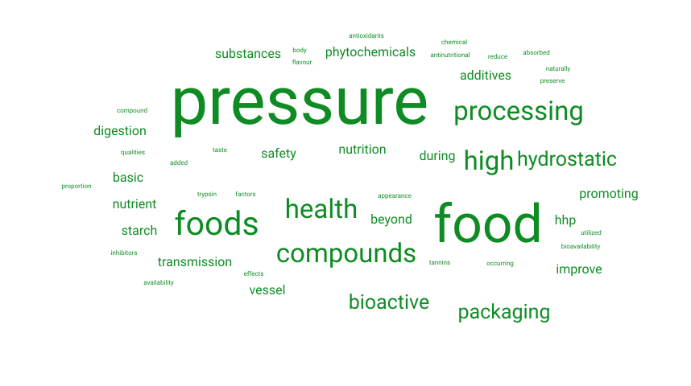
Glossary

Slide 29
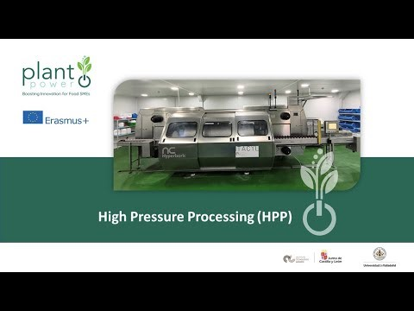
LEARN WATCHING

Slide 30
IF YOU WANT TO KNOW MORE
Balasubramaniam, V. M., Martínez-Monteagudo, S. I., & Gupta, R. (2015). Principles and application of high pressure–based technologies in the food industry. Annual Review of Food Science and Technology, 6, 435–462. https://doi.org/10.1146/annurev-food-022814-015539
Considine, K. M., Kelly, A. L., Fitzgerald, G. F., Hill, C., & Sleator, R. D. (2008). High-pressure processing – effects on microbial food safety and food quality. FEMS Microbiology Letters, 281(1), 1–9. https://doi.org/10.1111/j.1574-6968.2008.01084.x

Slide 31
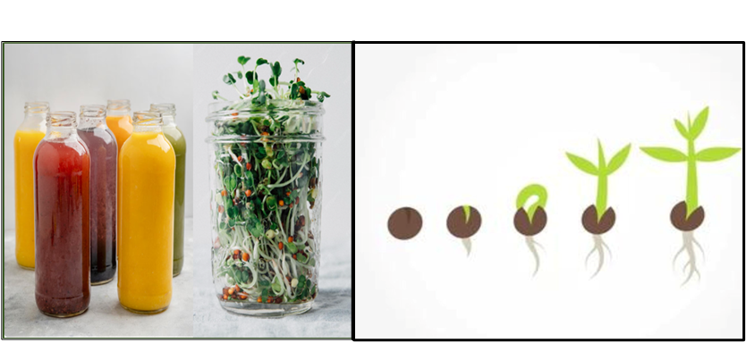
03
Controlled Sprouting: Bridging Ancestral Process with Modern Innovation

Slide 32

Learning Journey Overview
Sprouting represents one of humanity's oldest food preparation methods, now reimagined through modern science and technology. This ancient practice enhances nutritional quality, digestibility, and culinary versatility of seeds and legumes through controlled germination.
.

Slide 33
Importance of Sprouting
01
02
Biological Process
Enzymatic Changes
Understand sprouting's environmental requirements and physiological stages
Explore biochemical transformations
affecting nutrient composition
03
04
Common Seeds
Cultural Relevance
Identify seeds and legumes used for sprouting and their significance
Discuss historical and cultural importance
in food preparation
05
06
Food Innovation
Health Benefits
Recognize sprouting's role in functional foods and plant-based development
Evaluate improved digestion, nutrient absorption, and disease prevention

Slide 34
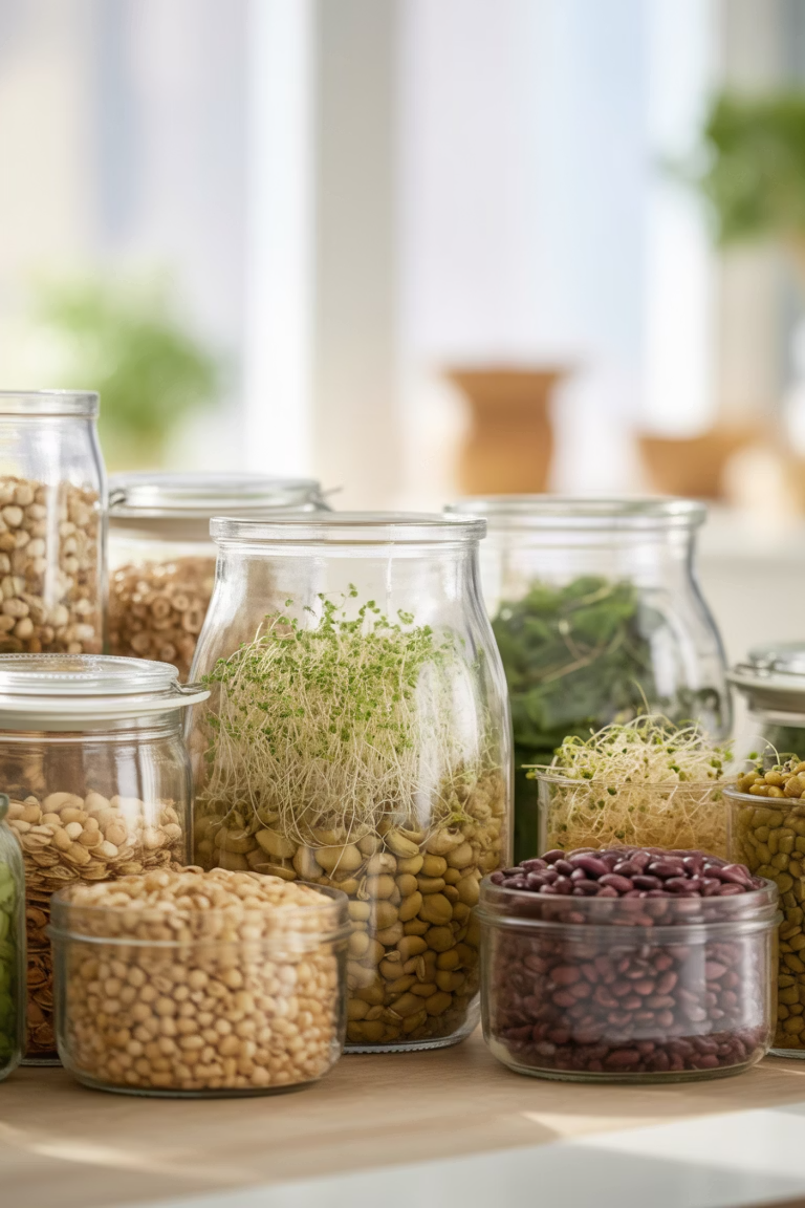
The Science of Sprouting
Germination is the biological process where seeds, grains, or legumes develop into young plants under controlled conditions of moisture, temperature, and oxygen. This represents the first stage of plant growth, involving complex physiological changes including water absorption, enzymatic activation, and cellular division.
Mung beans
Chickpeas
Lentils
Alfalfa
Fenugreek
Quinoa
Wheat and barley
Radish

Slide 35



Enzymatic Transformation During Germination
Amylases
Proteases
Break down complex starches into simpler sugars, increasing carbohydrate digestibility and providing natural sweetness
Hydrolyze storage proteins into smaller peptides and free amino acids, improving protein digestibility and essential amino acid availability
Phytases
Degrade phytates and antinutritional factors that bind minerals, enhancing mineral bioavailability

Slide 36

Health Benefits of Sprouted Foods
Digestive Health
Blood Glucose Regulation
Increases nutrient bioavailability and reduces compounds causing gastrointestinal discomfort
Breaks down starch into simple sugars, modifying glycemic response positively
Antioxidant Activity
Immune Support
Higher phenolic compounds reduce oxidative stress and inflammation
Enhanced vitamins, minerals, and bioactive peptides support overall health

Slide 37
Macronutrient Enhancement Through Sprouting
Protein Quality
Carbohydrate Modification
Lipid Quality
Proteases hydrolyze storage proteins into peptides and free amino acids, significantly improving digestibility. Essential amino acid availability increases, especially lysine. Protease inhibitors decrease, allowing efficient protein utilization.
Enzymatic activity reduces starch content and increases simple sugars (glucose, fructose, maltose), enhancing sweetness and energy availability. Soluble dietary fiber increases, supporting gut health.
While total lipid content remains stable, the proportion of unsaturated fatty acids improves. Endogenous lipases facilitate fat digestion and absorption.

Slide 38

Micronutrient and Phytochemical Improvements
10x
3x
60%
Vitamin C Increase
B-Vitamin Boost
Phytic Acid Reduction
Mung bean sprouts show up to tenfold increase compared to dry seeds
Riboflavin, niacin, folate, and thiamine levels rise significantly
Decreased antinutrients enhance mineral bioavailability
2x
Antioxidant Activity
Phenolic compounds and flavonoids double during germination

Slide 39
Industrial Sprouting Process
Seed Selection & Cleaning
1
High-quality seeds inspected and cleaned using sieving, air aspiration, or water flotation. Hygienization with hypochlorite ensures contamination-free starting material.
2
Soaking
Seeds immersed in water for 8-12 hours to initiate hydration and activate enzymatic systems. Water quality, temperature, and pH closely monitored.
Germination
3
Controlled environment maintained at 20-30°C, 80-95% humidity with adequate oxygen. Periodic rinsing 2-4 times daily removes metabolic byproducts and maintains hydration.
4
Harvesting
Sprouts harvested at desired length after 2-5 days. Timing critical for optimal texture and nutritional profile.
Post-Processing
5
Fresh consumption or drying, milling, powdering for functional ingredients. Modified-atmosphere packaging extends shelf life while preserving quality.

Slide 40
Key Takeaways
Sprouting boosts nutritional quality.
Improves digestibility and functionality.
Controlled processing ensures safety.
Increases macro and micronutrients.
Adds beneficial bioactive compounds.
Supports overall nutrient status.
Reduces chronic disease risk.
Activates enzymes for bioavailability.
Lowers naturally occurring antinutrients.
Improves protein quality digestibility.
Enhances carbohydrates and fiber.
Raises vitamins and antioxidants.
Requires control for quality.
Useful in home cooking.
Applied in functional foods.
Promotes digestion and protection.
Legumes, whole grains, nuts, and seeds provide protein, fiber, healthy fats, and protective phytochemicals including polyphenols, flavonoids, and lignans

Slide 41
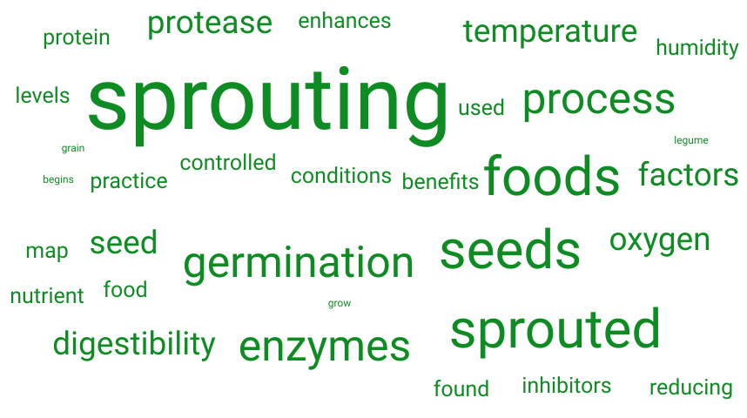
Glossary

Slide 42
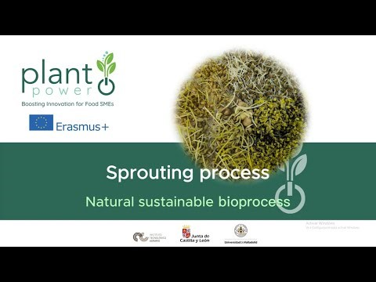
Learn Watching

Slide 43
If You Want To Know More
Stodolak, B. (2019). Sprouted Seeds: Preparation, Nutritional Benefits, and Applications. Food Reviews International, 35(7), 613–630. https://doi.org/10.1080/87559129.2019.1626557
Lim, T. K. (2012). Edible Medicinal and Non-Medicinal Plants. Volume 1: Fruits. Springer

Slide 44
04
Labelling of
Plant-based Products: Regulatory Aspects & Market Perspectives

Slide 45
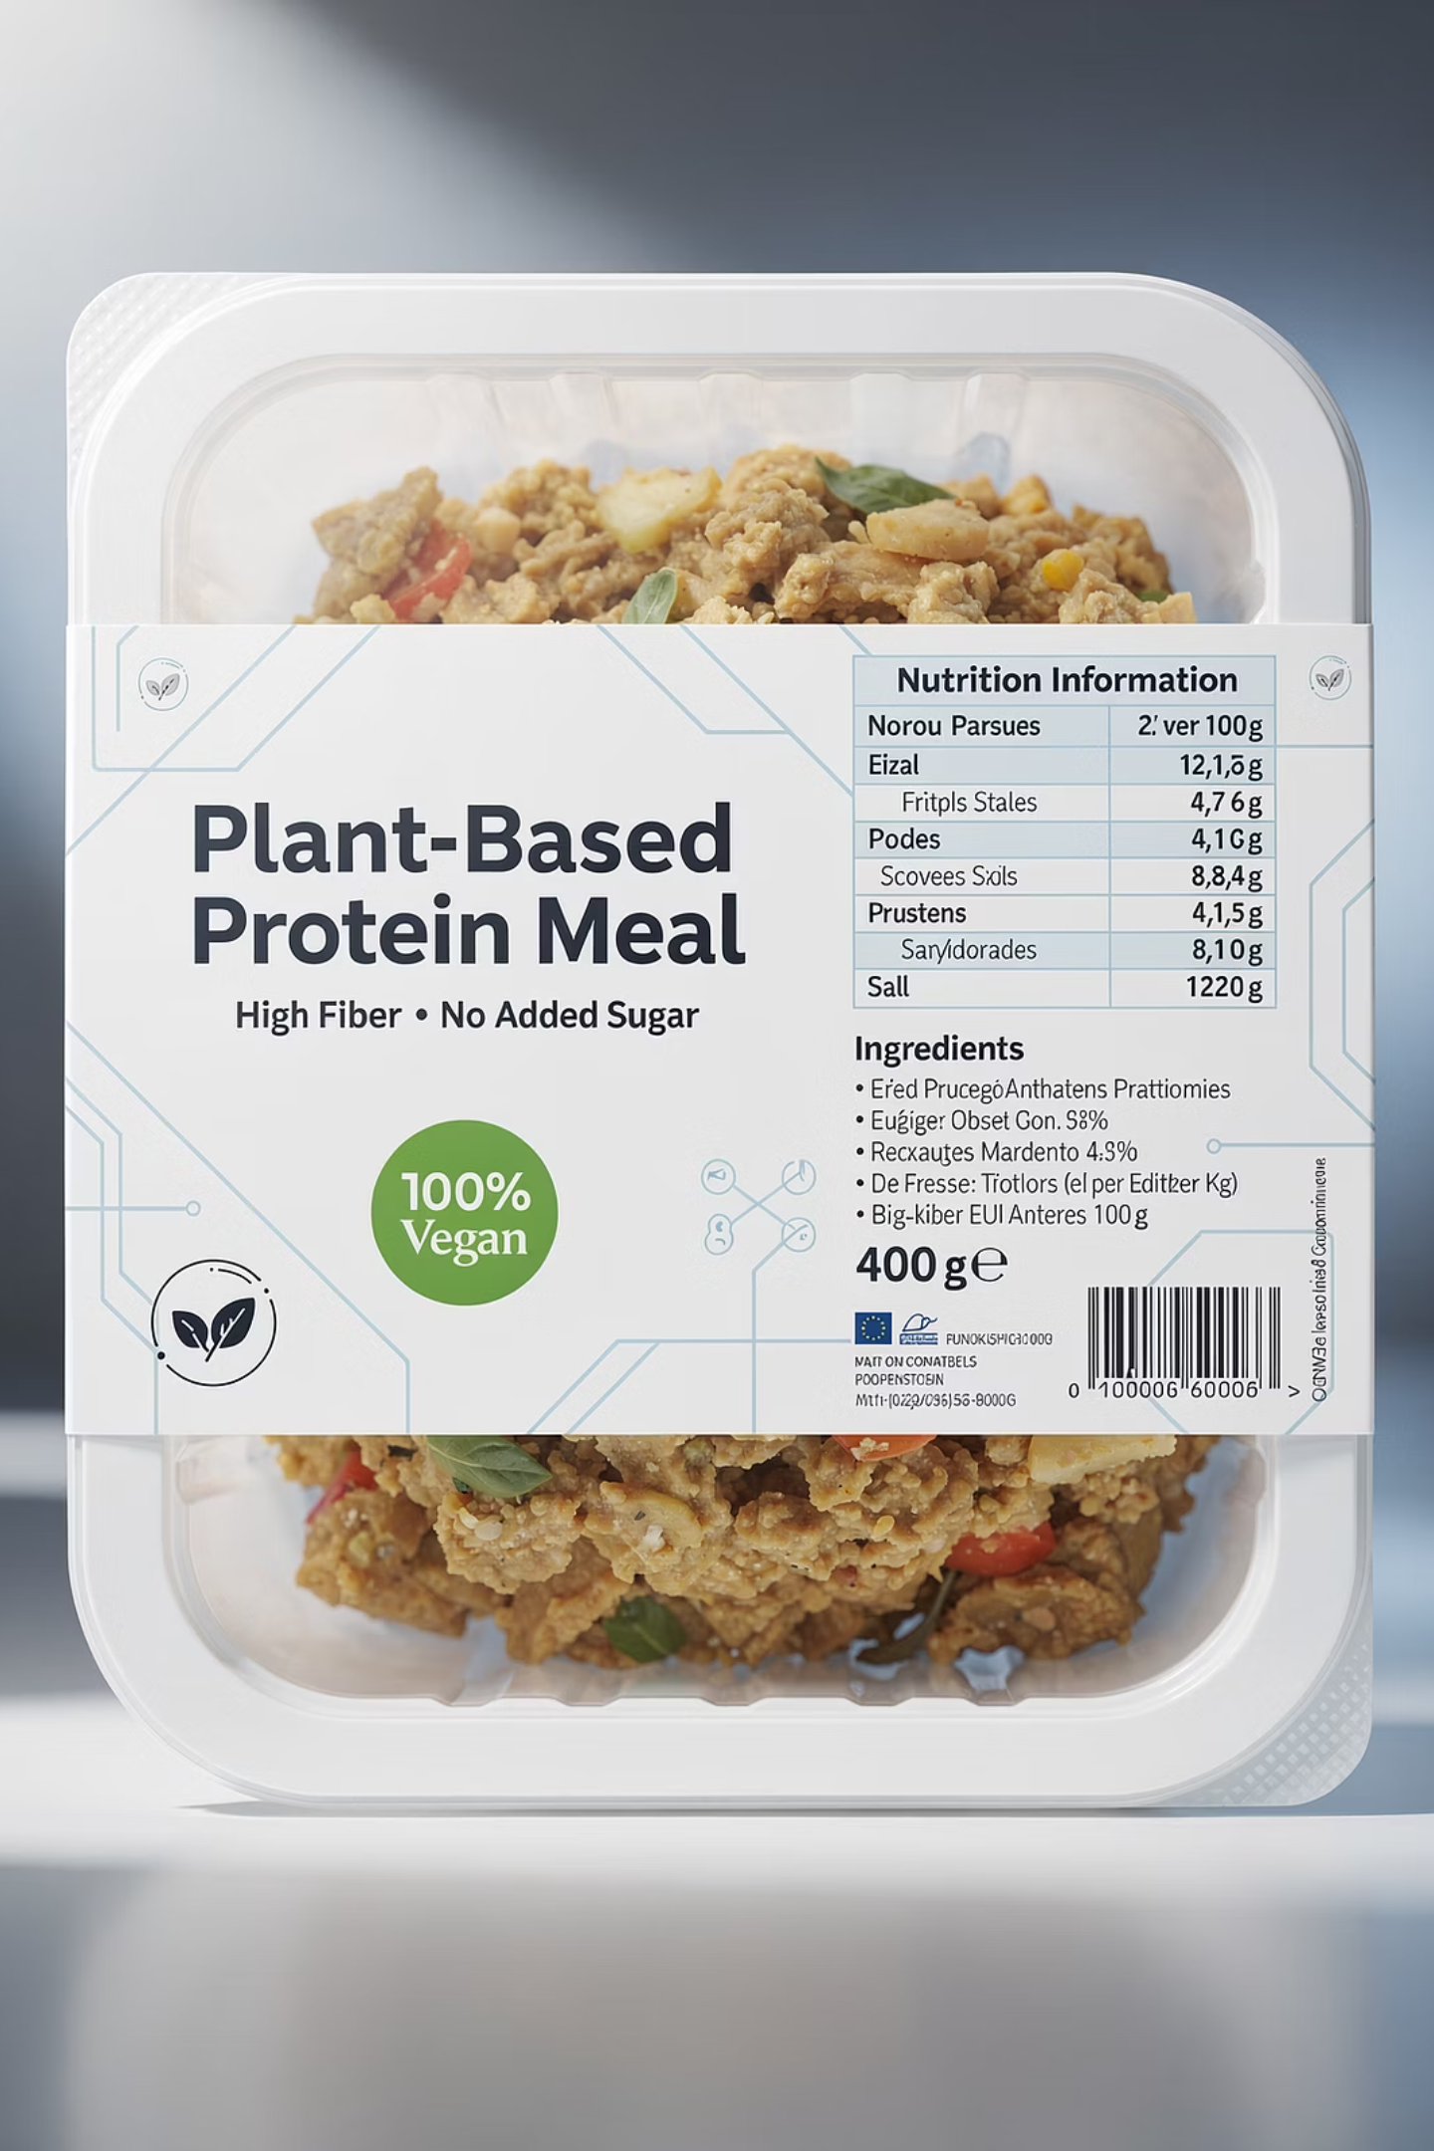
Learning Journey Overview
This module provides comprehensive information on current practices and regulations for labelling plant-based food products in the European Union. Topics include required labelling rules, voluntary claims on packaging, consumer understanding, and emerging regulatory trends.

Slide 46

Nutritional Labelling and
Consumer Perception
Nutritional Considerations
Marketing Impact
Legumes, whole grains, nuts, and seeds provide protein, fiber, healthy fats, and protective phytochemicals including polyphenols, flavonoids, and lignans
Plant-based beverages in Spain typically have lower protein and calcium than cow's milk (except soy), with higher carbohydrate content when sugars are added.
Research shows terms like "plant-based," "vegan," or "vegetarian" have minor effects on preference.
Claims like "no added sugars" don't always indicate higher quality—accurate labelling and consumer education are essential.
Anticipated taste and ethical values are stronger purchase predictors.

Slide 47
Defining Plant-Based: The Challenge of Terminology
Vegan
Vegetarian
Excludes all animal-derived ingredients including dairy, eggs, honey, and animal-based additives or processing aids
Excludes meat and fish but may include dairy and eggs
Plant-Based
Highly ambiguous—used interchangeably with "vegan" in half of studies, but may include dairy, eggs, or occasional meat in others
Critical Issue: No official, legally binding definitions exist for these terms at the EU level, creating confusion for consumers, researchers, and producers.

Slide 48

Three Pillars of EU Food Labelling Regulation
Regulation (EU) No 1169/2011
Regulation (EU) No 1308/2013
Essential labelling rules ensuring consumers have reliable, understandable information
Product naming protections for agricultural markets
Reserves terms like "milk," "cheese," "yogurt"
Mandatory information requirements
Defines protected designations
Legibility standards
Establishes quality schemes
Allergen protection
Regulation (EC) No 1924/2006
Framework for nutrition and health claims
Scientifically justified claims only
Pre-approved by EFSA
Prevents misleading information

Slide 49






How to Read and Apply Food Labelling Rules
Product Name
Does the name accurately describe the product without implying it's dairy or meat?
Ingredients
All ingredients listed in order from most to least, with allergens clearly highlighted
Nutritional Value
Values per 100g or 100mL for easy product comparison
Shelf Life
Check "best before" or "use by" date and storage instructions
Producer Details
Company name and EU address must be transparent
Claims
Verify health and nutrition claims follow EU-authorised standards

Slide 50
Key Takeaways
Legumes, whole grains, nuts, and seeds provide protein, fiber, healthy fats, and protective phytochemicals including polyphenols, flavonoids, and lignans
No Harmonised Definitions
Protected Animal Terms
Terms like "vegan" and "vegetarian" lack legal definition in EU legislation, causing inconsistencies across Member States
Under Regulation 1308/2013, names like "milk," "cheese," and "yogurt" are reserved for animal-derived products (exceptions exist like "coconut milk")
Compliance Required
Voluntary Standards
Producers must follow Regulation 1169/2011 ensuring labelling is clear, not misleading, and accurate regarding composition
In absence of EU-wide definitions, operators may use guidelines from organizations like European Vegetarian Union or certification schemes like V-label

Slide 51
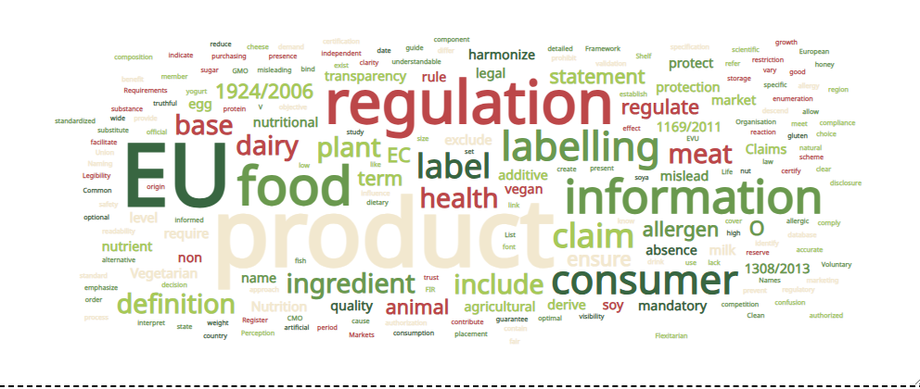
GLOSSARY

Slide 52
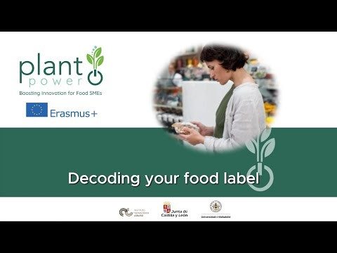
LEARN WATCHING

Slide 53
If You Want To Know More
Smith, J., & Taylor, R. (2024). Innovations in plant protein ingredients: Expanding the horizons of meat alternatives. Journal of Food Science and Technology, 59(3), 1410–1423. https://doi.org/10.1007/s13197-023-05678-9
European Commission. (2024). Plant-based foods and sustainability: Trends and policy implications. Publications Office of the European Union. https://ec.europa.eu/food/sustainability/plant-based-food_en

Slide 54

05
Nutrition: Clinical
Training on Gaps & Opportunities in Plant-based Diets

Slide 55

Learning Journey Overview
Equip clinical staff to identify nutritional deficiencies and assess dietary patterns in patients following plant-based diets, considering the impact of processing methods like HHP, sprouting, and fermentation on nutrient bioavailability. Develop evidence-based skills to recommend balanced, tailored plant-based nutrition strategies for diverse patient needs and clinical conditions.

Slide 56
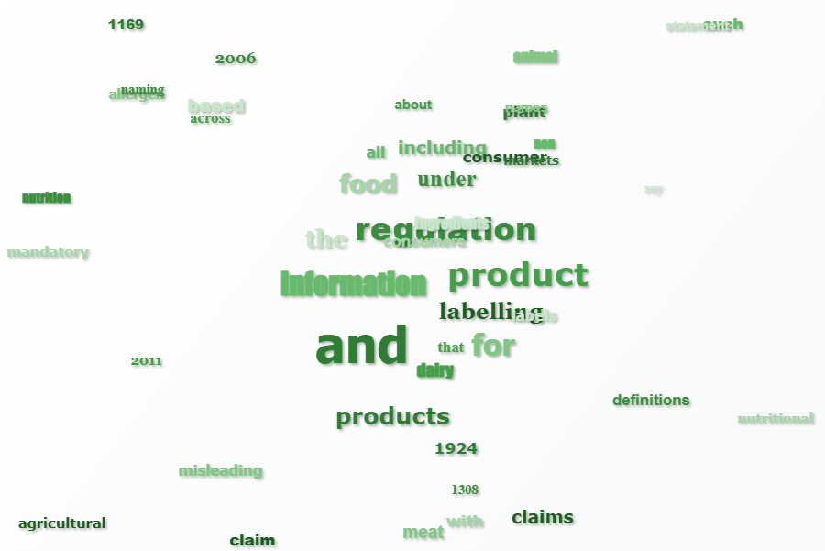
GLOSSARY

Slide 57




Plant-Based in Clinical Scenarios
Omnivorous Diets
Plant-based products improve nutritional quality by increasing fiber, antioxidants, and unsaturated fats while reducing saturated fat and cholesterol.
Vegetarian and Vegan Diets
Form the foundation. Proper planning with fortified foods and supplements ensures adequate B12, calcium, vitamin D, and omega-3.
Disease-Related Malnutrition
Complete oral supplements and protein modules provide essential nutrients for cancer, COPD, heart failure, and frailty patients.
Obesity and Metabolic Syndrome
High fiber and low glycemic index regulate glucose. Phytochemicals reduce inflammation and cardiovascular risk.

Slide 58

Balancing the Plate
Strengths
Low saturated fat and cholesterol; high fiber and antioxidants
Proven benefits in diabetes, obesity, metabolic syndrome
Cultural and ethical adaptability
Lower carbon footprint and resource use
Limitations
Nutrient gaps: B12, D, calcium, iron, zinc, omega-3
Variable quality: some ultra-processed with excess sodium
Higher cost and limited clinical availability
Insufficient professional training on planning

Slide 59
Medical Nutritional Therapy
Plant-based products formulated as Foods for Special Medical Purposes (FSMP) are indicated in
disease-related malnutrition, cachexia, and chronic conditions.
Complete Plant-Based Formulas
1
Ensure® Plant-Based, Fortimel® Plant-Based, Fresubin® Plant-Based Drink: blends of pea/soy proteins, carbohydrates, healthy fats, fiber, vitamins, and minerals for DRM and oncology patients.
Plant-Based Protein Modules
2
Pea, rice, or soy protein powders enrich soups, purees, and smoothies. Provide essential
amino
acid
Specific Supplements
3
Omega-3 from microalgae (DHA and EPA) for cardiovascular prevention and triglyceride
control.

Slide 60
Key Takeaways
Not all plant-based foods are equally healthy—quality matters more than the “plant-based” label.
Strategic use of fortified foods and supplements is essential to cover nutrient gaps.
Clinical staff should be skilled in identifying deficiencies and tailoring plant-based recommendations.
Plant-based nutrition provides opportunities for sustainable, ethical, and patient-centered care.
Future directions include innovation in plant protein processing, cost reduction, and integration into clinical nutrition protocols.
Legumes, whole grains, nuts, and seeds provide protein, fiber, healthy fats, and protective phytochemicals including polyphenols, flavonoids, and lignans

Slide 61
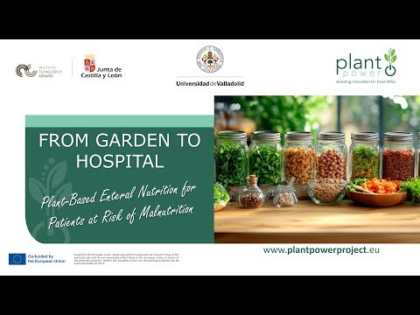
Learn Watching

Slide 62
If You Want To Know More
Nutricia. Fortimel® PlantBased Energy – product info and press releases (2023).
Fresenius Kabi Spain. Fresubin® Plant-Based Drink – technical documentation (2025).
Abbott España. Ensure® Nutrivigor Origen Vegetal – product page (2025).
Satija A, Hu FB. Plant-based diets and cardiovascular health. Trends Cardiovasc Med. 2018.
Willett W, et al. Food in the Anthropocene: the EAT-Lancet Commission on healthy diets. Lancet. 2019.
Melina V, Craig W, Levin S. Position of the Academy of Nutrition and Dietetics: Vegetarian Diets. J Acad Nutr Diet. 2016.
Delsoglio M, et al. Plant-based oral nutritional supplements in malnutrition: multicenter study. Clin Nutr ESPEN. 2023.Fruits. Springer.

Slide 63
06
Learning
Summary

Slide 64
Overall Learning
This module explains how traditional methods like sprouting and
Fermentation with modern food technologies that include high hydrostatic
pressure, extrusion, and nanoencapsulation, can improve the safety, nutritional
quality, sustainability, and market value of plant-based foods. It highlights the
nutritional benefits and challenges of plant-based products, addresses
processing and formulation issues, and reviews EU labelling and regulatory
requirements.

Slide 65
Overall Learning
The module also provides clinical nutrition guidance, emphasising the importance of careful planning, fortification, and evidence-based recommendations to ensure plant-based diets are both healthy and sustainable across different populations.

Slide 66

Thank you for Completing Module 5 Imagining A Better World Via Plant Power
Supporting Europe’s food sector in adopting plant-based innovation and sustainability.
follow our journey
www.plantpowerproject.eu

