Slide 1
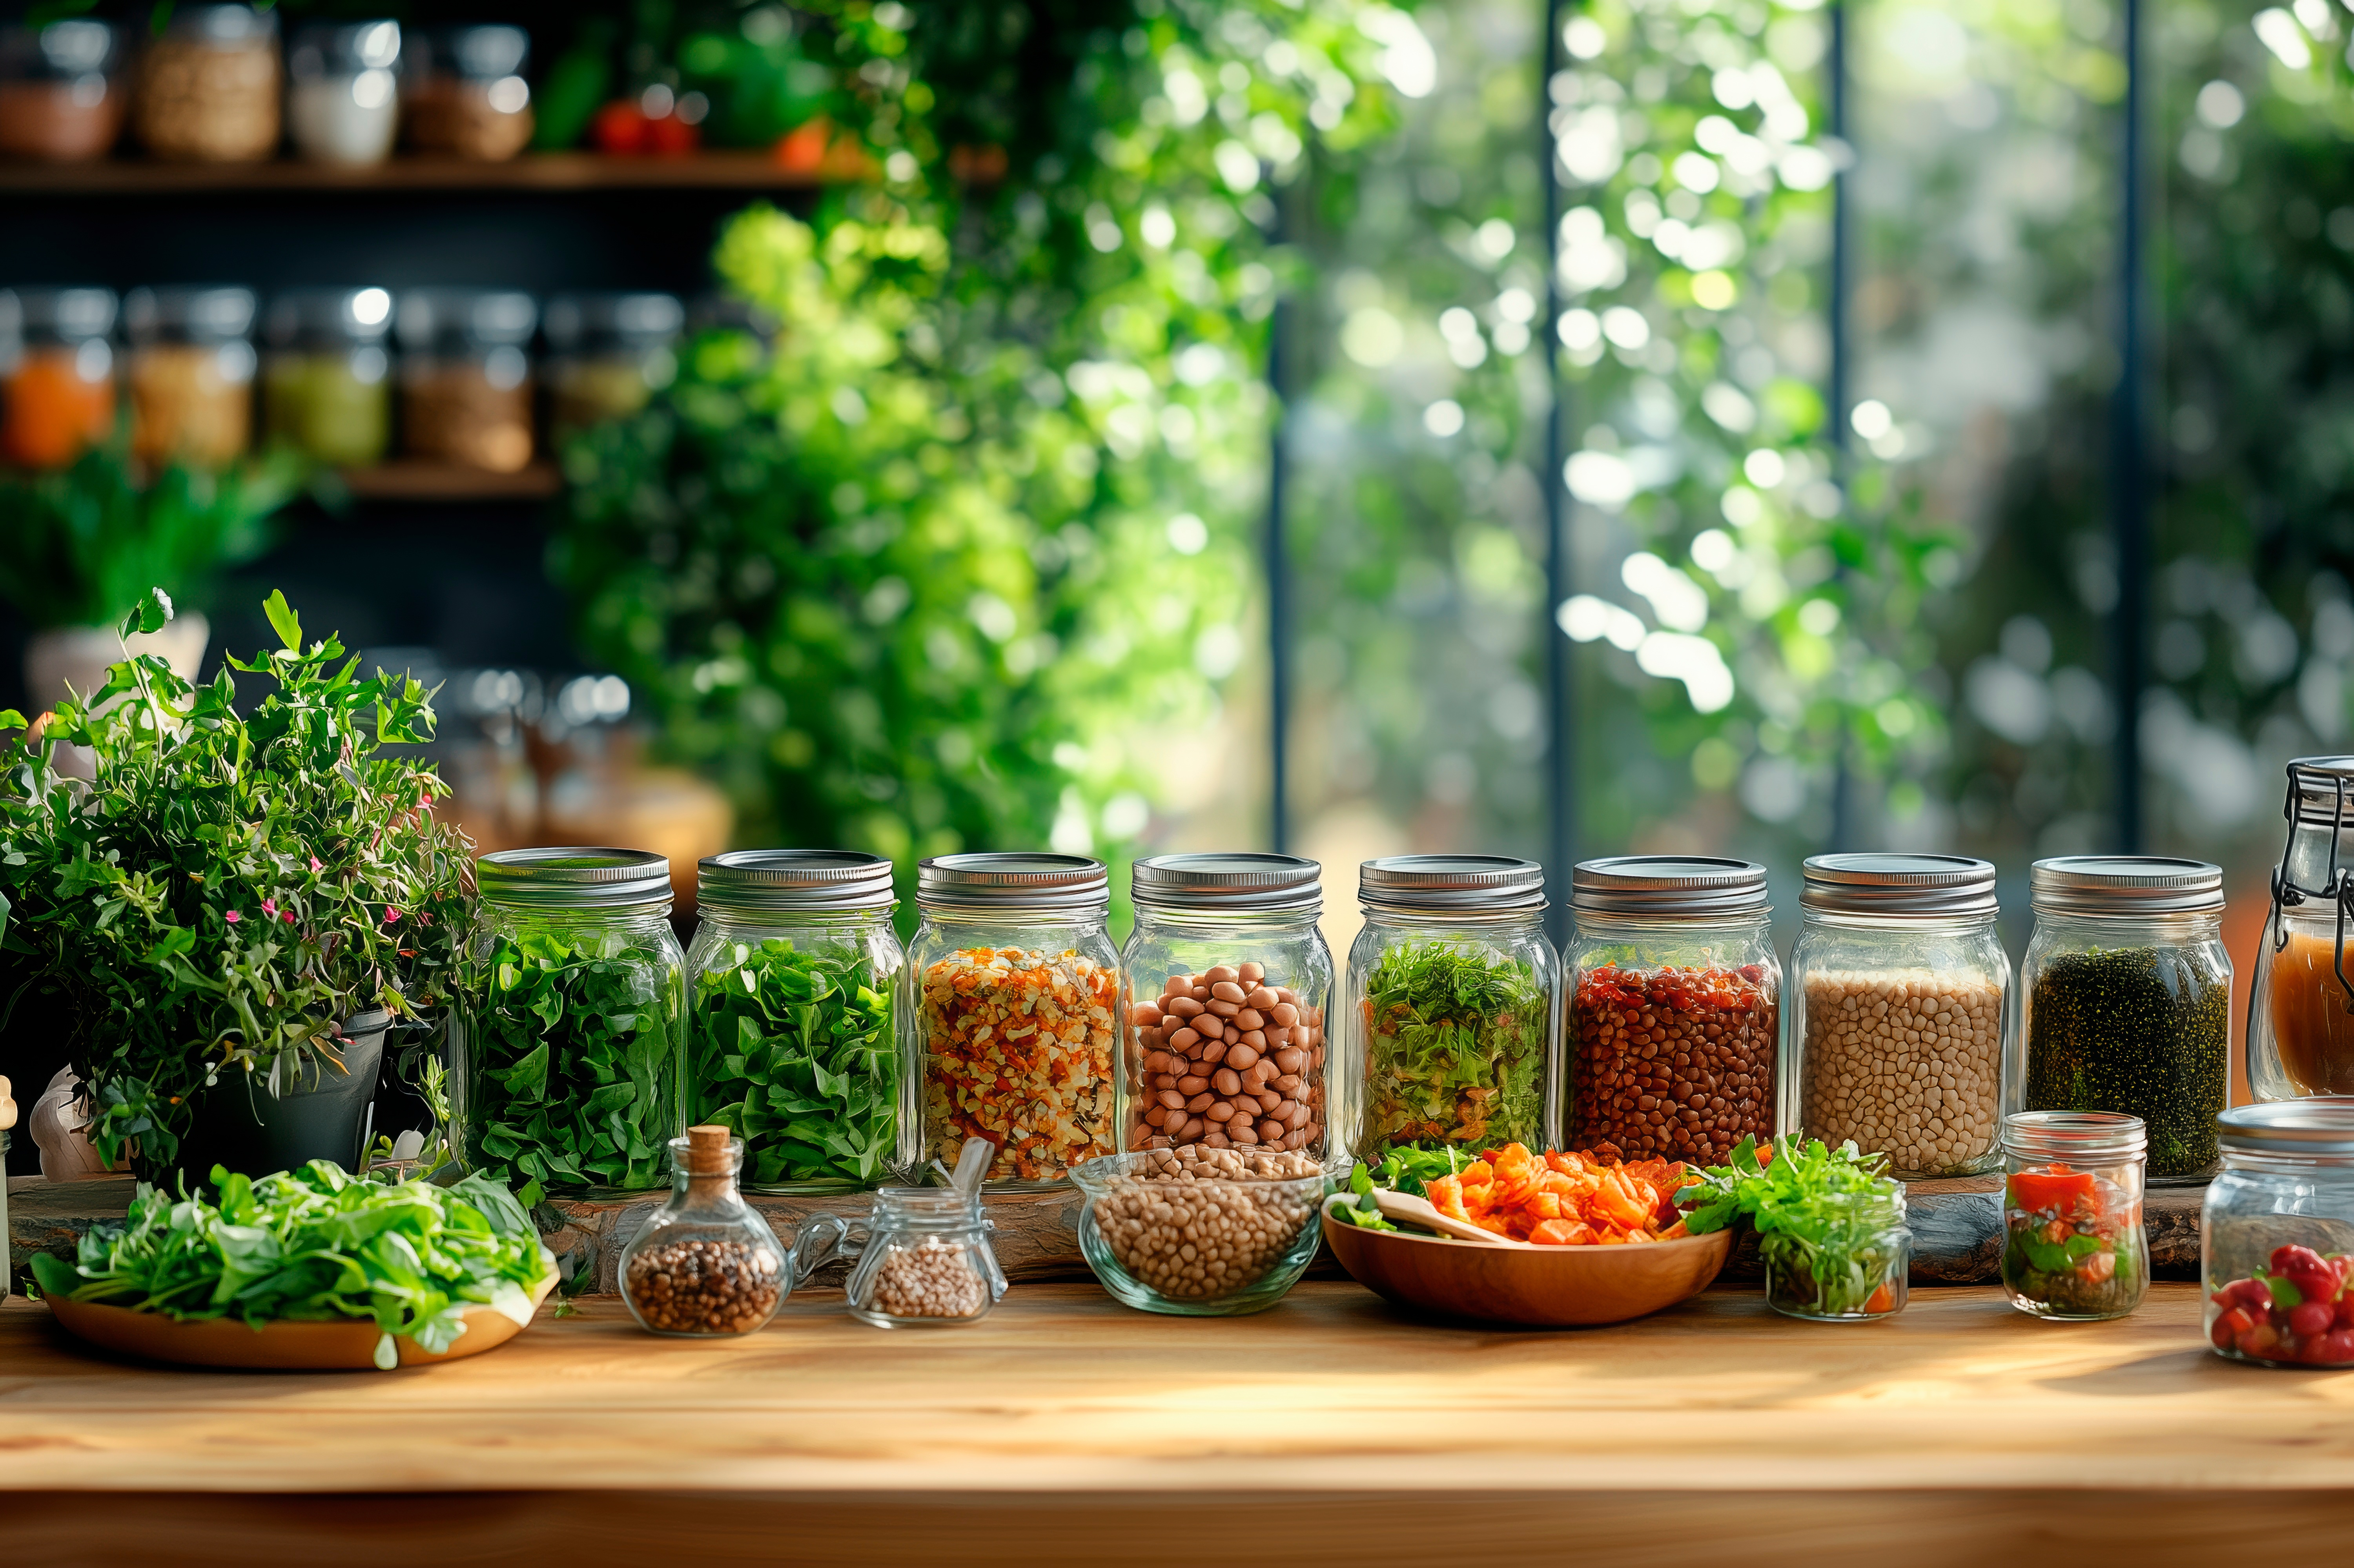

MODULE 3
Creating Plant-
based Innovations
For Retail Prepared Consumer Foods
www.plantpower.eu
Plant Power OERs Modules © 2025 by Plant Power Partnership is licensed under CC BY 4.0. To view a copy of this license, visit https://creativecommons.org/licenses/by/4.0/

Slide 2
Contents
01
Purpose and Objectives
02
Market trends and consumer insights in plant-based retail
03
Product innovation strategies for ready-to-eat & retail foods
04
Packaging, shelf-life & logistics considerations
Marketing, labelling & consumer trust
05

Slide 3
Contents
06
Learning Summary

Slide 4
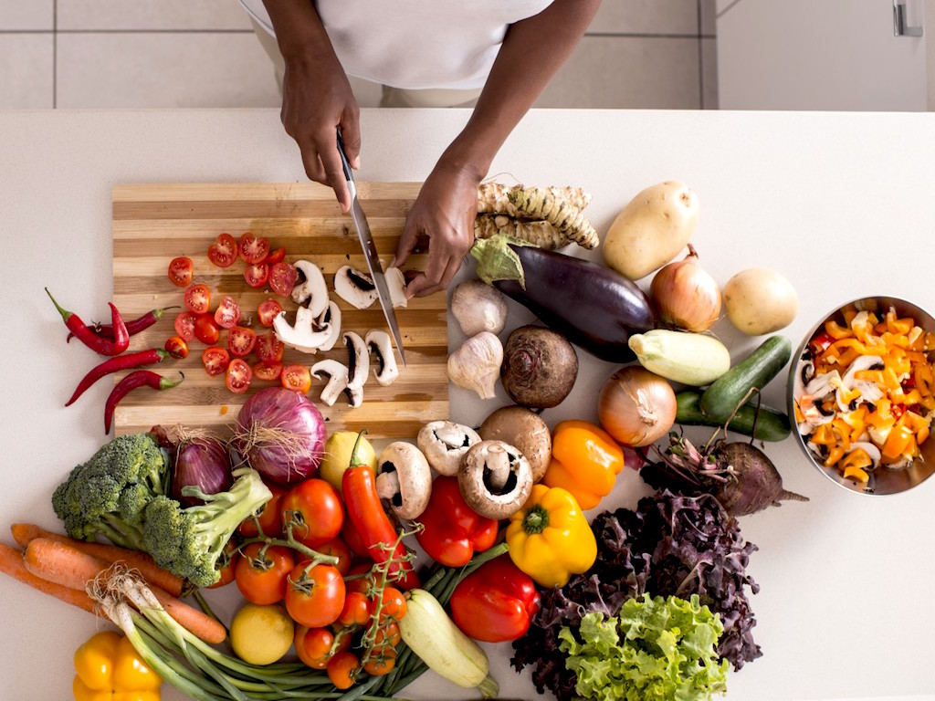
01
Purpose and Objectives

Slide 5
Purpose
This module aims to provide learners with a comprehensive understanding of the consumer trends and market demand for plant-based ready-to-eat and retail products. It explores innovative strategies for developing plant-based products that appeal to diverse consumer segments, while analyzing challenges and solutions related to formulation, shelf life, packaging, and distribution. Additionally, the module highlights how to integrate sustainability, nutrition, and convenience into retail product design and offers insights into effective branding, labeling, and consumer communication for plant-based foods.

Slide 6
Objectives
By the end of the module, learners will be able to:
Identify the key drivers of innovation in plant-based retail foods.
Design new plant-based products aligned with current trends and health requirements.
Evaluate packaging and processing technologies suitable for consumer products.
Apply knowledge of regulatory and labeling requirements.
Incorporate sustainability and ethical sourcing into product development.

Slide 7
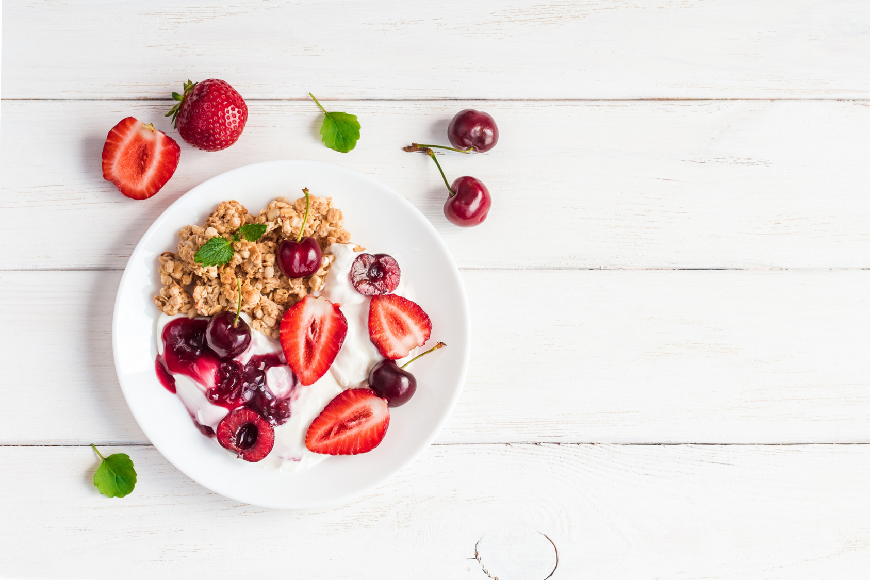
02
Market trends and consumer insights in plant-based retail

Slide 8
Why are we turning to plant-based foods today?
Over the last decade, plant-based foods have shifted from niche health shops to the mainstream shelves of large supermarkets. Once considered products for vegans or vegetarians only, they now attract a much wider audience. Entire aisles are dedicated to plant-based milks, cheeses, ready-to-eat bowls, snacks, and meat alternatives.
This rapid growth reflects profound changes in consumer behavior, industry innovation, and cultural values. Modern lifestyles, with busy schedules and a demand for quick, convenient meals, make ready-to-eat plant-based products especially appealing. Understanding the main categories, the reasons behind consumer demand, and the audiences shaping this market is essential for creating successful plant-based products.

Slide 9

Growth of plant-based categories
Meat analogues
Dairy-free alternatives
Plant-based snacks
Convenience meals

Slide 10
Health
Consumers link plant-based diets to wellbeing and lower risk of chronic diseases
Sustainability
Less resource-intensive than animal farming; appeals to eco-conscious shoppers
Key Drivers of Growth in Plant-Based Foods
Ethics
Supports animal welfare and ethical food choices
Convenience
Quick, ready-to-eat options fit busy urban lifestyles

Slide 11
Vegans & Vegetarians
Loyal, value ethics, health, sustainability, often trendsetters.
Flexitarians
Experiment occasionally, motivated by health and environment, largest growth driver.
Athletes & Fitness Enthusiasts
Seek clean, plant-based protein alternatives to whey or casein.
Seniors
Interested for health management—cholesterol, lactose intolerance, fortified products.
Understanding Target Audiences -Who Eats Plant-Based Foods?
The success of plant-based products depends on knowing the motivations, needs, and barriers of specific consumer groups. Unlike traditional markets segmented by age or income, plant-based consumers are guided by values, lifestyle, and identity.

Slide 12
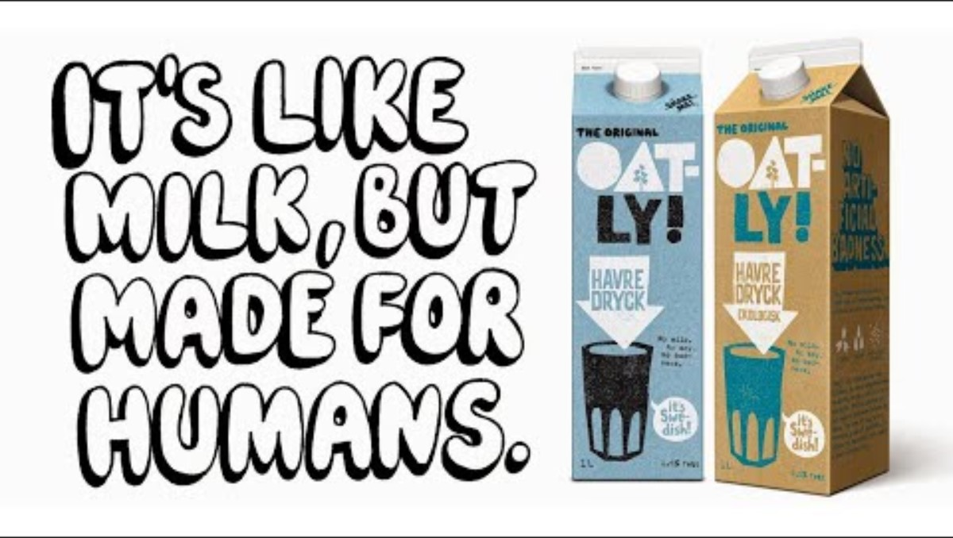
Plant-Based success stories - OATLY: The Ultimate Rebranding Story
Originally a niche oat milk brand from Sweden, Oatly became a global leader by emphasizing sustainability, barista-quality performance, and witty marketing. Its packaging openly discusses climate impact, resonating strongly with environmentally conscious consumers. Watch the video and get inspired!

Slide 13
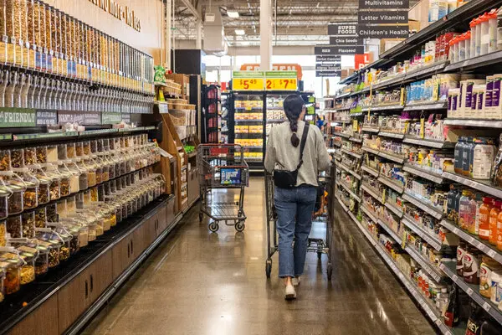
03
Product innovation strategies for ready-to-eat & retail foods

Slide 14
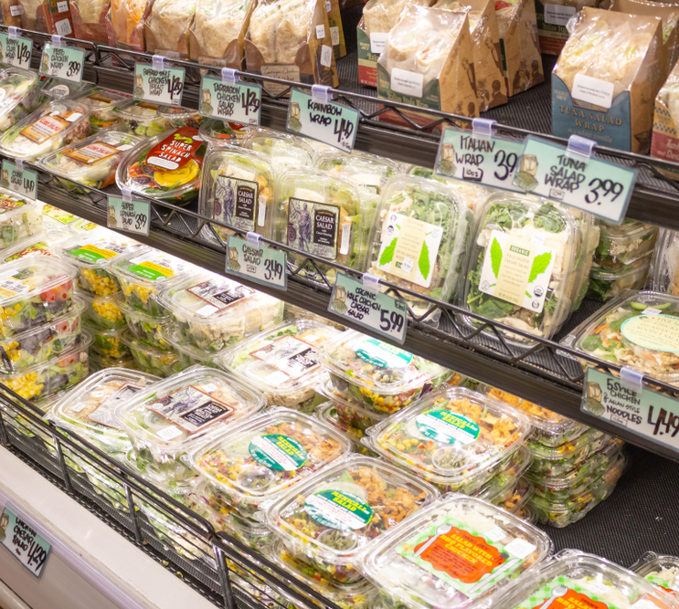
Product Innovation Strategies for Ready-to-Eat & Retail Foods
Innovation in the plant-based ready-to-eat (RTE) and retail food sector is essential for market growth and consumer acceptance. Innovation goes beyond simply replacing animal-derived ingredients—it involves technological development, sensory optimization, nutritional adequacy, and alignment with consumer expectations for convenience, clean-label claims, and sustainability.

Slide 15
Plant-Based Meat & Dairy Alternatives
1
Developing plant-based alternatives requires a structured approach to achieve proper texture, flavor, and nutrition. Common protein sources—legumes, cereals, pseudo-cereals, fungi, and fermentation-derived proteins—each contribute unique textural and nutritional qualities, while processing techniques help mimic the sensory experience of meat and dairy.
Plant-Based Innovation in Ready-to-Eat & Retail Foods
Texture Optimization
2
Texture is key to consumer acceptance. Methods like extrusion create fibrous, meat-like structures, while enzymes improve gelation, water retention, and mouthfeel. Plant gums and stabilizers help maintain structure and juiciness, ensuring ready-to-eat products remain satisfying.
Flavor Development
3
Flavor is crucial for repeat consumption. Umami can be boosted with natural glutamates, yeast extracts, and fermentation-derived compounds. Reducing plant-protein off-flavors and using herbs, spices, and natural enhancers helps create appealing, enjoyable products.

Slide 16

The Umami Enhancement
Enhancing the natural umami taste is a key strategy in plant-based product development. Ingredients such as yeast extracts, natural glutamates, and fermentation-derived compounds are used to enrich savory flavors, creating a more satisfying and meat-like taste experience. These techniques help mask off-flavors typical of plant proteins and improve overall consumer acceptance.

Slide 17
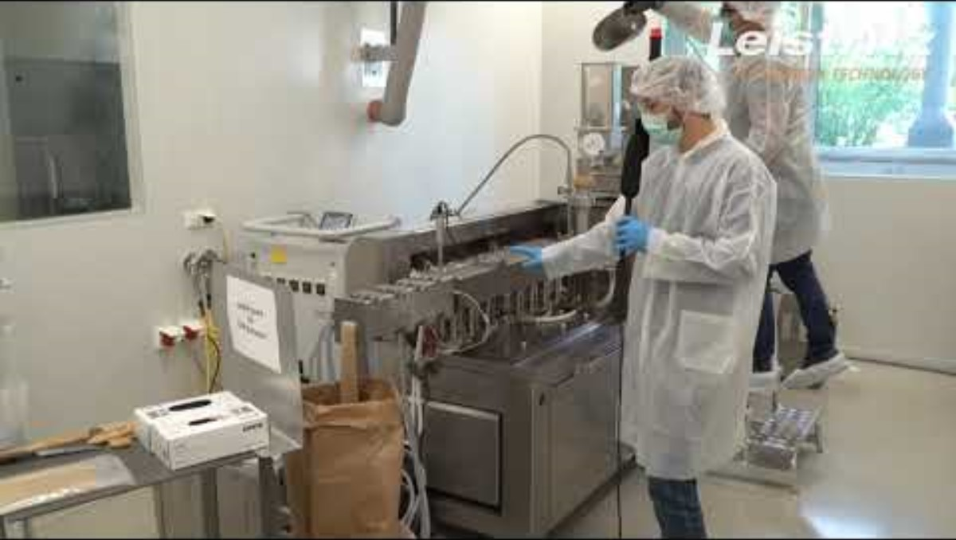
Extrusion Technology
Extrusion is a key method for creating fibrous, meat-like textures in plant-based products. By applying heat, pressure, and shear forces to plant proteins, extrusion forms structures that mimic the chewiness and bite of muscle fibers. This technology allows developers to produce ready-to-eat products with appealing texture and consistency, essential for consumer satisfaction.

Slide 18
Clean-Label and Additive-Free Formulations
4
Growing demand for transparency makes clean-label formulations essential. Products avoid synthetic additives and favor natural ingredients, improving perceived health and sustainability. Natural preservatives like rosemary or green tea extracts, along with plant-based binders and stabilizers, help maintain quality while supporting nutritional value.
Plant-Based Innovation in Ready-to-Eat & Retail Foods
Plant-Based Convenience Meals
5
Integrating plant-based foods into ready-to-eat formats meets the needs of busy consumers. Convenient options like soups, salads, wraps, and grain bowls support flexitarian diets. Taste, portability, and perceived health benefits drive adoption and help normalize plant-based eating.
Balancing Nutrition, Taste, and Visual Appeal
6
Successful plant-based products balance nutrition, sensory quality, and visual appeal. They provide sufficient protein, essential amino acids, and micronutrients while optimizing flavor and texture. Attractive colors and presentation boost perceived freshness and satisfaction, encouraging repeat purchases.

Slide 19
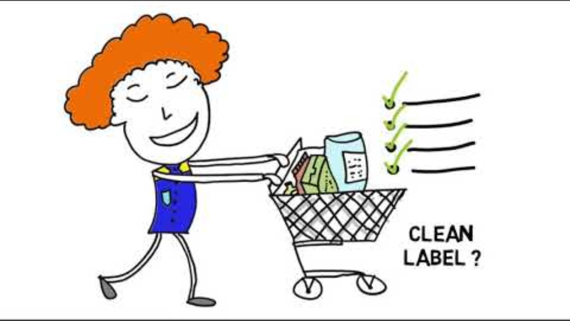
What is a Clean Label?

Slide 20
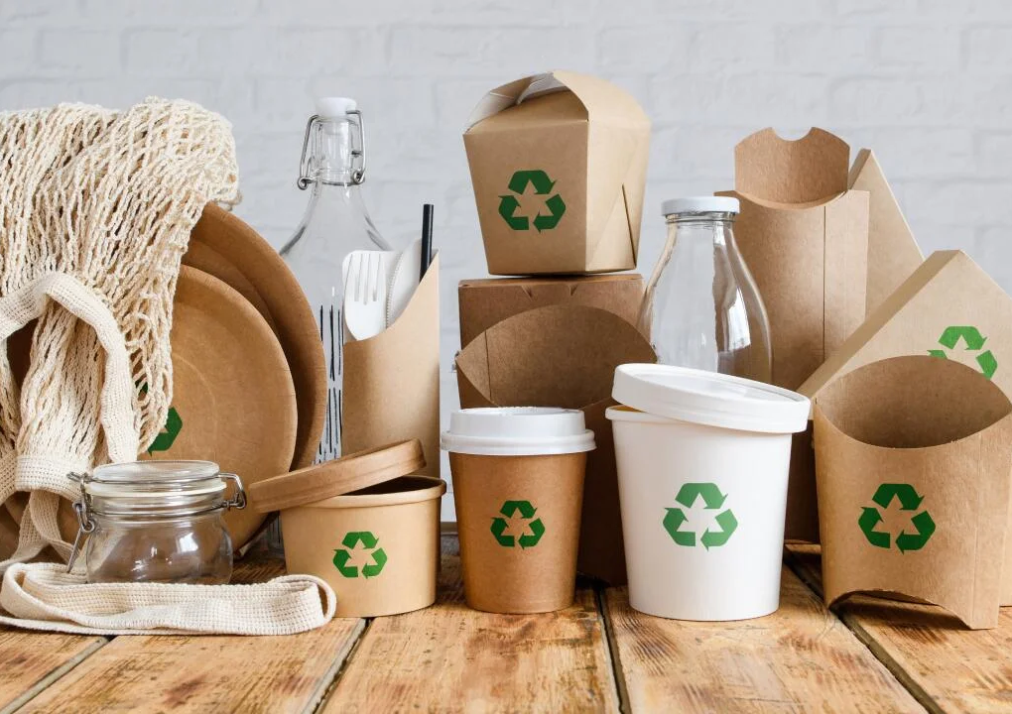
04
Packaging, shelf-life & logistics considerations

Slide 21
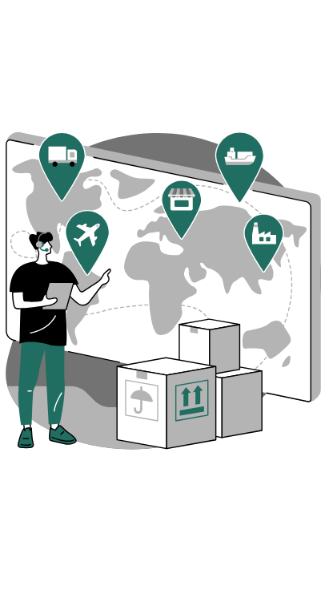

Sustainable packaging for plant-based products
Product
Packaging
Cold Chain
Retail
Consumer
Packaging, shelf-life, and logistics are critical for plant-based foods. Consumers expect sustainable, safe, and “clean” products, which requires innovations in materials, preservation methods, and supply chain management.
Animal Welfare

Slide 22

Sustainable Packaging
Packaging for plant-based foods must balance three requirements:
Product protection – preventing spoilage and contamination.
Sustainability – minimizing negative environmental impact.
Consumer communication – packaging as a tool for branding and trust.

Slide 23
Biodegradable and Compostable Materials
Biodegradable materials are materials that can be broken down by microorganisms (bacteria, fungi, algae) into natural substances such as carbon dioxide (CO₂), water, and biomass. However, biodegradability depends on environmental conditions (temperature, oxygen, humidity). For example, a biodegradable fork might decompose in months in an industrial facility but take years in a landfill.
Compostable materials are a subset of biodegradable materials that break down into nutrient-rich compost under controlled composting conditions. They must meet specific standards. A widely used compostable bioplastic is Polylactic Acid (PLA), produced from renewable resources such as cornstarch or sugarcane. PLA is suitable for cold foods (e.g., salad bowls, wrap containers), but its low thermal resistance and weak oxygen barrier limit applications in hot or long-shelf-life products

Slide 24

Recyclable Mono-Materials
Conventional packaging often uses multi-layer films (e.g., plastic-aluminum-paper laminates) to achieve strong barriers against oxygen, moisture, and light. These are almost impossible to recycle because the layers cannot be easily separated. Mono-materials (packaging made entirely from one polymer, such as polyethylene (PE) or polypropylene (PP)) simplify recycling and still provide adequate barrier properties for many products.

Slide 25
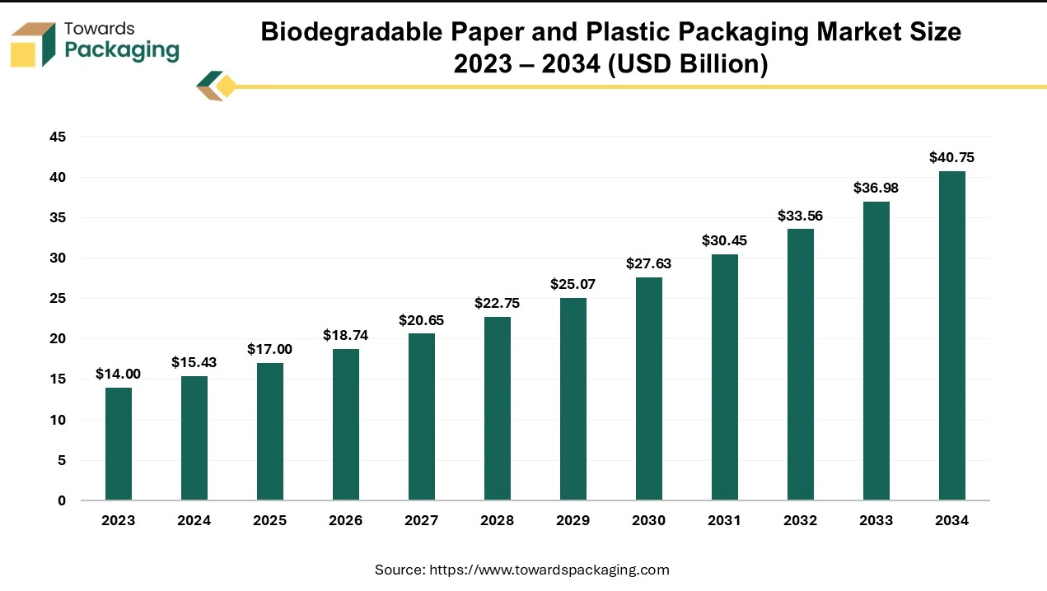
Paper-Based Packaging
Paper and paperboard are renewable and widely accepted by consumers as eco-friendly. When coated with bio-based or thin plastic layers, they can be used for ready-to-eat (RTE) bowls, wraps, or bakery products. However, paper has limitations: it needs barrier coatings to resist grease and moisture, which may complicate recyclability.
Biodegradable Paper and Plastic Packaging Market Size 2023- 2034 (Source: https://www.towardspackaging.com/insights/biodegradable-paper-and-plastic-packaging-market-sizing)

Slide 26
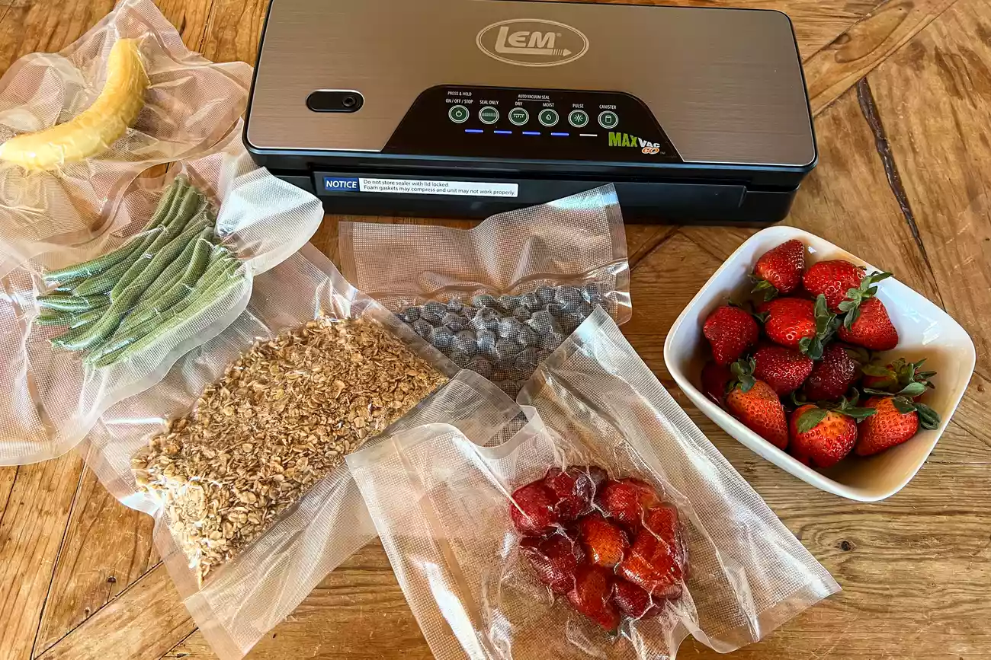
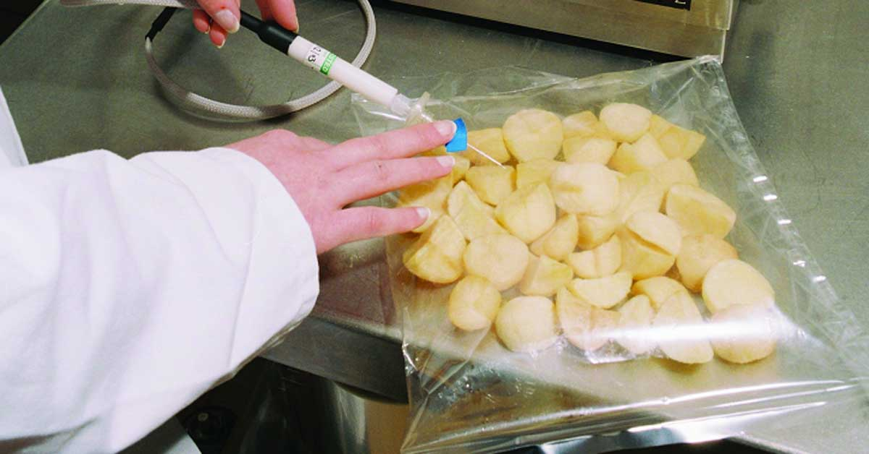
Modified Atmosphere Packaging (MAP) vs Vacuum Sealing
Modified Atmosphere Packaging (MAP) replaces the air inside a package with a specific mix of gases—mainly CO₂, N₂, and sometimes O₂. CO₂ inhibits microbial growth, N₂ prevents package collapse, and O₂ can preserve color. MAP slows spoilage and oxidation, extending the shelf life of plant-based RTE foods like deli slices, meat analogues, and cheeses from a few days up to 3–4 weeks while maintaining flavor and texture.
Vacuum Sealing removes almost all air, reducing oxygen levels to prevent microbial growth. It works well for frozen products, semi-moist snacks, and ingredients like marinated tofu or seitan, but can deform delicate items such as layered pastries or crumbly vegan cheeses.
Dependence on continuous cold chain; temperature breaks compromise safety
Packaging materials must provide sufficient barrier properties
High-barrier films and MAP systems increase cost and may reduce recyclability
Balance needed between shelf-life extension, food safety, and sustainability
Challenges

Slide 27
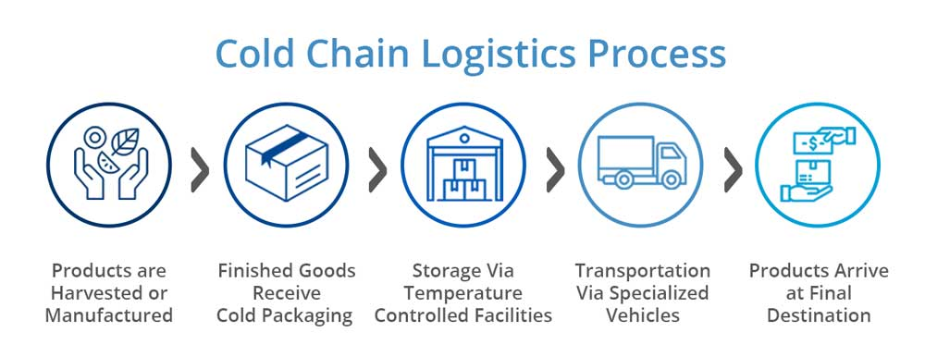
Cold Chain Management & Natural Preservatives
The cold chain ensures uninterrupted refrigeration from production to consumer storage, which is critical for plant-based products, especially high-moisture items like meat analogues or dairy-free yogurts. Even short temperature breaks can increase microbial growth and reduce shelf life.
To support safety and stability, natural preservatives derived from plants or microbial fermentation are increasingly used. Compounds such as rosemary extract, essential oils, and fermented sugar-derived molecules provide antimicrobial and antioxidant activity, preserving both safety and sensory quality. Their dual function makes them particularly attractive for plant-based formulations, where both microbial safety and sensory stability (flavor, color, aroma) are crucial.

Slide 28

Shelf-Life Extension Strategies
Extending shelf life in plant-based foods often requires combining multiple preservation strategies.
Hurdle technology integrates methods like MAP, pH control, and mild heat treatment to provide stronger protection.
Bioprotective cultures such as lactic acid bacteria can suppress spoilage organisms, while active packaging that releases antimicrobials or antioxidants further preserves product quality.
Active packaging that slowly releases antimicrobials or antioxidants can further extend shelf life.
Animal Welfare

Slide 29
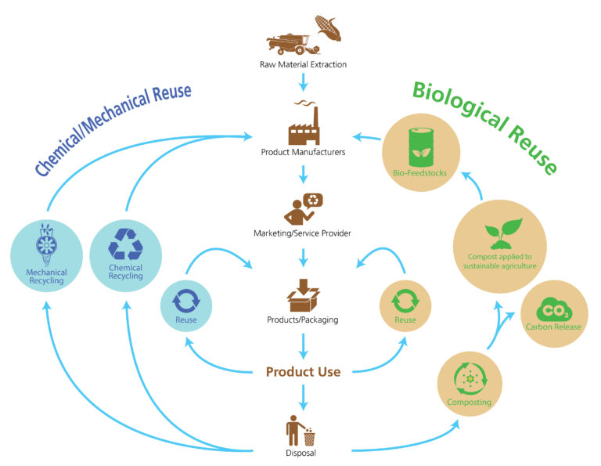
Waste reduction and circular packaging systems
Food waste is a global challenge, but packaging can prevent spoilage and extend shelf life while minimizing environmental impact.
Circular packaging embraces reuse, recycling, composting, and upcycling.
Consumer adoption depends on usability, hygiene, and cost, with plant-based buyers often more receptive to sustainable solutions.
However, compostable materials often require specialized facilities, reusable systems add logistics complexity with reverse supply chains, and recyclability is limited by food residue contamination and local infrastructure gaps.

Slide 30
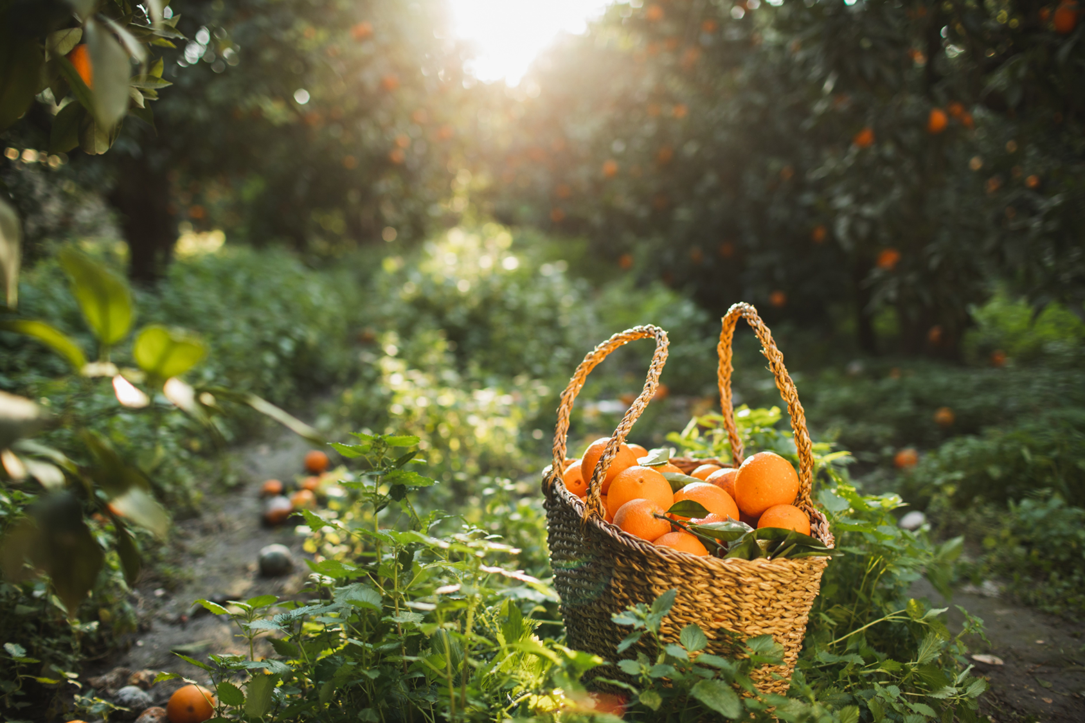
05
Marketing, labelling & consumer trust

Slide 31

Why Do Marketing, Labelling & Consumer Trust Matter?
The success of plant-based foods depends not only on taste, texture, and nutrition but also on trust, transparency, and communication.
As awareness of health, ethics, and sustainability grows, labelling, certification, and marketing strategies shape consumer perception and drive purchasing behavior. Effective communication builds credibility, while unclear or misleading claims can erode trust.

Slide 32
Labelling & Regulatory Framework
Vegan Claims
Non strict EU-wide legal definition of "vegan", but claims must be accurate and non-misleading
Allergen Labelling
Mandatory under EU Regulation 1169/2011 for 14 allergens (soy, nuts, gluten, sesame etc.)
Crucial for plant-based foods, where soy, nuts or wheat are often used as protein bases
Regulated under EC Regulation 1924/2006, requiring scientific substantiation
Examples: "High in protein", Source of calcium."
Products cannot contain animal-derived ingredients, even in trace or hidden forms
Misuse can erode consumer trust and provoke backlash
Clear allergen warnings reinforce safety and credibility
Strongly influence consumer evaluation, especially for processed plan-based alternatives perceived as healthier.
Nutrition Claims
Labelling is not only acompliance obligation but also a strategic tool. It ensures safety and transparency, while helping brands signal quality and differentiate in a competitive plant-based market.

Slide 33
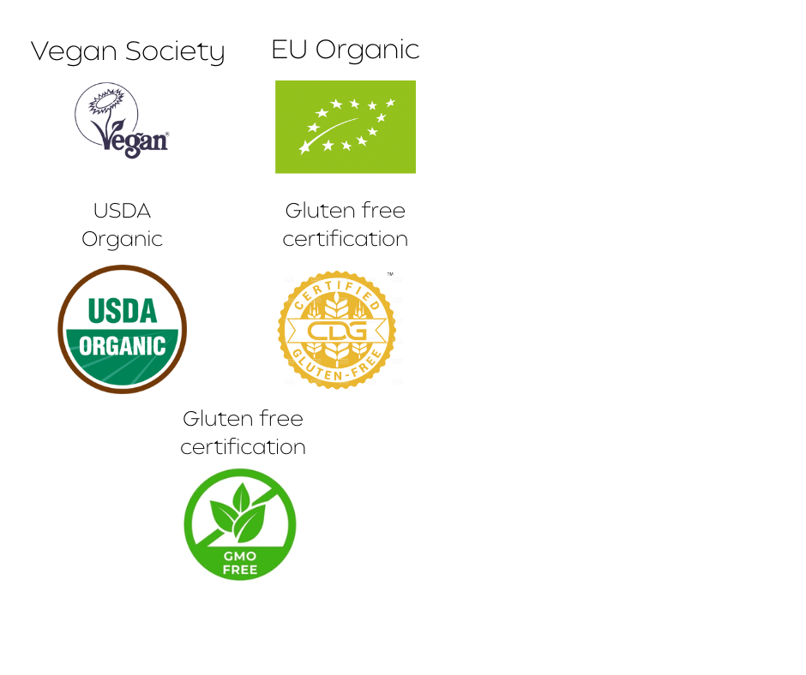

How Certifications Build Consumer Trust
Certifications serve as visible proof that a product meets specific quality, safety, and ethical standards. They provide objective assurance, strengthen brand credibility, and help products stand out in crowded retail shelves.
Vegan Certification Confirms absence of animal-derived ingredients and compliance with ethical production. Logos like The Vegan Society are widely recognized.
Organic Certification EU Organic, USDA Organic; ensures products meet organic farming standards, with minimal synthetic inputs and sustainable practices.
Gluten-Free Certification Provides reassurance for consumers with celiac disease or gluten sensitivities; third-party verification adds credibility.
Additional Labels Non-GMO, Fairtrade, allergen-free, carbon-neutral. Each adds layers of trust and allows premium positioning.

Slide 34

But what makes consumers trust plant-based labels?
Transparency
Certifications
Social Proof
Ethical Storytelling
Consistency
Clear ingredients & sourcing
Same message across packaging & ads
3rd party logos as proof
Sustainability & animal welfare
Reviews, testimonials, and influencer endorsements

Slide 35
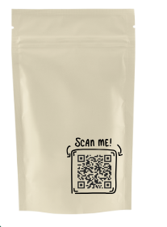
How can packaging tell a story and build trust?
Storytelling
Effective packaging must also be integrated with the broader marketing and brand strategy. All elements—storytelling, visual cues, transparency—should align across digital, in-store, and social media channels to create a cohesive consumer experience.
Transparency
Visual Clues

Slide 36
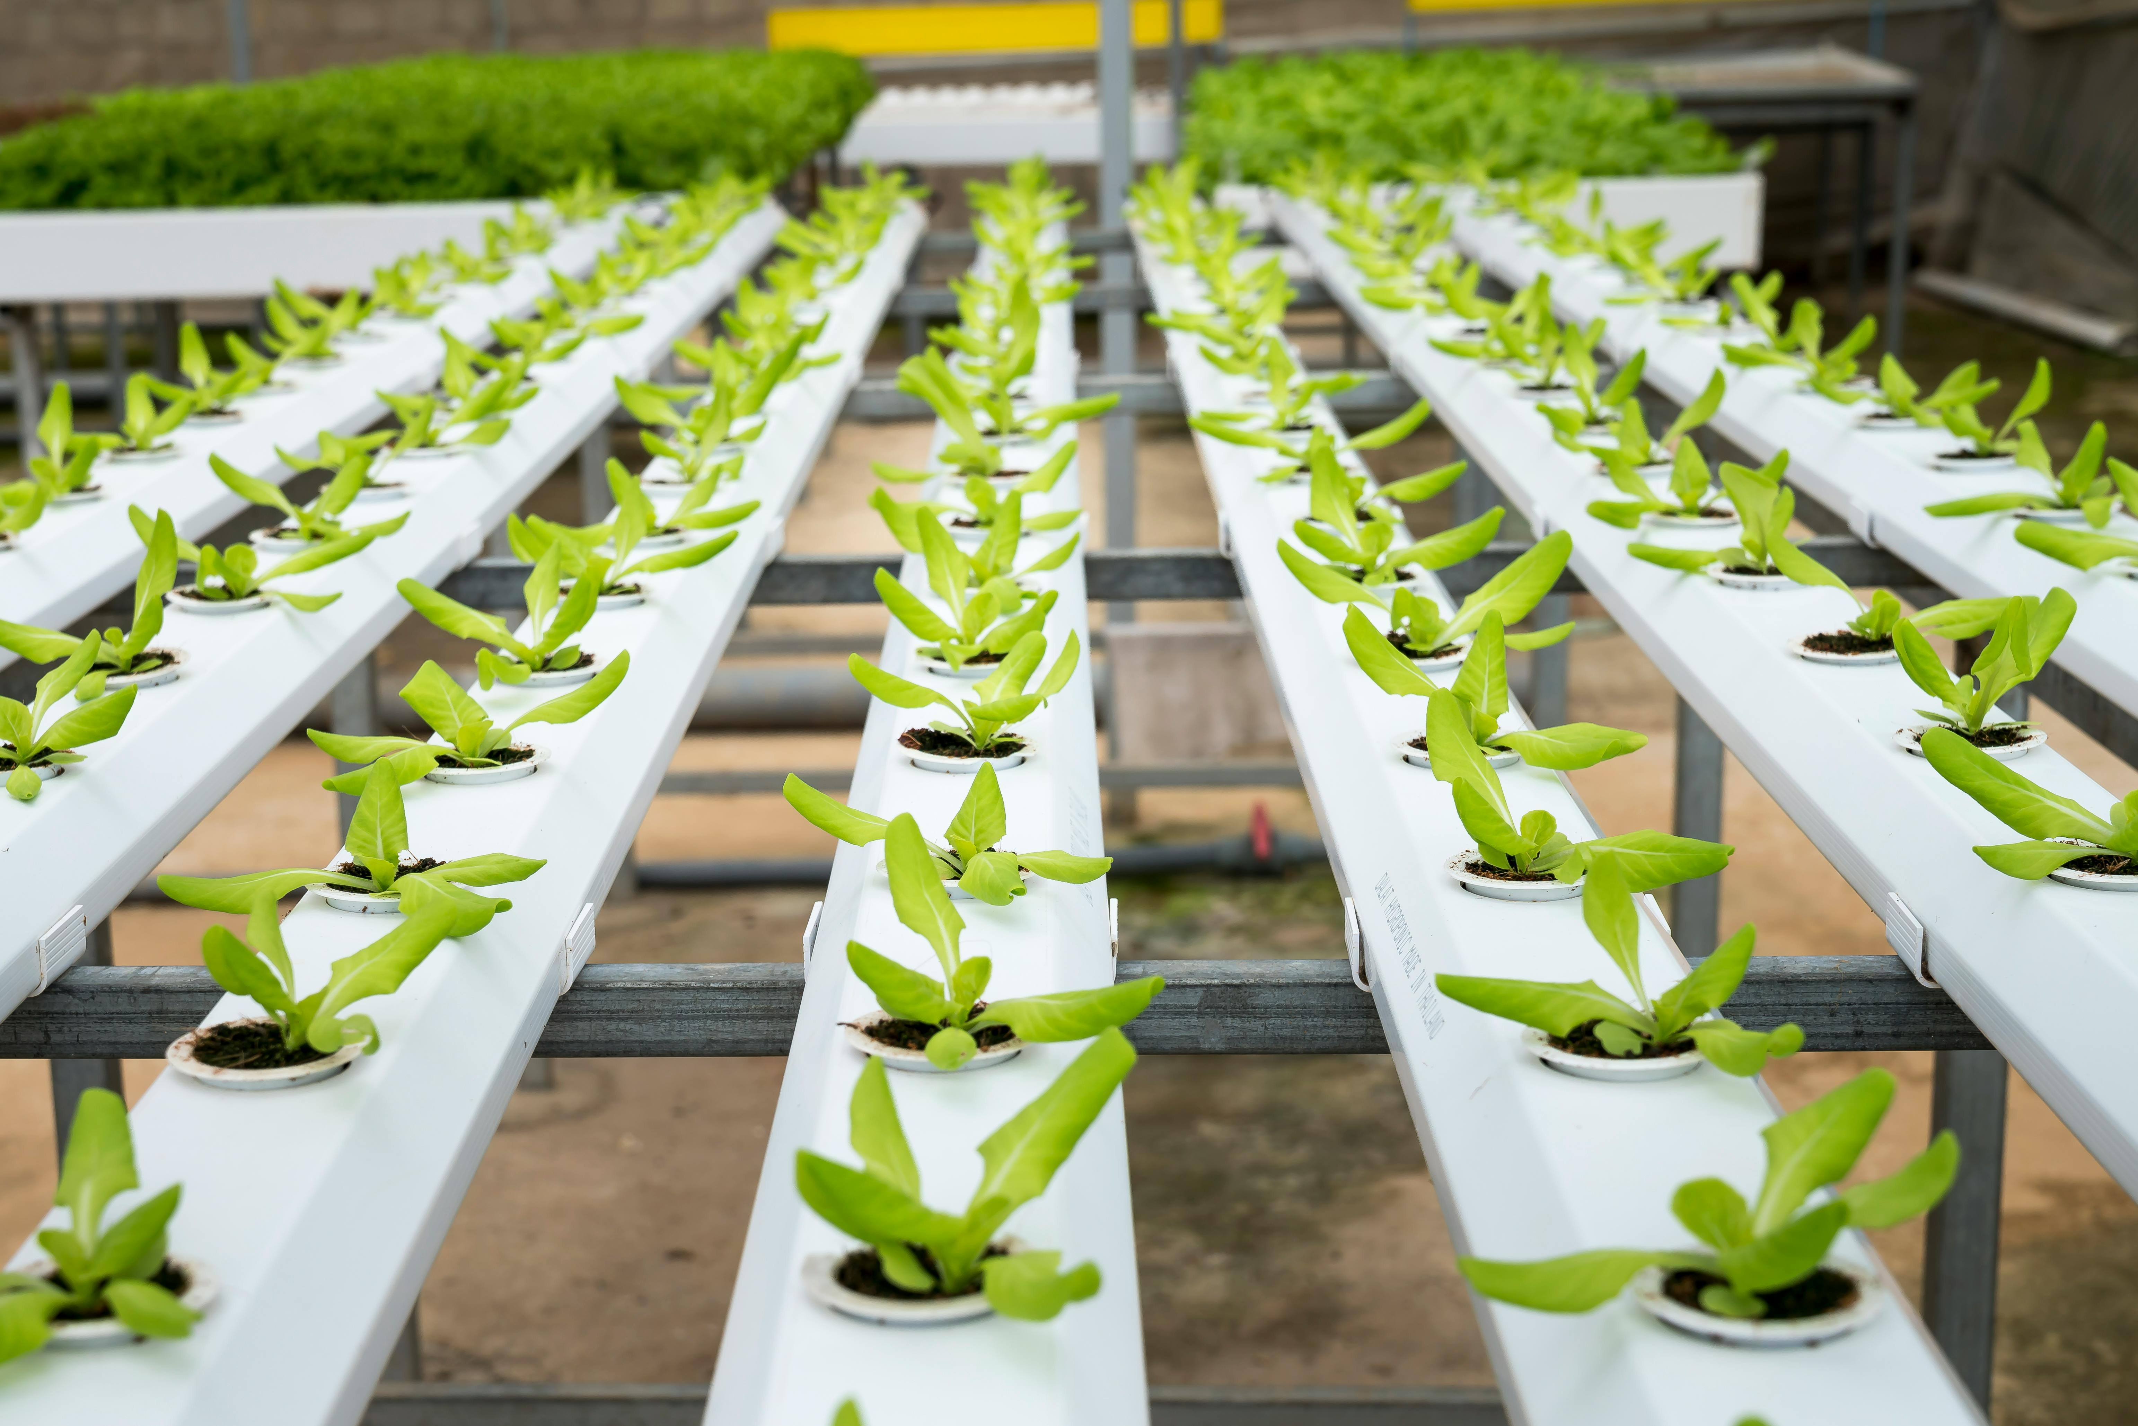
06
Conclusion and Key Takeaways

Slide 37
What drives success in plant-based innovation
We envision a food system that is sustainable, equitable, and resilient, rooted in biodiversity, soil health, social justice, and cultural diversity. Innovation, circular principles, and inclusive governance shift us from extractive to regenerative practices. The plant-based sector thrives when products are consumer-focused, offering taste, texture, and clean-label nutrition for diverse lifestyles. Sustainability and logistics—circular packaging, eco-friendly materials, and reliable cold chains—ensure safety, quality, and environmental responsibility. Finally, trust and communication complete the picture. Transparent labeling, certifications, and engaging storytelling build confidence, loyalty, and adoption, supporting long-term growth.

Slide 38
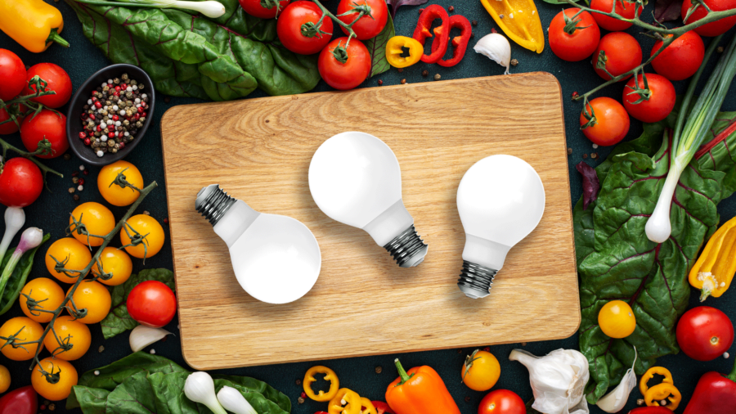
Plant-based innovation is where science, creativity, and market insight converge to satisfy evolving needs and drive long-term growth.

Slide 39

Thank you for completing Module 3 - Creating plant-based innovations for Retail, Prepared Consumer Foods
Supporting Europe’s food sector in adopting plant-based innovation and sustainability.
follow our journey
www.plantpower.eu

