Slide 1
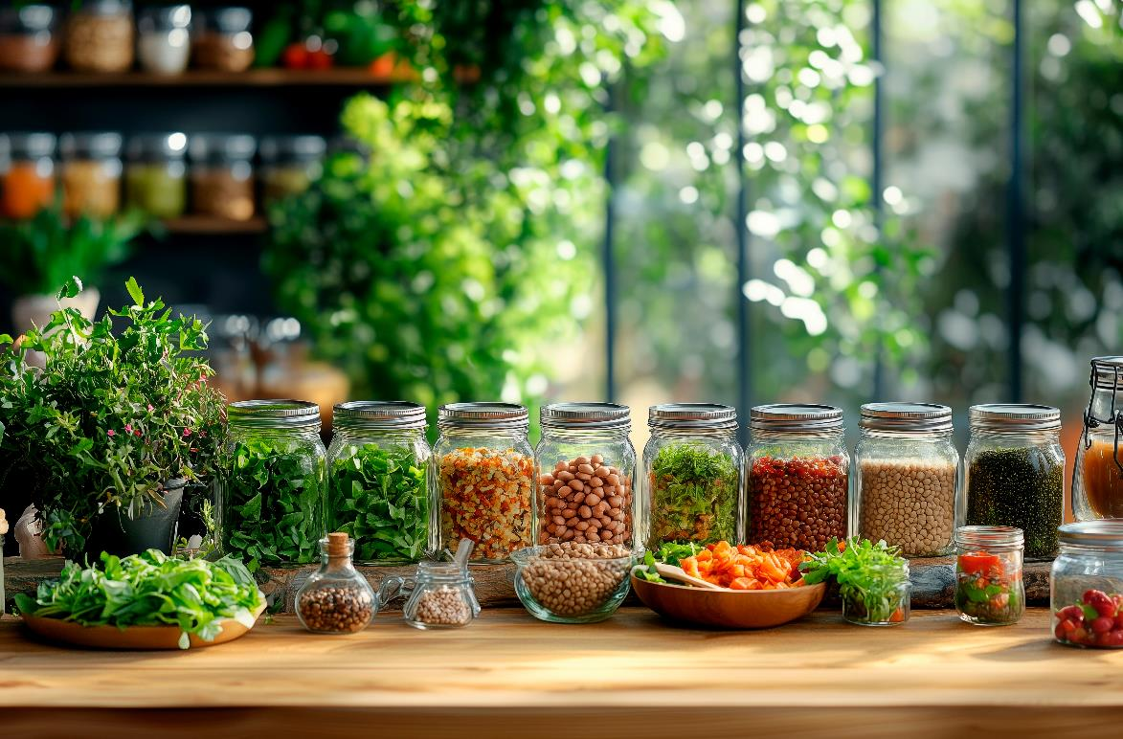
MODULE 4
Sourcing/ Mapping Local/Regional raw Materials
www.plantpower.eu

Slide 2
Contents
01
Purpose and Objectives
02
Introduction to Local/ Regional Sourcing
03
Mapping Ingredients in Your Region
04
Criteria For Selecting Local Raw Materials
05
Case Studies in Regional Sourcing

Slide 3
Contents
06
Why Local and Regional Sourcing Matters
07
Learning Summary

Slide 4

01
Purpose and Objectives

Slide 5
Purpose
This module enables learners to understand how local and regional sourcing supports sustainable plant-based food systems. Learners explore the link between ingredients, place, and responsibility, and consider how sourcing closer to origin can reduce environmental impact, support local economies, and strengthen traceability.
The module provides practical methods for finding, mapping, and assessing raw materials in a given region. Learners will learn how to locate producers, understand supply routes, judge suitability for plant-based products, and recognise common barriers such as seasonality, cost, and limited processing capacity, as well as opportunities in logistics, preservation, and collaboration.
We combine theory, case studies, digital tools, and applied tasks. By the end, learners will be able to prepare an evidence based regional sourcing plan and propose how locally available ingredients could be used in future plant-based products.

Slide 6
Objectives
By the end of the module, learners will be able to:
Understand the importance of local and regional raw material sourcing in plant-based food systems
Identify methods for mapping available raw materials within a given territory
Evaluate the environmental, economic, and social benefits of sourcing locally
Recognize barriers and opportunities in regional supply chains
Apply sourcing strategies to develop sustainable, regionally appropriate plant-based products.

Slide 7

02
Introduction to Local/ Regional Sourcing

Slide 8
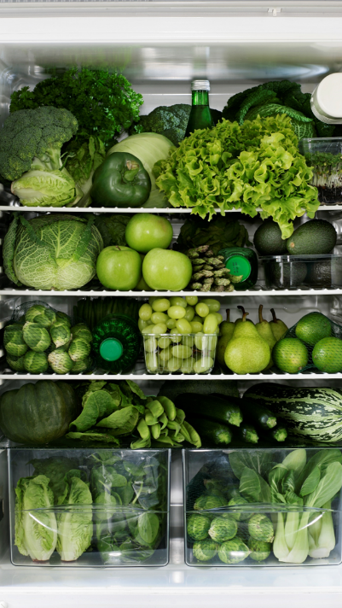
What Do We Mean by Local and Regional?
Local sourcing means using ingredients that come from nearby, usually within the same town, county, or local area. In many EU countries, this typically means the food travels less than 100 to 150 kilometres from source to production.
Regional sourcing means obtaining ingredients from a broader surrounding area, such as another part of the same country or from a nearby EU country. It still prioritises shorter supply chains and supports more sustainable sourcing.

Slide 9

Proximity Matters in Supply Chains
Sourcing raw materials close to where they are processed supports more sustainable plant-based food systems. Shorter distances mean lower fuel use and lower transport emissions, which supports the EU Green Deal and Farm to Fork Strategy aims for low carbon, resource efficient supply chains.
Proximity also keeps more economic value in the region. It can support local jobs, strengthen small producers, and contribute to balanced regional development. This reflects EU priorities for a more resilient agri-food sector.
Shorter supply chains are also easier to monitor. With fewer intermediaries, it is easier to track origin, check compliance with food safety standards, and give reliable information to consumers. This helps build trust in plant-based products.

Slide 10
Trends in Ingredient Sourcing
Past
For most of European history, ingredients were local. Small farms supplied nearby markets with seasonal crops. Before the 1950s most people relied on short supply chains. Long distance transport of fresh food was rare, so people used fermenting, drying and cellaring to preserve food.
Present
Today sourcing combines global trade with a stronger local first approach. Since COVID 19 demand for regional produce has grown. Supermarkets highlight local lines and public buyers such as schools and hospitals test shorter supply chains. Traceability is now standard. Batch IDs, QR codes and blockchain pilots track food from farm to fork and support fast recalls. Buying is data led, using verified supplier lists, regional production data and logistics assets such as cold stores and distribution centres. Cold chain and transport networks also allow safe movement of fresh ingredients all year around.

Slide 11

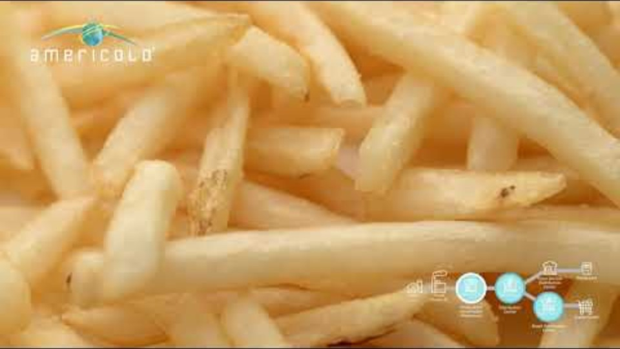
Watch this short video to find out more
https://www.youtube.com/watch?v=FqLxJywe9Uc
https://www.youtube.com/watch?v=FqLxJywe9Uc

Slide 12

Benefits of Local Sourcing
Environment & economy: Lower fuel use, emissions and spoilage; supports EU Green Deal goals and keeps value local. Reduces intermediaries and risk from market or transport disruptions; public procurement can stabilise demand.
Traceability & trust: Easier monitoring with batch IDs/QR codes; clearer proof of origin, sustainability and quality, building consumer confidence.
Waste, quality & nutrition: Fewer handovers cut damage and packaging waste; faster delivery preserves freshness and reduces additives and overproduction.
Resilience, barriers & enablers: Local sourcing improves resilience to shocks. Key barriers: seasonality, limited processing and price volatility. Enablers: co-ops, food hubs, shared logistics, procurement and traceability tools.
Notes:
<a href="https://www.flaticon.com/free-icons/localization" title="localization icons">Localization icons created by Pop Vectors - Flaticon</a>

Slide 13

Quiz
Define local sourcing for plant-based ingredients in the EU context.
Give one environmental reason why proximity matters.
Name one current EU trend that shows local or regional sourcing is growing.
Reflection
“What raw materials are local to you”
List three to five plant-based inputs produced within roughly 100–150 kilometres.
For each, note distance, harvest window, any nearby processor and one way it could
replace an imported ingredient. Add one barrier and one opportunity you foresee.

Slide 14

03
Mapping Ingredients in Your Region

Slide 15
What is Ingredient Mapping?
Ingredient mapping means identifying nearby raw materials, processors, logistics routes and buyers, and linking them into a workable, traceable supply chain. It asks: what is available, where is it, and how does it move. The aim is lower impact, more regional value and stronger traceability.
Manual mapping: Find suppliers within about 150 km and 500 km. Speak to chambers, co operatives, grower groups, farms and processors. Record product, distance, volume, harvest window, certification, contact and local processing. Output: a verified supplier list and one sourcing plan per ingredient.
Digital mapping: Use Eurostat NUTS 2 and NUTS 3 to locate crop regions. Confirm producers in national organic, PDO or PGI registers. Plot producers, processors and routes in Google My Maps or QGIS. Add batch IDs and QR codes linking each lot to farm or region, harvest date and certification. Output: a digital, traceable regional map.
Research task
Choose three plant-based ingredients from your region. Note where they are grown, confirm one producer for each in a national register, and record location for the next exercise.

Slide 16


Core Tools and Data
Ingredient mapping depends on reliable data about where crops are grown, who supplies them and how they move.
Key data sources
Eurostat (NUTS 2 / NUTS 3): Shows main crop regions for peas, fava beans, lupin, oats, rapeseed, sunflower and others.
National registries: Approved producers, organic operators, PDO and PGI holders. Confirms real suppliers.
Regional networks: Co operatives and chambers of commerce. Can list members, storage hubs, cold stores, railheads and ports.
Mapping and traceability
Google My Maps / QGIS: Plot producers, processors, routes and logistics.
Traceability: Use a Batch ID (for example YYYYMMDD Supplier ID Lot#) and link by QR code to farm or region, harvest date, certification and first processing step.

Slide 17

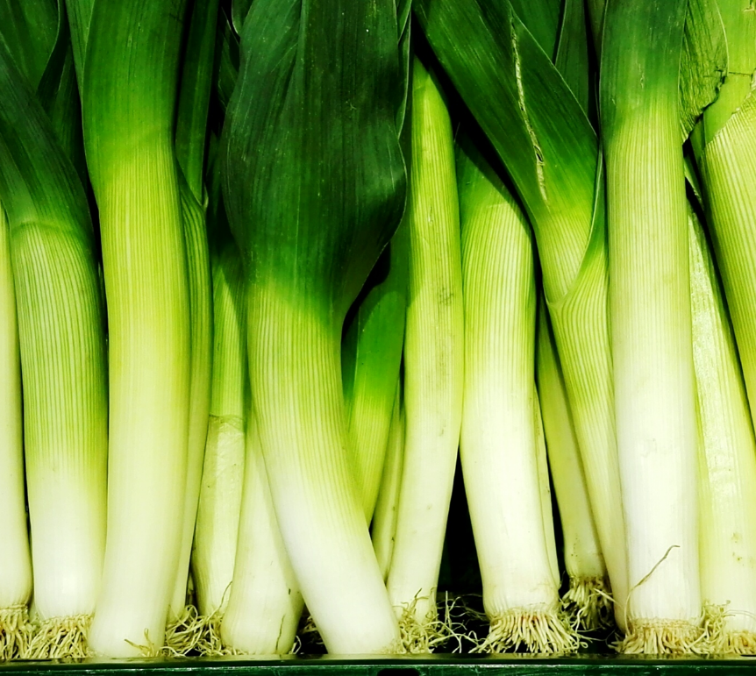
Read the data: Common crops; main processors/storage; items in demand not produced locally.
Link supply to processing: Match producers to nearby processors or hubs (cold stores, DCs, rail/port). Note distance, roads, seasonality.
Show the pathway: Trace one ingredient from producer → processor → buyer (caterer/retailer). Map local flows ~100–150 km; regional ~500 km.
Find gaps: Missing storage/processing or long transport legs: these signal where co-operation or investment is needed.
Task: Pick one ingredient and sketch producer → processor → buyer for your region.

Slide 18
Workshop
Mapping Regional Ingredient Networks
In this workshop you will turn your draft ingredient flow into a full regional network map. The aim is to show how ingredients are sourced, processed and moved in your region, and to highlight gaps and opportunities.
Regional ingredient network
Pick one plant-based ingredient from your region.
Find and record:
  one producer
  one processor
  one logistics site (cold store, distribution centre, rail or port)
  one buyer
Map these in Google My Maps or QGIS and draw arrows showing the flow.
Add labels: distance in km, harvest window, and any certification (organic, PDO, PGI).
Write three bullet points: one strength, one barrier, one opportunity.

Slide 19

Knowledge check
Be ready to answer:
What does NUTS 3 mean in Eurostat data.
Name one national registry to verify producers.
What is the purpose of a batch ID.
What two types of data can a QR code hold for traceability.
Why include logistics assets such as cold stores or ports.
Reflection
Write a short paragraph on how mapping could improve sourcing, traceability or sustainability in your organisation.
Notes:
<a href="https://www.flaticon.com/free-icons/localization" title="localization icons">Localization icons created by Us and Up - Flaticon</a>

Slide 20
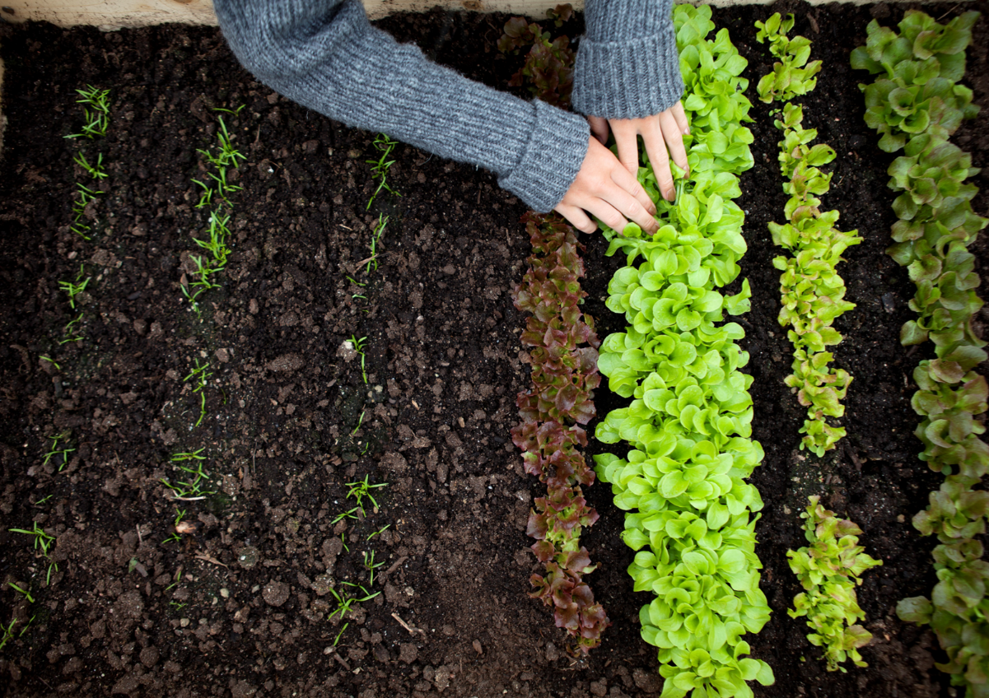
04
Criteria For Selecting Local Raw Materials

Slide 21
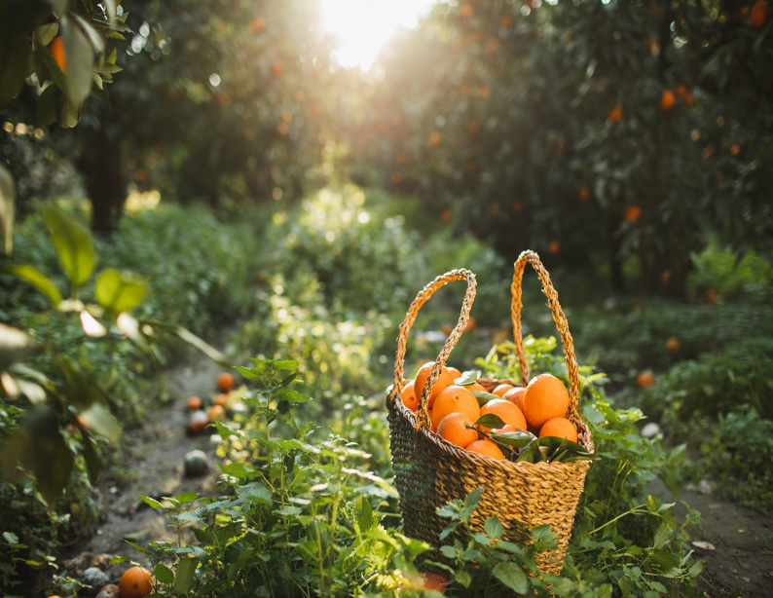
Why Selection Criteria Matter
Choosing the right local raw materials is essential for developing sustainable plant-based products. Good selection helps balance nutrition, functionality and sustainability, while supporting regional supply chains and reducing dependence on imports.
Why it matters
Strengthens regional value chains
Improves nutritional content and product identity
Lowers transport emissions
Builds links between farmers, processors and food producers
Key selection principles
Nutritional quality: protein, fiber, micronutrients
Functional reliability: texture, binding, stability in processing
Availability: steady and scalable supply
Sustainability: certified origin and strong traceability

Slide 22
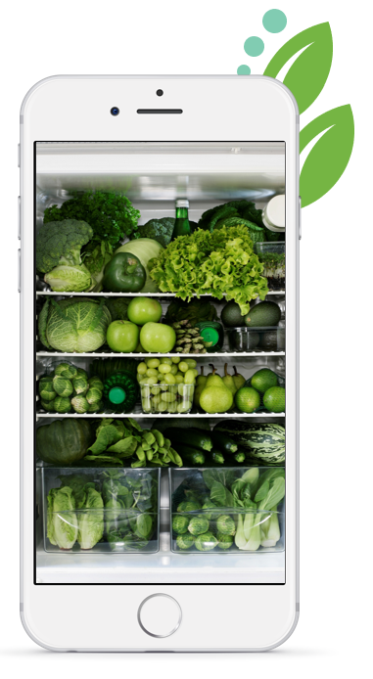
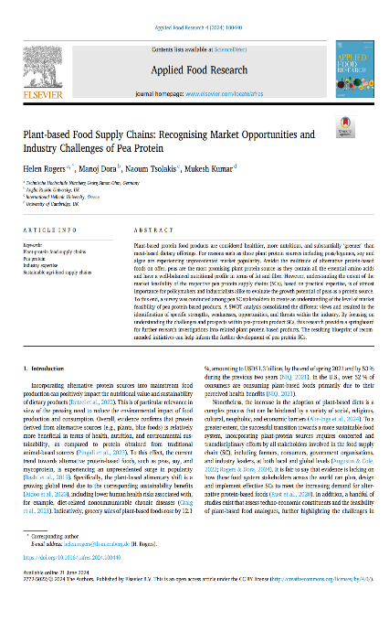
Further Reading: Selecting Local Raw Materials
Further Reading: Selecting Local Raw Materials
Article
Rogers, H. (2024). Plant based food supply chains: Recognising market feasibility of pea protein-based products. Journal of Food Systems and Sustainability, 6(2).
Overview
Shows how raw materials are chosen using technical performance, availability, cost, logistics, and sustainability. Links choices to European policy and market needs.
https://www.sciencedirect.com/science/article/pii/S2772502224000520

Slide 23



Evaluating Ingredient Suitability
When choosing ingredients for plant-based products, you should assess how well each option performs in nutrition, processing and sustainability, not only cost.
Key evaluation criteria
Nutritional composition: protein, fiber, amino acids, key micronutrients
Functional behavior: thickening, binding, moisture retention
Processing compatibility: performance under heat, storage and blending
Safety and consistency: contamination risk, quality stability, compliance
Economic and logistical fit: cost, scalability, distance between production and processing
Practical tool
Create a simple table and rate each ingredient from 1 to 5 for each factor. Add one column for environmental performance using regional data.
Applied task
Choose two local ingredients (for example oat flour and fava bean flour). Score them using the table. Then write about 100 words explaining which ingredient is more suitable for product development and why.

Slide 24

Example: Applying Selection Criteria
Comparison: Oat Flour vs Fava Bean Flour
Criterion | Oat Flour | Fava Bean Flour | Comment
Nutritional quality | 3 | 5 | Fava beans provide higher protein and micronutrient content.
Functional reliability | 4 | 5 | Fava bean flour offers better texture and binding for plant-based applications.
Availability | 5 | 4 | Oats are more common, though regional fava supply is improving.
Sustainability | 4 | 5 | Fava beans fix nitrogen, improving soil health and lowering emissions.
Overall suitability (avg.) | 4.0 | 4.8 | Fava bean flour outperforms overall.
Example outcome
Fava bean flour ranks higher overall for its strong nutritional value, functionality, and sustainability benefits. Though oat flour is easier to source, fava bean flour is the better choice for protein-rich, sustainable products that support local value chains and EU goals.

Slide 25
Managing Seasonality and Preservation
Local sourcing must deal with seasonal change. Planning production, processing and storage helps keep supply steady, reduce waste and maintain quality.
Seasonality
Use agricultural calendars and Eurostat NUTS 2 and NUTS 3 data to find harvest periods.
Use crop rotation and complementary planting to avoid gaps.
Process ingredients during peak harvest to limit losses.
Preservation and storage
Use shared regional storage or cold chain facilities.
Monitor temperature, humidity and moisture for quality and traceability.
Use drying, fermentation or freezing to extend shelf life without additives.
Task
Choose one ingredient from your evaluation. Identify its harvest period and two preservation methods that keep quality and support sustainability.

Slide 26

Sustainability and Life Cycle Considerations
Choosing ingredients on the basis of sustainability supports environmental and social responsibility. Life Cycle Thinking looks at total impact from farm to finished product.
Key impact areas
Carbon footprint: emissions from growing, processing and transport
Land use and biodiversity: soil health, habitat, yield
Energy demand: energy used in production and storage
Social value: local jobs, co operative models, fair pay
Using this in sourcing
Use EU Product Environmental Footprint or other open life cycle data to compare options
Compare local and imported ingredients using the same indicators
Choose ingredients that balance low impact, good nutrition and good functionality
Task
Pick one ingredient from your shortlist. Estimate its carbon and water footprint and compare it with an imported alternative. Say which is more sustainable and why.

Slide 27

Assessment, Reflection, and Discussion
This final stage consolidates your learning on ingredient selection, sustainability, and local supply chain design. It combines individual analysis with collaborative reflection.
Multiple-Choice Quiz
Which factor most influences an ingredient’s functional performance?
Why is seasonal mapping important in regional sourcing?
Which EU initiative promotes shorter and more sustainable food supply chains?
Why might a locally sourced ingredient still have a higher environmental impact?

Slide 28

05
Case Studies in Regional Sourcing

Slide 29


Case Study: Denmark
Organic Denmark is the national organisation for organic food and farming. It links farmers, brands, retailers, and consumers, and advances organic and plant-based innovation through policy, market development, advice, and education.
Scale and achievements
• Nationwide reach with broad membership across the food system
• Partnerships with ministries, retailers, researchers, and European networks
• Highest national market share of organic food worldwide
• Support for farmers to diversify into plant-based crops and products
Result
This coordinated work strengthens value chains, improves biodiversity and soil health, reduces pesticide use, and grows trusted organic and plant-based markets, placing Denmark among the leaders in sustainable low carbon food systems.
Notes:
<a href="https://www.flaticon.com/free-icons/denmark" title="denmark icons">Denmark icons created by GeekClick - Flaticon</a>

Slide 30

Case Study: Ireland
Naked Bakes, founded by Aisling Tuck, is an Irish plant-based bakery that produces vegan cookie
dough made with 100% Irish ingredients. The brand grew from a home kitchen into a recognised
national label through rebranding, clear positioning, and local sourcing.
Achievements
Rebranded from Oh Happy Treats to reach mainstream shoppers
Simple, high-quality recipes and eco friendly packaging
Blas na hÉireann Gold Award 2023 and further shortlisting's in 2024
Stocked by Lidl and SuperValu; production facility in Tallaght employing 12 people
Impact
Naked Bakes shows how local sourcing, brand design, and product innovation can move a niche
vegan offer into the mainstream while supporting sustainable, Irish supply chains
Notes:
<a href="https://www.flaticon.com/free-icons/denmark" title="denmark icons">Denmark icons created by GeekClick - Flaticon</a>

Slide 31

Case Study: Spain
Overview
Molinos del Duero is a Spanish company combining tradition and innovation to produce high
quality, sustainable flours. Through its Alere Vital brand, it develops organic sprouted grain flours
that enhance nutrition, functionality, and environmental performance.
Approach
The company focuses on local sourcing, controlled germination,
low-temperature drying, and stone milling to preserve nutrients and
ensure traceability. Its process supports both product quality and
sustainability, aligning with circular economy goals.
Impact
Molinos del Duero demonstrates how advanced food technology and responsible sourcing can
transform everyday staples into nutritious, plant-based ingredients. Its work contributes to
healthier diets, regional value creation, and reduced environmental impact.
Notes:
<a href="https://www.flaticon.com/free-icons/denmark" title="denmark icons">Denmark icons created by GeekClick - Flaticon</a>

Slide 32

Case Study: Slovakia
Vegget Microfarm in Bratislava is an urban farming initiative producing herbs, greens, and
microgreens through sustainable, space-efficient methods.
Approach
Vertical farming and hydroponics
Organic cultivation and composting
Efficient water use and rainwater collection
Direct supply to restaurants and local customers
Community workshops and education
Impact
Vegget Microfarm demonstrates how urban agriculture can deliver fresh, local produce, reduce
emissions, and strengthen community engagement in sustainable food production.
Notes:
<a href="https:/
/www.flaticon.com/free-icons/slovakia" title="slovakia icons">Slovakia icons created by Kathelynnexx - Flaticon</a>

Slide 33
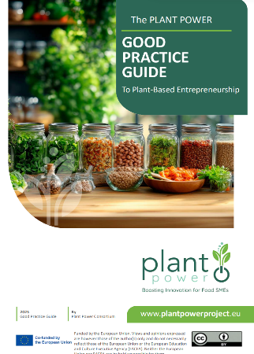
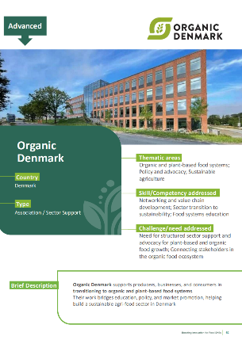
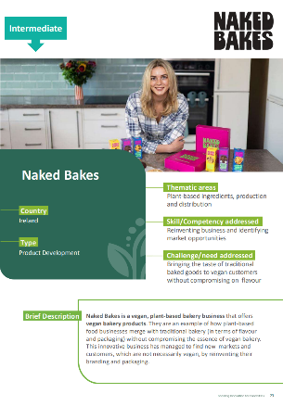
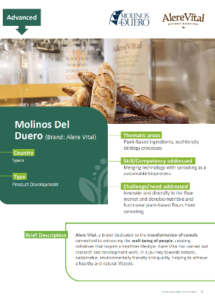
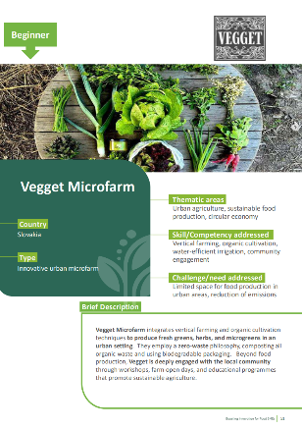
Find the full Case Studies in out Good Practice Guide
https://plantpowerproject.eu/resources/good-practice-guide-to-plant-based-entrepreneurship/

Slide 34
Reflection and Application
These European case studies show how regional sourcing and plant-based innovation can build sustainable, high value food systems. They highlight the importance of local knowledge, partnership and practical problem solving.
Assessment activities
Individual: Choose one case study. Explain how its sourcing model supports sustainability and suggest how this approach could be copied in your region
Group: Discuss how local knowledge and partnership support entrepreneurship and innovation

Slide 35

Further Learning: Food for Europe Podcast
Episode 58: Organic Awards – Flying the Flag for Organic Food and Farming in Europe
Available on Apple Podcasts: Food for Europe – Episode 58
(Produced by the European Commission, Directorate-General for Agriculture and Rural
Development)
Why listen
Highlights leading European examples of sustainable and regional sourcing
Demonstrates how collaboration and transparency build consumer trust
Shows how EU strategies translate into real actions and results

Slide 36
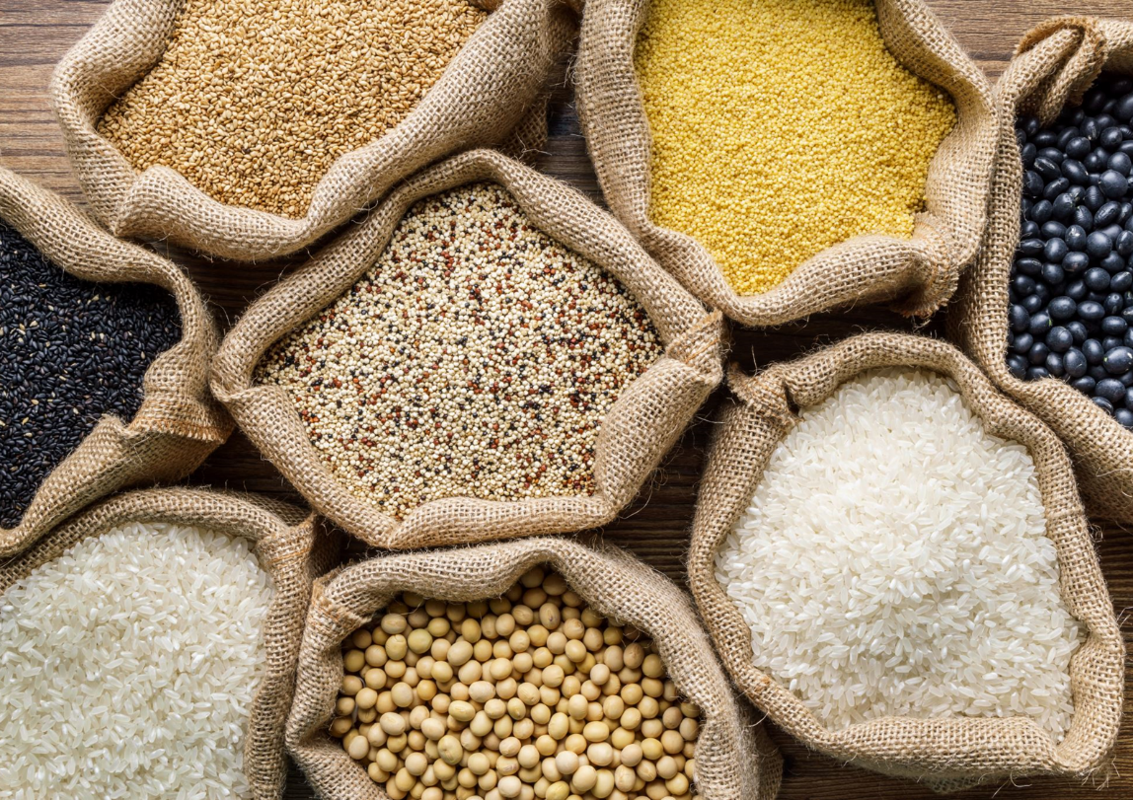
06
Why Local and Regional Sourcing Matters

Slide 37
Why Local and Regional Sourcing Matters
Local and regional sourcing supports sustainability, food security and community resilience. Keeping production, processing and distribution close reduces transport emissions, keeps more value in the regional economy and improves traceability.
For small and medium sized enterprises, local sourcing can build consumer trust and transparency but also shows weak points. Smaller producers face limits in storage and processing, higher costs and seasonal gaps, and must compete with large scale and global suppliers.
The Plant Power Project helps address these barriers by offering training, open learning resources and practical tools for innovation. Strong regional value chains allow SMEs to move towards low carbon, locally rooted production that matches consumer demand and reflects local identity.

Slide 38


Barrier 1 – Limited Infrastructure and Processing Capacity
Many rural areas lack adequate storage, processing, or packaging facilities.
Solution: Establish shared-use hubs or co-operatives to pool resources and access essential equipment collectively.
Barrier 3 – Seasonal Availability and Supply Gaps
Short harvest periods restrict year-round product consistency.
Solution: Adopt preservation techniques such as drying, freezing, or sprouting to extend shelf life and stabilise supply.
Overcoming Barriers to Local Sourcing
For more examples, watch this short video: https://www.youtube.com/watch?v=glp0NzdIJzw
Barrier 2 – High Costs and Small Volumes
Producers often operate at a disadvantage due to limited bargaining power and small batch sizes.
Solution: Engage in joint purchasing, shared logistics, and regional funding mechanisms such as EU innovation vouchers.
Barrier 4 – Market Visibility and Consumer Perception
Local plant-based products are often perceived as niche or expensive.
Solution: Use storytelling, transparent labelling, and place-based branding to communicate quality, sustainability, and freshness.

Slide 39


Find out more by watching this free video
https://www.youtube.com/watch?v=glp0NzdIJzw

Slide 40
Innovation in Local and Regional Sourcing
Preservation and processing
Solar drying, vacuum sealing, fermentation and cold plasma can extend shelf life without additives. This allows year-round use of seasonal crops and reduces waste.
Digital traceability
Blockchain, QR codes and mapping tools let SMEs track origin and product movement in real time. Platforms like Google My Maps and QGIS show routes and logistics needs.
Circular economy
By products and surplus crops are turned into new products, for example fruit pulp into snacks or vegetable trimmings into sauces.
Zero-mile production
Urban and rooftop farms, such as hydroponic microfarms, cut transport distance and involve local communities.

Slide 41
Climate and Policy Influences on Local Sourcing
Climate pressure
More drought, unstable rainfall and shifting seasons make crops less reliable. Producers must adapt through water efficient irrigation, climate resilient varieties and soil regeneration.
Policy direction
EU strategies such as the European Green Deal and Farm to Fork Strategy promote shorter, low carbon supply chains and more sustainable production. Some national plans, such as Denmark’s Plant Based Action Plan, direct funding towards circular, plant-based systems.
Regulation
New approval and labelling rules aim to increase clarity and safety
but also add complexity for small and medium sized enterprises.
Staying compliant is now part of competitiveness.

Slide 42
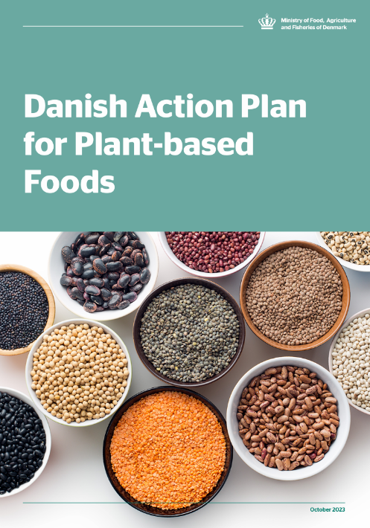
Read about Denmark's Plant-Based Action plan here

Slide 43

Reflection and Assessment
Local and regional sourcing is more than a procurement strategy — it represents a cornerstone of sustainable and circular food systems. By identifying barriers, leveraging innovation, and adapting to climate and policy dynamics, SMEs can establish traceable, locally grounded supply networks that benefit both producers and consumers.
Assessment Activities:
Brainstorm: How could you improve the accessibility of local ingredients in your community or region?
Quiz: Test your understanding of emerging innovations in preservation, logistics, and zero-mile sourcing.

Slide 44
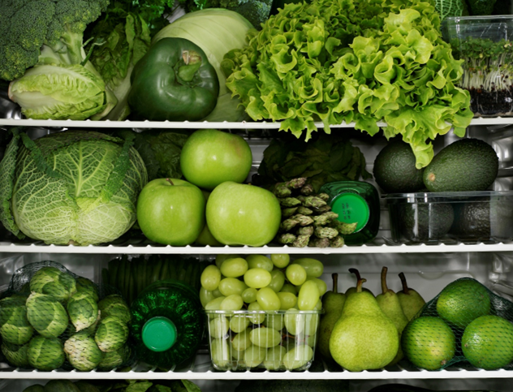
Key Learnings
Builds more sustainable, transparent, resilient food systems.
Shorter journeys strengthen links between producers, processors, and consumers.
Mapping local networks shows how value chains work and where to improve.
Collaboration across farmers, processors, and buyers balances sustainability with demand.
Digital tools make chains visible and accountable.
European cases show innovation and circular practices can meet policy goals.
Drives local jobs, income, and community wellbeing not just environmental gains.

Slide 45
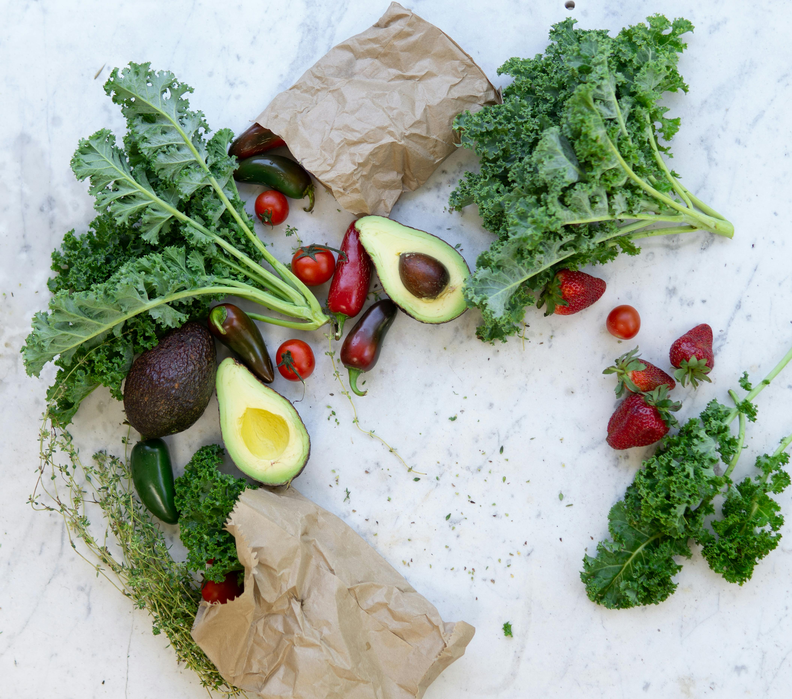
07
Learning
Summary

Slide 46
Module Summary
This module examined local and regional sourcing in plant-based food systems, highlighting how
shorter supply chains can reduce environmental impact, strengthen local economies, and improve
transparency and traceability.
Core content covered ingredient mapping with manual investigation and digital tools to locate
producers, processors, logistics nodes, and routes. Selection criteria were defined across nutrition,
functional performance, logistical feasibility, and sustainability, with guidance on seasonality,
preservation, and storage.
European case studies from Denmark, Ireland, Spain, and Slovakia illustrated how local sourcing
aligns with innovation and circular practices. Common barriers, including infrastructure gaps and
seasonal variability, were paired with responses such as cooperative models, shared facilities, and
appropriate technologies.
On completion, the module offers a foundation for designing traceable, sustainable, and
locally anchored supply systems consistent with European policy priorities and current market
expectations.

Slide 47


Thanks for your Attention
Thank you for your engagement in this training module.
We encourage you to apply these technologies and knowledge in practice to foster a healthier and more sustainable future!

