Slide 1
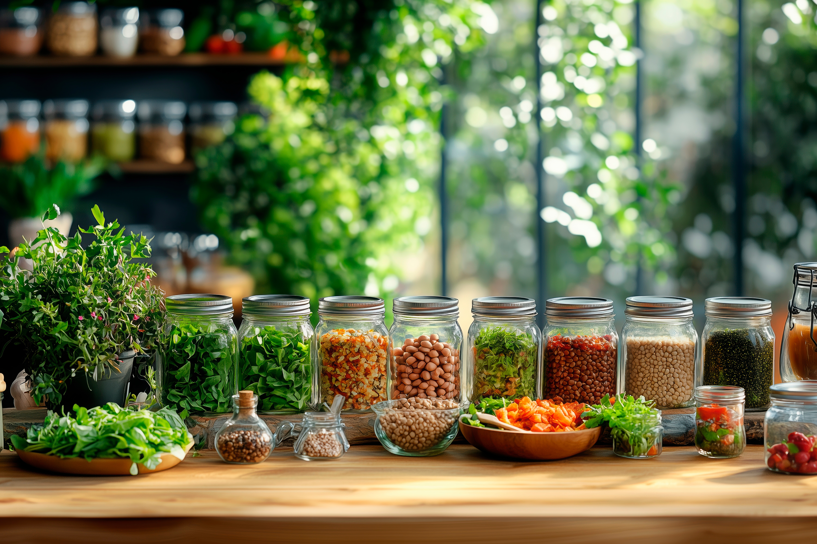

MODULE 5
Imagining a Better World Via Plant Power
www.plantpower.eu
Plant Power OERs Modules © 2025 by Plant Power Partnership is licensed under CC BY 4.0. To view a copy of this license, visit https://creativecommons.org/licenses/by/4.0/

Slide 2
Contents
01
Purpose and Objectives
02
Introduction to Global Sustainability and Food Systems
03
The Environmental Case for Plant-Based Diets
04
Food, Ethics, and Social Justice
05
Vision: Future Food Systems

Slide 3
Contents
06
Learning Summary

Slide 4
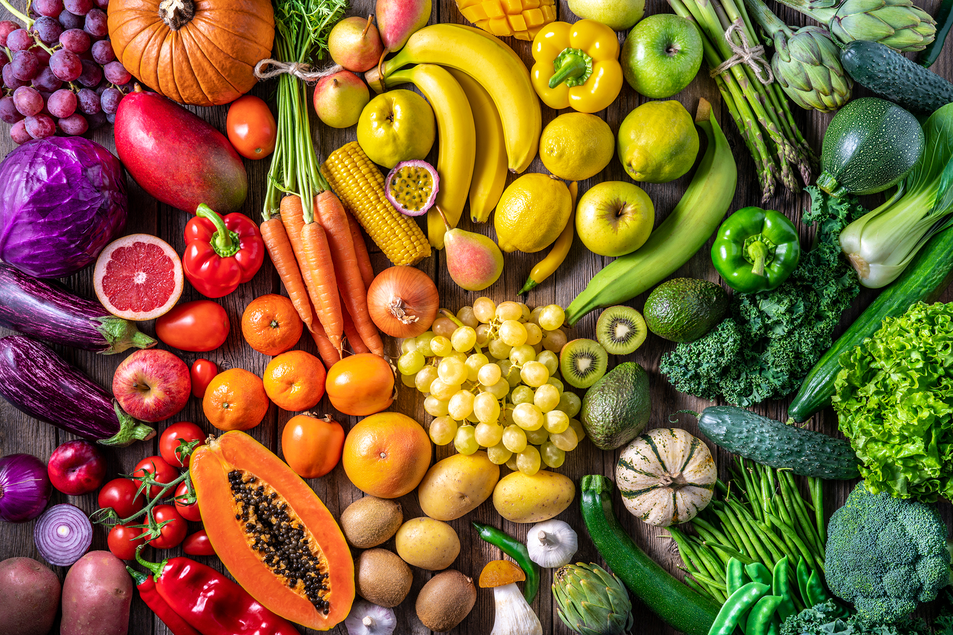
01
Purpose and Objectives

Slide 5
Purpose
This module empowers learners to understand the critical role plant-based food systems play in shaping a sustainable, and resilient future. Learners are encouraged through exploration of the interconnections between food, environment, health, and equity to reflect on current global challenges and imagine transformative solutions rooted in plant-based innovation.
This module serves as a foundational introduction to a plant-based food future, encouraging participants to critically examine traditional food systems and envision alternatives that align with the Sustainable Development Goals (SDGs).
We blend theory, multimedia content, and practical activities so learners will develop the awareness, values, and motivation to become agents of change in the transition to sustainable food systems.

Slide 6
Objectives
By the end of the module, learners will be able to:
Explain the role of plant-based food systems in environmental and public health.
Identify how plant-based solutions align with the EU Green Deal and UN SDGs.
Reflect on the socio-economic impact of shifting to plant-based diets.
Envision innovative plant-based ideas that promote sustainability and equity.

Slide 7
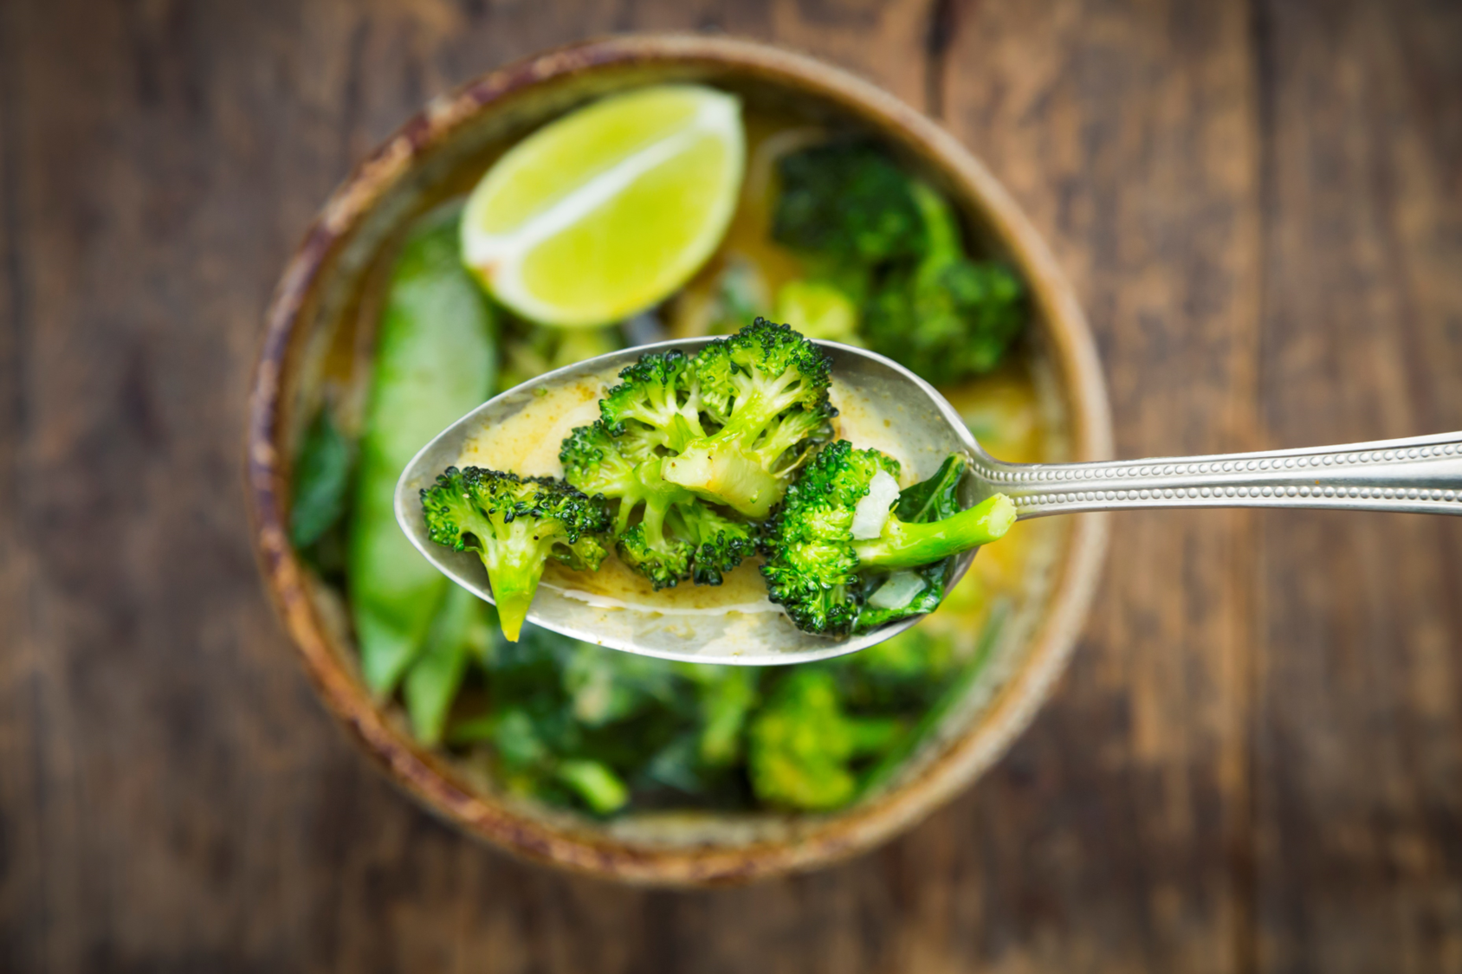
02
Introduction to Global Sustainability and Food Systems

Slide 8
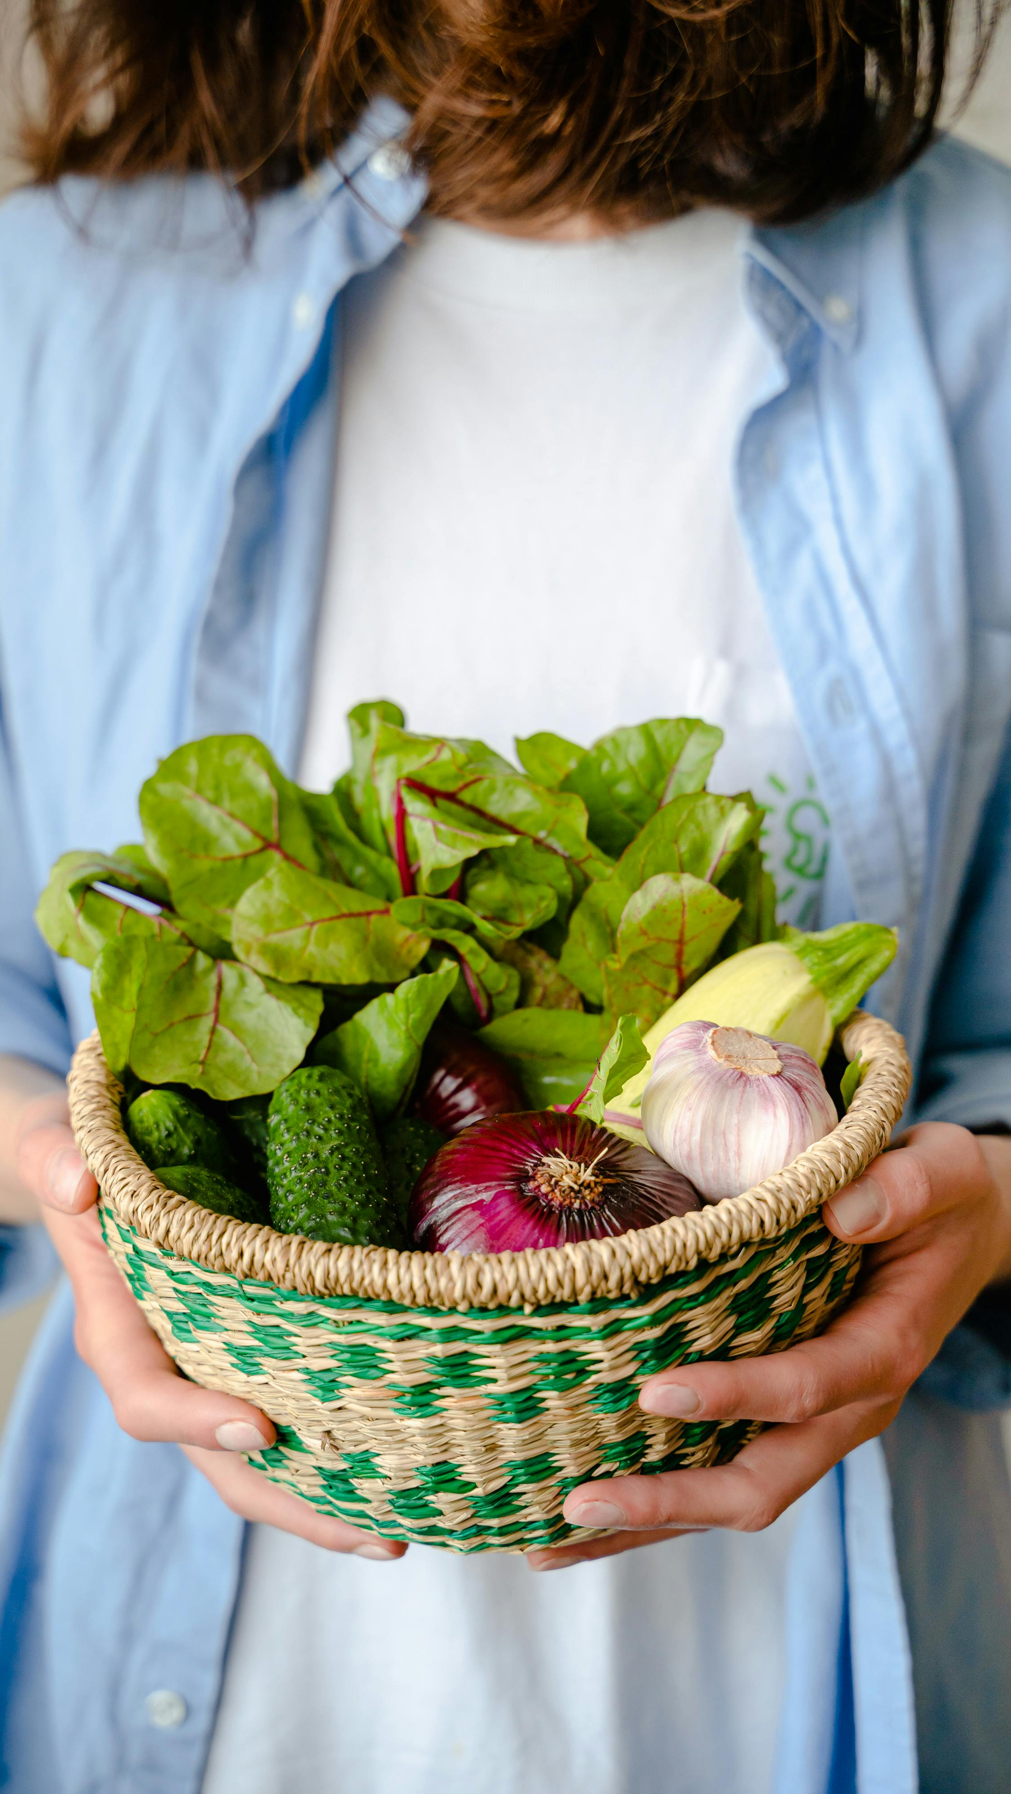
What do we mean by sustainability in food systems?
Sustainability, in the food‐system sphere, means developing and operating food systems that fully meet human needs without compromising the ability of future generations to meet their needs. It implies balancing environmental, social, health, and economic concerns across all aspects from production to consumption.

Slide 9

Sustainable Food Systems
Ensuring access to
sufficient, safe, and
nutritious food for all.
Food
Security
Minimizing harm to
natural ecosystems and
reducing resource
overuse.
Environmental
Stewardship
Conserving resources
by minimizing food
loss and waste.
Waste
Reduction
Promoting fair access
to food and supporting
sustainable livelihoods.
Ensuring food systems
are economically
sustainable for all
stakeholders.
Social
Equity
Economic
Viability
Health
& Wellbeing
Producing diets that
promote health and
reduce disease risks.
Resilience & Adaptability
Adapting food systems
to change and reducing
vulnerability.

Slide 10
How do the Sustainable Development Goals apply?
The Sustainable Development Goals (SDGs) are a set of 17 intersectional goals adopted by UN member states in 2015, aiming to achieve a fairer, more sustainable, and prosperous world by 2030.
The SDGs set out a blueprint for ending hunger, improving health, protecting the environment, and ensuring equality. Global food systems are central to all of this. It’s due to the way we produce what we eat, affect the health of people and the planet, and involve the livelihoods of millions. To reach goals like Zero Hunger (SDG 2), Clean Water (SDG 6), Climate Action (SDG 13), and Life on Land (SDG 15), we need food systems that are not only productive but also sustainable, fair, resilient, and inclusive.

Slide 11
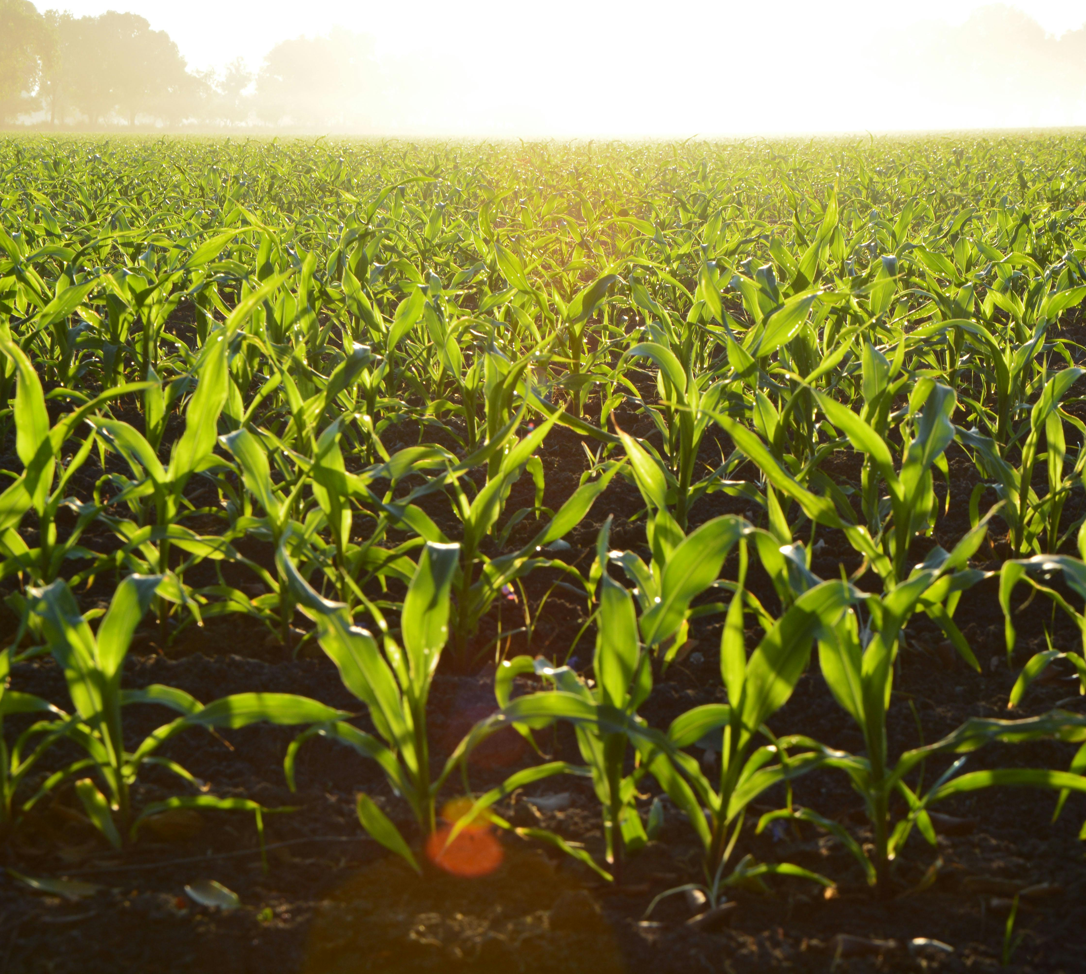
Interdependence of Environment, Economy, and Society in Food Production
For food systems, environmental, economic, and social dimensions are deeply intertwined. The changes in one affect the others.
Sustainable food production means maintaining this balance so that food systems serve human needs now and in the future without degrading the environment, generating inequality, or undermining livelihoods.

Slide 12

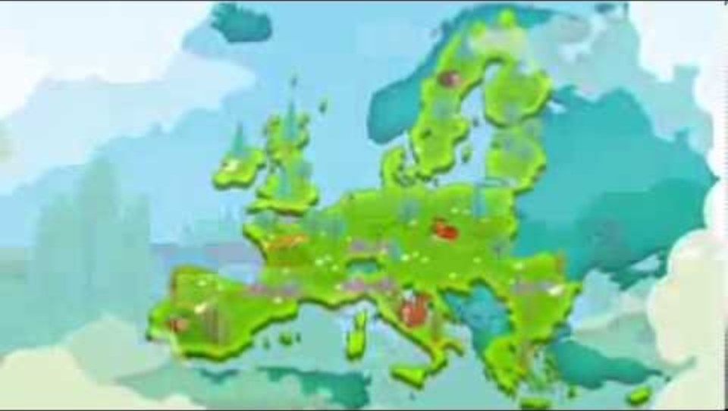
Watch this!
This video focuses on how the Common Agricultural Policy (CAP) aims to make agriculture greener and more efficient.
It addresses natural resource use, climate change mitigation, and biodiversity protection thus illustrating how EU policy links with agriculture’s environmental impacts.

Slide 13
Soil Degradation and Loss of Soil Health
1
The European Environment Agency reports that soil degradation has been worsening in recent years across the EU. Degradation includes erosion, reduction in organic matter, compaction, and declining fertility.
How
Current
Food
Systems
Contribute
to
Ecological
Degradation
Water Resource Stress and Pollution
2
Agriculture is one of the major users of freshwater. Over‑use leads to water scarcity. This is especially true in southern Europe.
Biodiversity Loss
3
Agricultural expansion, especially conversion of semi‑natural land to intensive farming, reduces natural habitat.

Slide 14
Greenhouse Gas Emissions and Climate Impacts
4
Agriculture contributes significantly to greenhouse gas emissions via land use change, methane from livestock, nitrous oxide from fertilizers, and CO₂ from soil and deforestation.
How
Current
Food
Systems
Contribute
to
Ecological
Degradation
Overuse of Inputs and Chemical Dependency
5
Heavy reliance on pesticides and synthetic fertilizers harms ecosystems such as pollinators, beneficial insects, and soil microbes.
Next we look at how these systems play a role in driving inequality.

Slide 15
The Current Food Systems Contribution to Inequality
1. Unequal Access to Healthy and Sustainable Food
Low‑income households in Europe often have less access to high quality, nutritious food. Affordability and availability of sustainable and organic options can be limited.
2. Unequal Exposure to Environmental Hazards
Vulnerable groups are more exposed to polluted water, air pollution, pesticide drift, and degraded environments. These exposures can affect health, nutrition, and livelihood.
3. Disparities Among Farmers and Producers
Smallholder farms, farms in less favourable climates, or poorer regions are more negatively affected by climate change, soil degradation, water scarcity, and lack of access to resources or capital.

Slide 16
The Current Food Systems Contribution to Inequality
4. Inter‑Regional Inequalities
Regions exposed to environmental stress like drought, degraded soils, and marginalised rural areas bear more risk. Those with less infrastructure, institutional support, or investment will be less resilient.
5. Health Inequalities
Poorer populations are more likely to suffer diet‑related diseases due to less access to healthy food, higher exposure to environmental toxins, and less adaptive capacity to climate impacts.

Slide 17

Impact of Food Waste in Food Systems
Systemic
Consequences
Wasted
Resources
Economic Loss
Production
inefficiencies degrade
environment
Inputs used are never
consumed
Producers and retailers
lose money
Environmental
Impacts
Social Inequity
Food insecurity is
greatly increased
Emissions contribute to
greenhouse gases

Slide 18
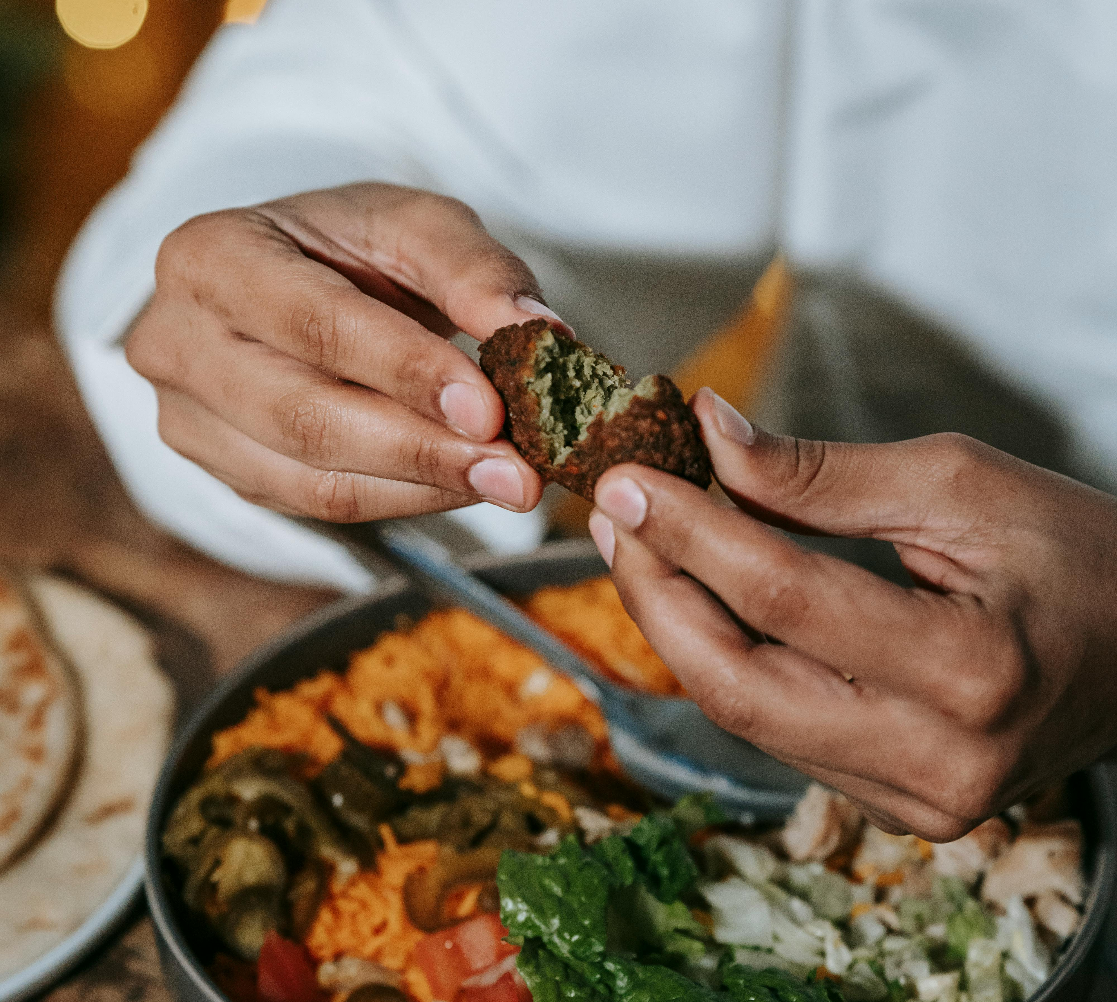
Personal Action & Vision
Reflect on your own eating or food consumption habits.
What changes could you make to align your food choices with a more sustainable, plant-powered, or equitable system?
What challenges might you face?
How could you overcome them?

Slide 19
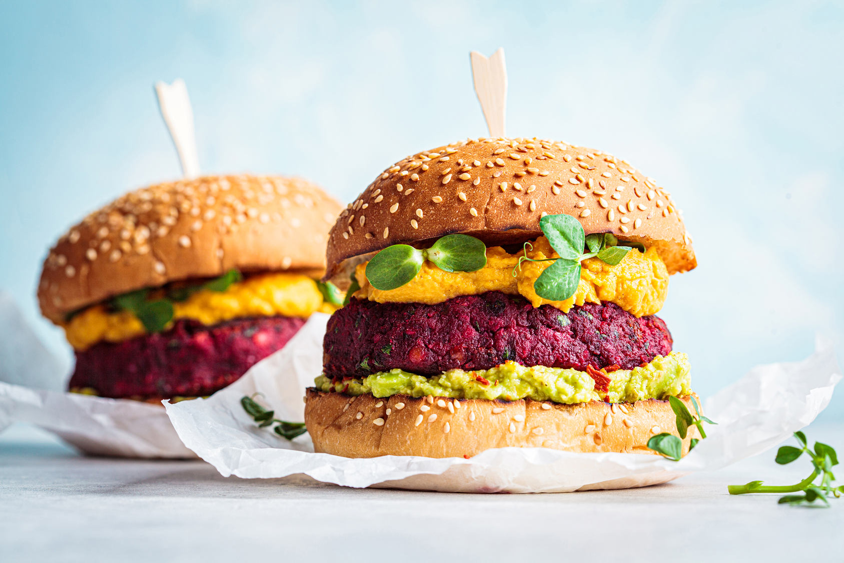
03
The Environmental Case for Plant-Based Diets

Slide 20

What is the European Green Deal?
A roadmap by the EU to make Europe climate-neutral by 2050.
Aims to cut greenhouse gas emissions, restore biodiversity, and reduce pollution.
Transforms how Europe produces, distributes, and consumes food.

Slide 21
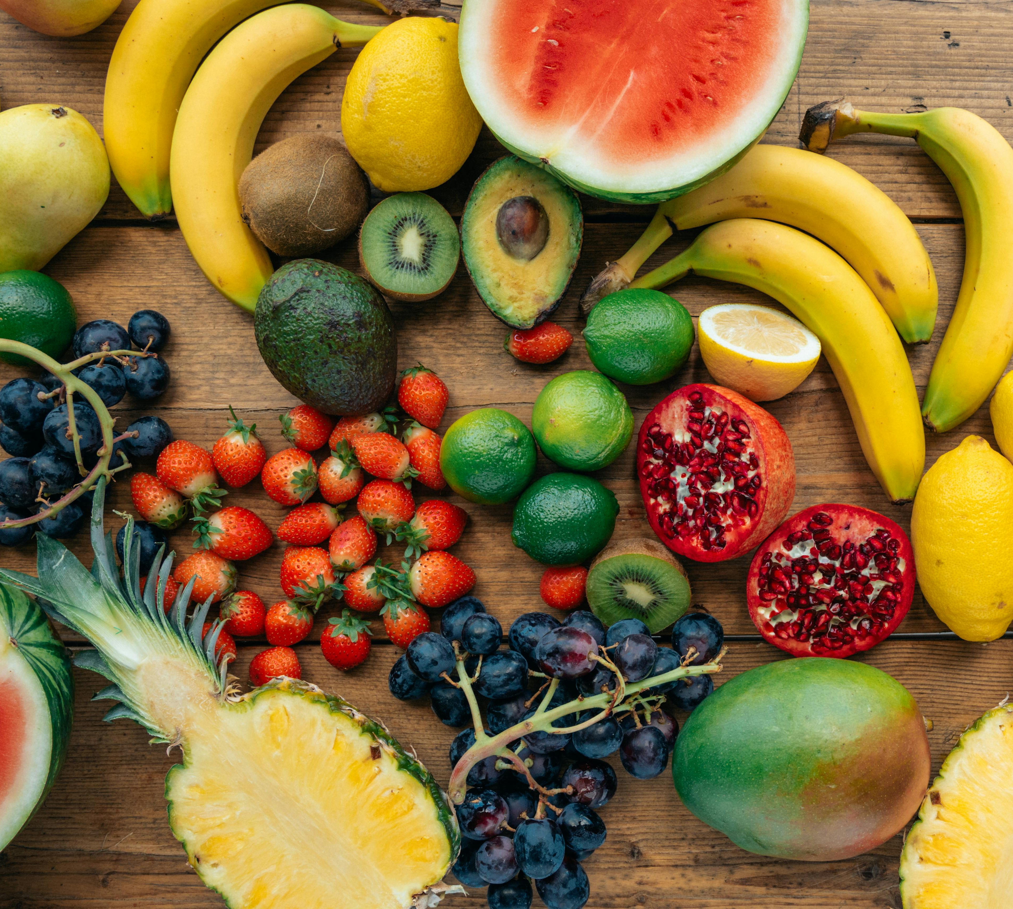
How Plant-Based Diets Fit the Green Deal
Lower Environmental Impact
Animal-based foods produce far more greenhouse gases and use more land and water than plant-based alternatives. Switching to more plant-based diets can reduce the climate and ecological footprint of food systems.
Supports Key Green Deal Targets
Contributes to reducing food-related Greenhouse Gas Emissions by 20%.

Slide 22
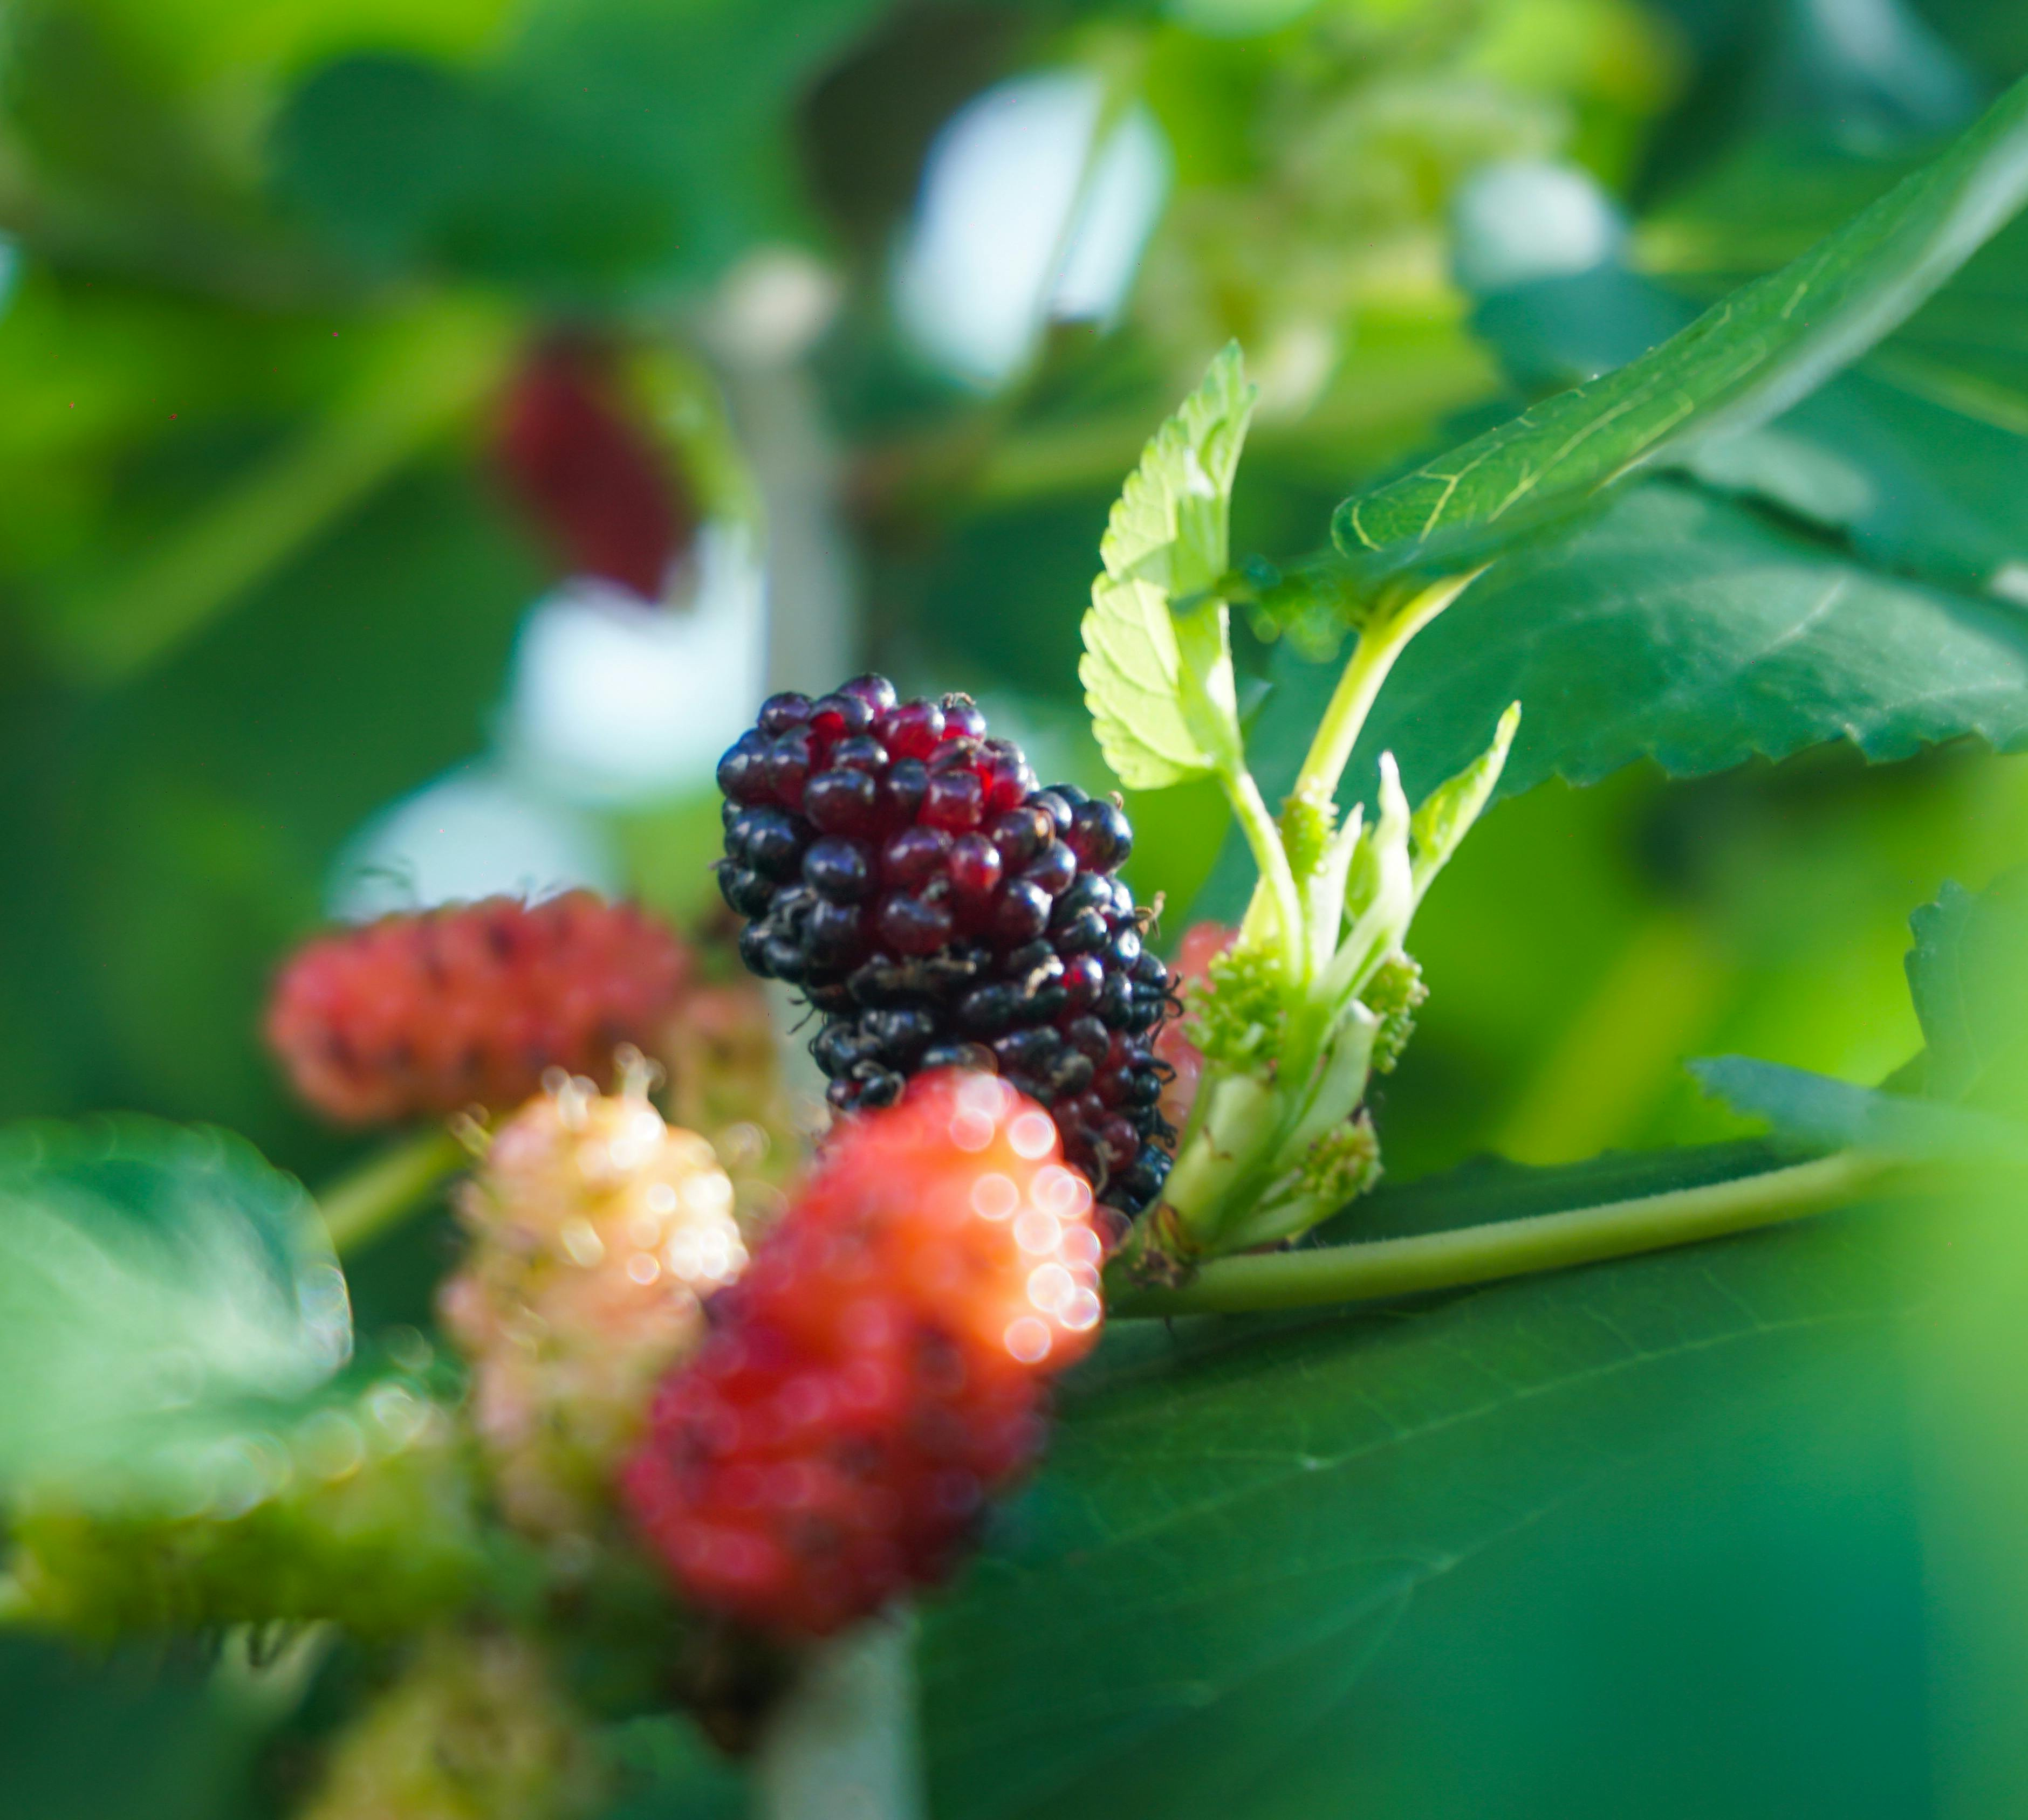
How Plant-Based Diets Fit the Green Deal
Helps cut biodiversity damage by 40–50%. We focus on land use and feed production here.
Aligned with the Farm to Fork Strategy
Promotes sustainable food consumption and healthier diets. Encourages reduction of red and processed meat in EU diets. Supports increased production and access to plant-based protein and legumes.

Slide 23
How Plant-Based Diets Fit the Green Deal
Part of a circular food system vision
Reduces waste across the supply chain. It makes better use of plant resources and by-products. Moreover, it integrates dietary change with sustainable farming and land use.

Slide 24
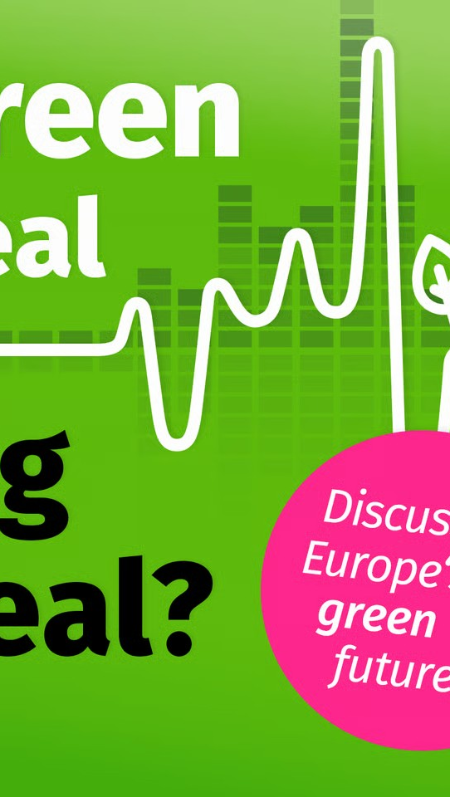
How Do We Reduce Greenhouse Gas Emissions and Resource Consumption?
Episode 4 Farm to Fork: Feeding a continent without wrecking a planet
Sustainability, in the food‐system sphere, means developing and operating food systems that fully meet human needs without compromising the ability of future generations to meet their needs.
It implies balancing environmental, social, health, and economic concerns across all aspects from production to consumption.
CLICK & LISTEN!

Slide 25

Food/Animal Product Type
Beef
29%
Cow’s milk
29%
Pork
26%
Other
Livestock
Products
16%
Percentage of Total
EU Livestock Emissions
Greenhouse Gas Emissions by
Food/Animal Product Type in EU

Slide 26
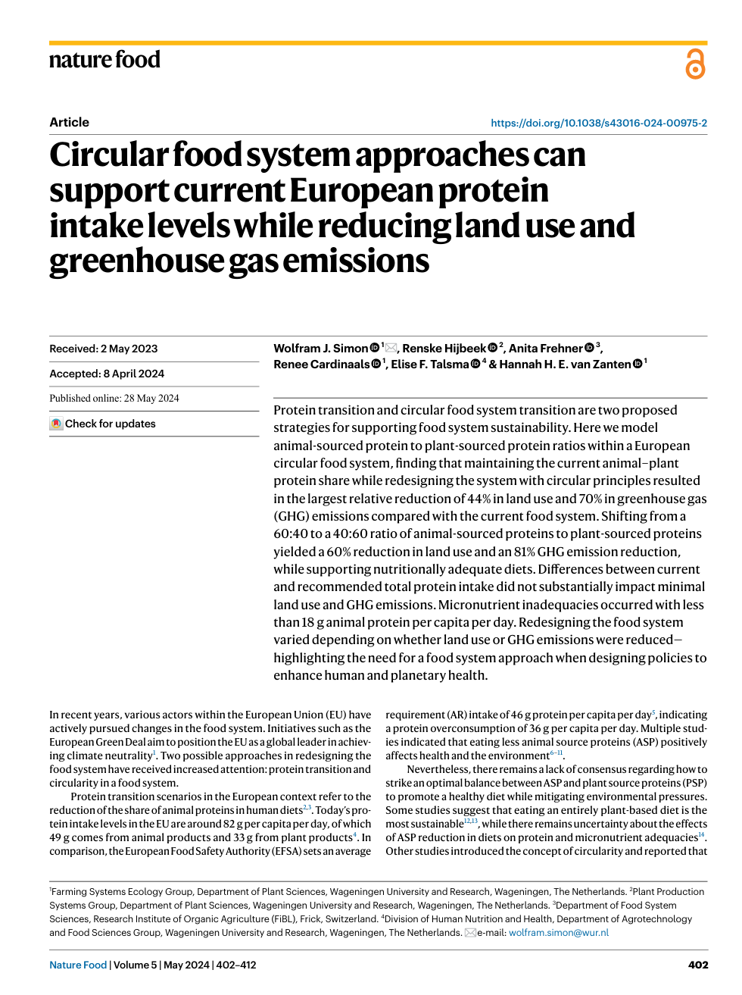

Read this!
This article by Nature Food discusses circular food system approaches and will help you further understand the environmental footprints of animal vs. plant-based foods.
FOLLOW LINK

Slide 27
Role of Agriculture in Deforestation
1. European import demand drives deforestation abroad
The EU is responsible for about 16% of tropical deforestation associated with international trade. Key commodities linked to this are soy, beef, palm oil, and others like cocoa, coffee, rubber. In 2017, approximately 203,000 hectares of tropical forest were cleared because of EU‑imported commodities which contributing to 116 million tonnes CO₂ emissions.
2. Agricultural expansion and feed demand
Livestock farming requires large amounts of feed for which soy is one of the major feed crops.

Slide 28
Role of Agriculture in Deforestation
The demand for feed, especially from non‑EU countries where deforestation risk is higher, contributes significantly to forest land conversion. The EU’s Common Agricultural Policy (CAP) has historically played a role in shaping this demand through subsidies or incentives, and some reports point out that CAP reforms are needed to reduce incentives for deforestation.
3. EU regulation to tackle deforestation
The EU Regulation on Deforestation‑free Products (EUDR, Regulation 2023/1115) was adopted to ensure that certain commodities entering the EU market do not come from recently deforested land.

Slide 29

Role of Agriculture in Deforestation
The regulation covers products like cattle, soy, palm oil, wood, rubber, cocoa, coffee, etc. The regulation aims among other things to reduce greenhouse gas emissions and biodiversity loss by stopping agricultural expansion that causes deforestation and forest degradation.

Slide 30
Role of Agriculture in Pollution
1. Agricultural pollution affecting water and ecosystems
Agriculture is a major source of nutrient pollution which runoff into water bodies causing algal blooms, and low oxygen. The EU Commission and European Environmental Agency reports frequently list fertiliser runoff, pesticide use, and manure management in livestock as key contributors. Usage of pesticides and other agrochemicals also leads to contamination of soil, water, and harm to pollinators as they cause ecosystems to lose resilience.
2. Air pollution and emissions from agricultural practices
Agricultural activities generate emissions not just of CO₂ but also methane, nitrous oxide from fertilizer. These contribute both to greenhouse gas warming and to local air quality problems.

Slide 31
Role of Agriculture in Pollution
Manure management, feed production, and land conversion release the carbon stored in soil and vegetation.
3. Soil degradation and biodiversity decline
Agricultural expansion often involves clearing land which reduces habitat and diversity in species. Soil erosion, loss of organic matter, compaction from heavy machinery, and pesticide use all contribute to degradation of soil health. They weaken the system’s ability to filter water, store carbon, sustain yields, etc.

Slide 32
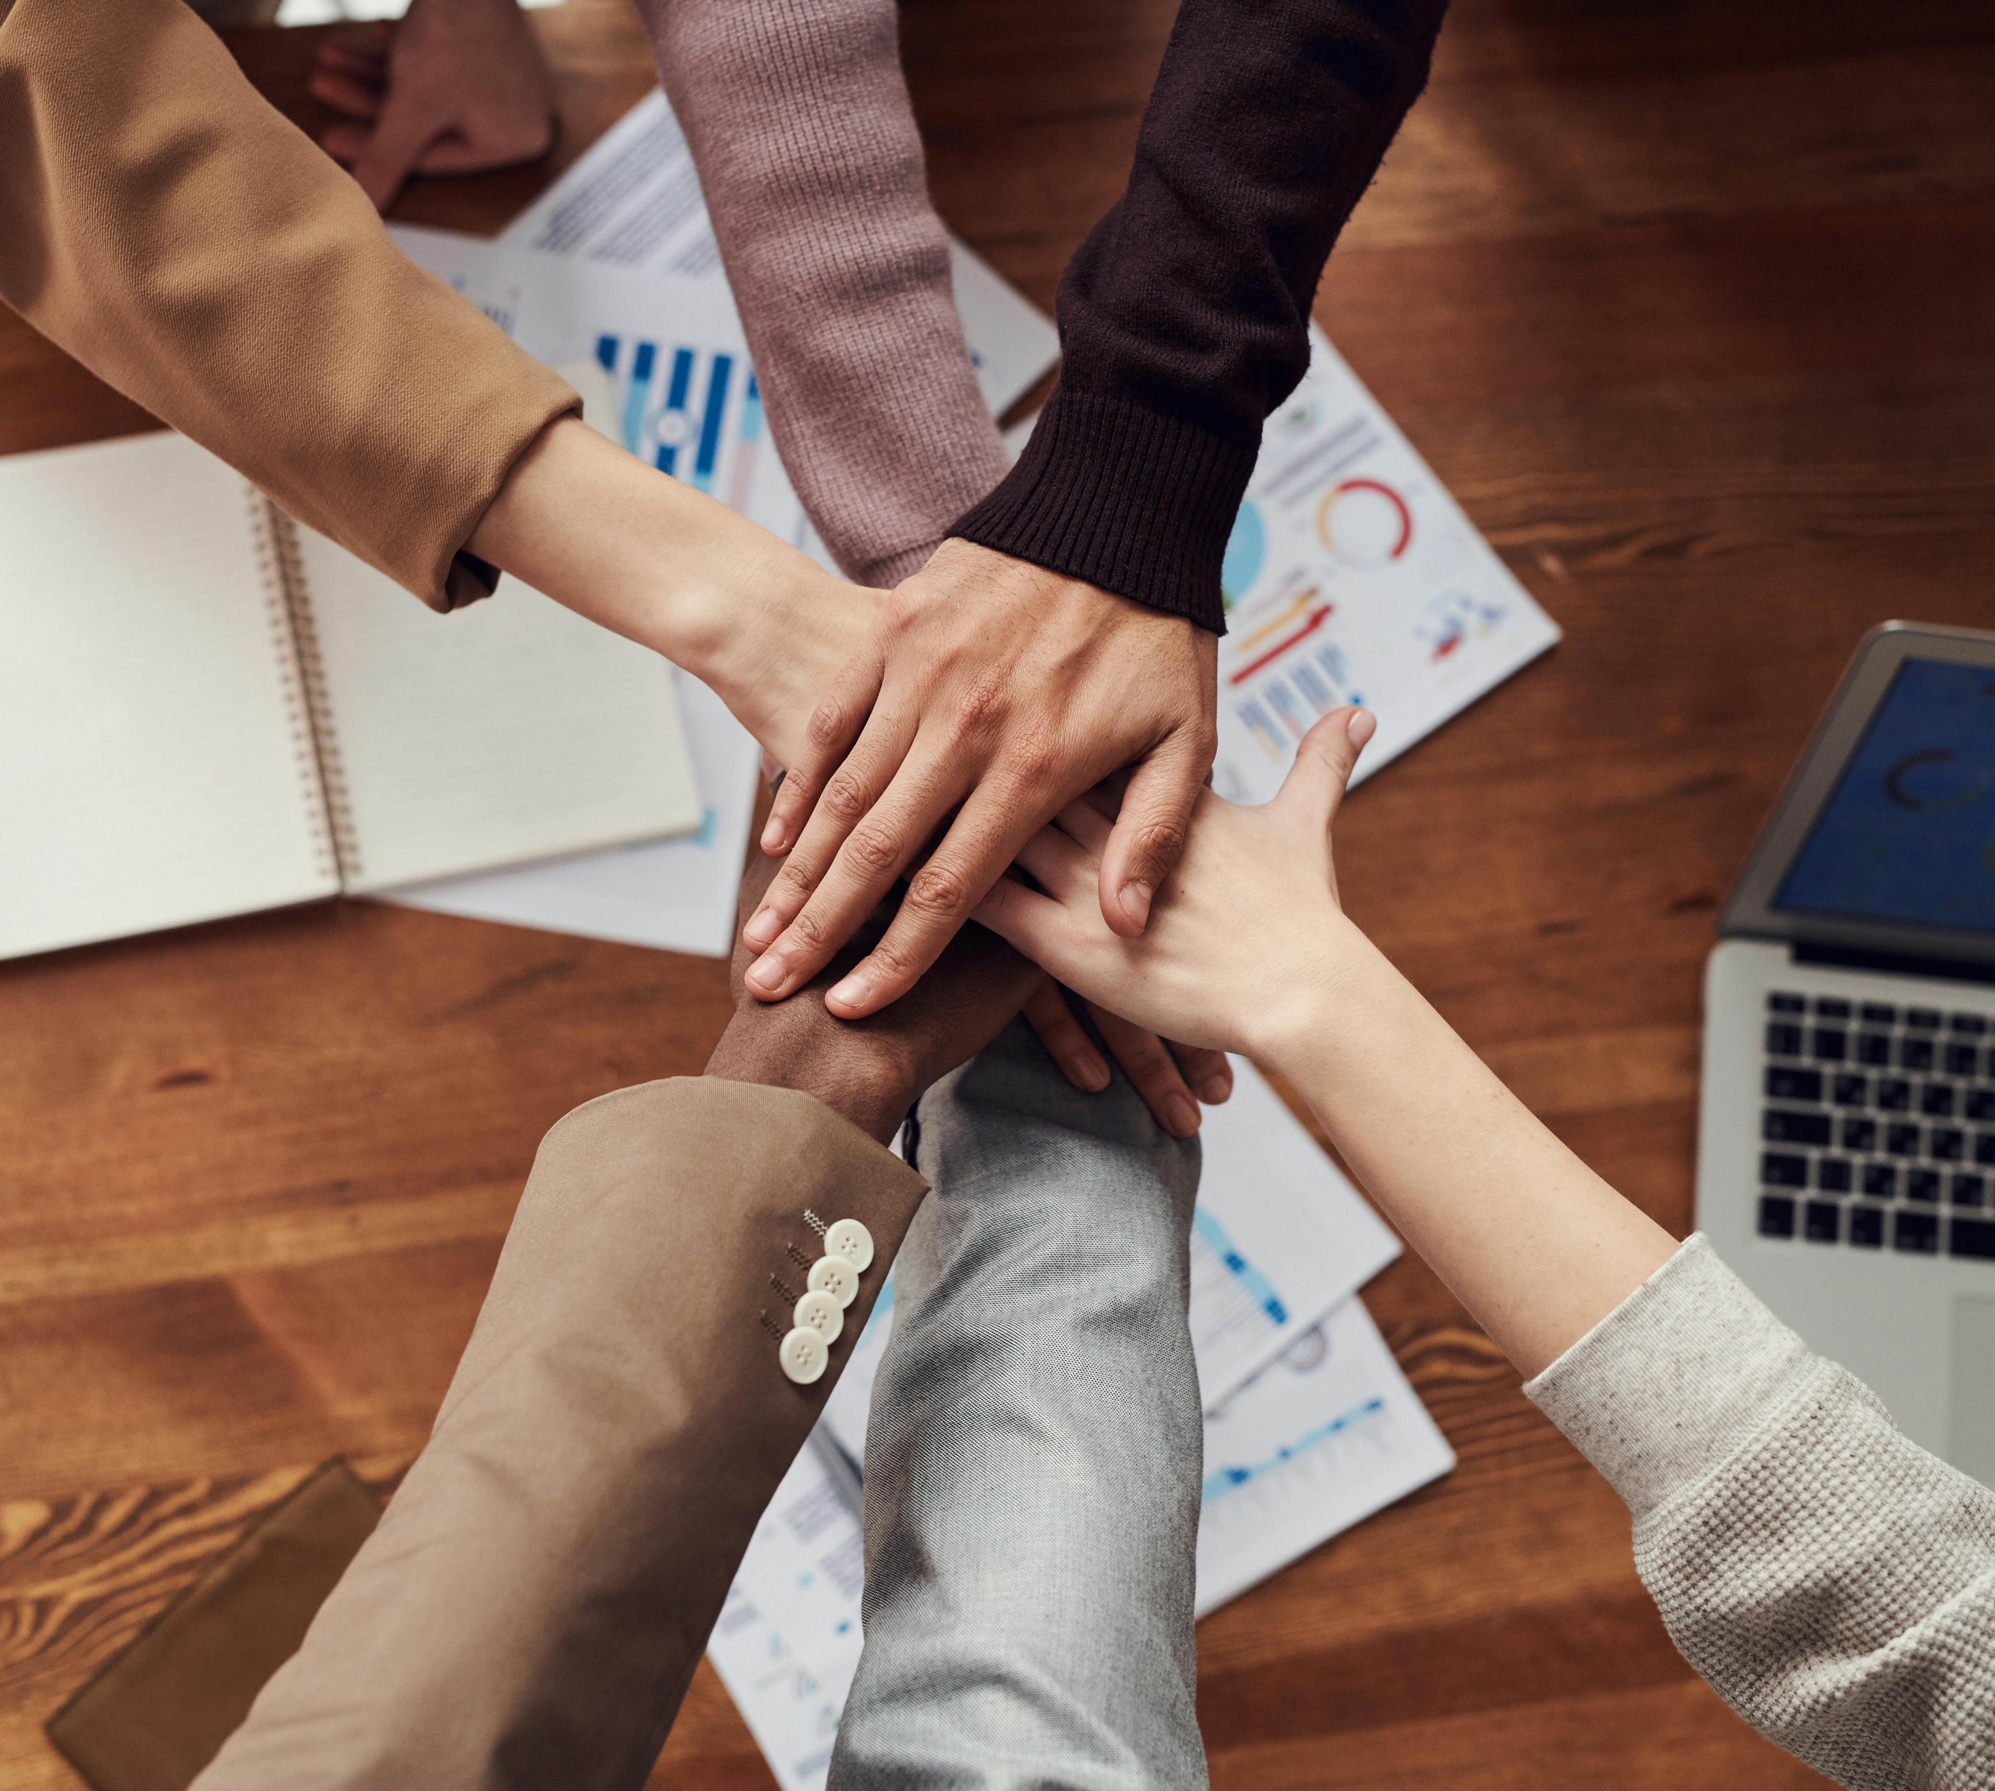
Group Activity: Sustainable Meal Plan
Step 1 – Menu Planning (15 mins) Each group creates a breakfast, lunch, and dinner menu using mostly plant-based foods. They must minimize foods with high GHG emissions such as beef, cheese, etc. Include foods with low land and water use like legumes, and seasonal vegetables. Avoid or reduce ultra-processed items and food waste.

Slide 33
Group Activity: Sustainable Meal Plan
Step 2 – Impact Justification (5–10 mins) For each meal, the group adds a short justification. It must include
Why is this food environmentally better?
How does it support sustainability or align with the Green Deal?
Step 3 - Presentation (5 mins per group) Groups can briefly present their menu and reasoning to the class.

Slide 34
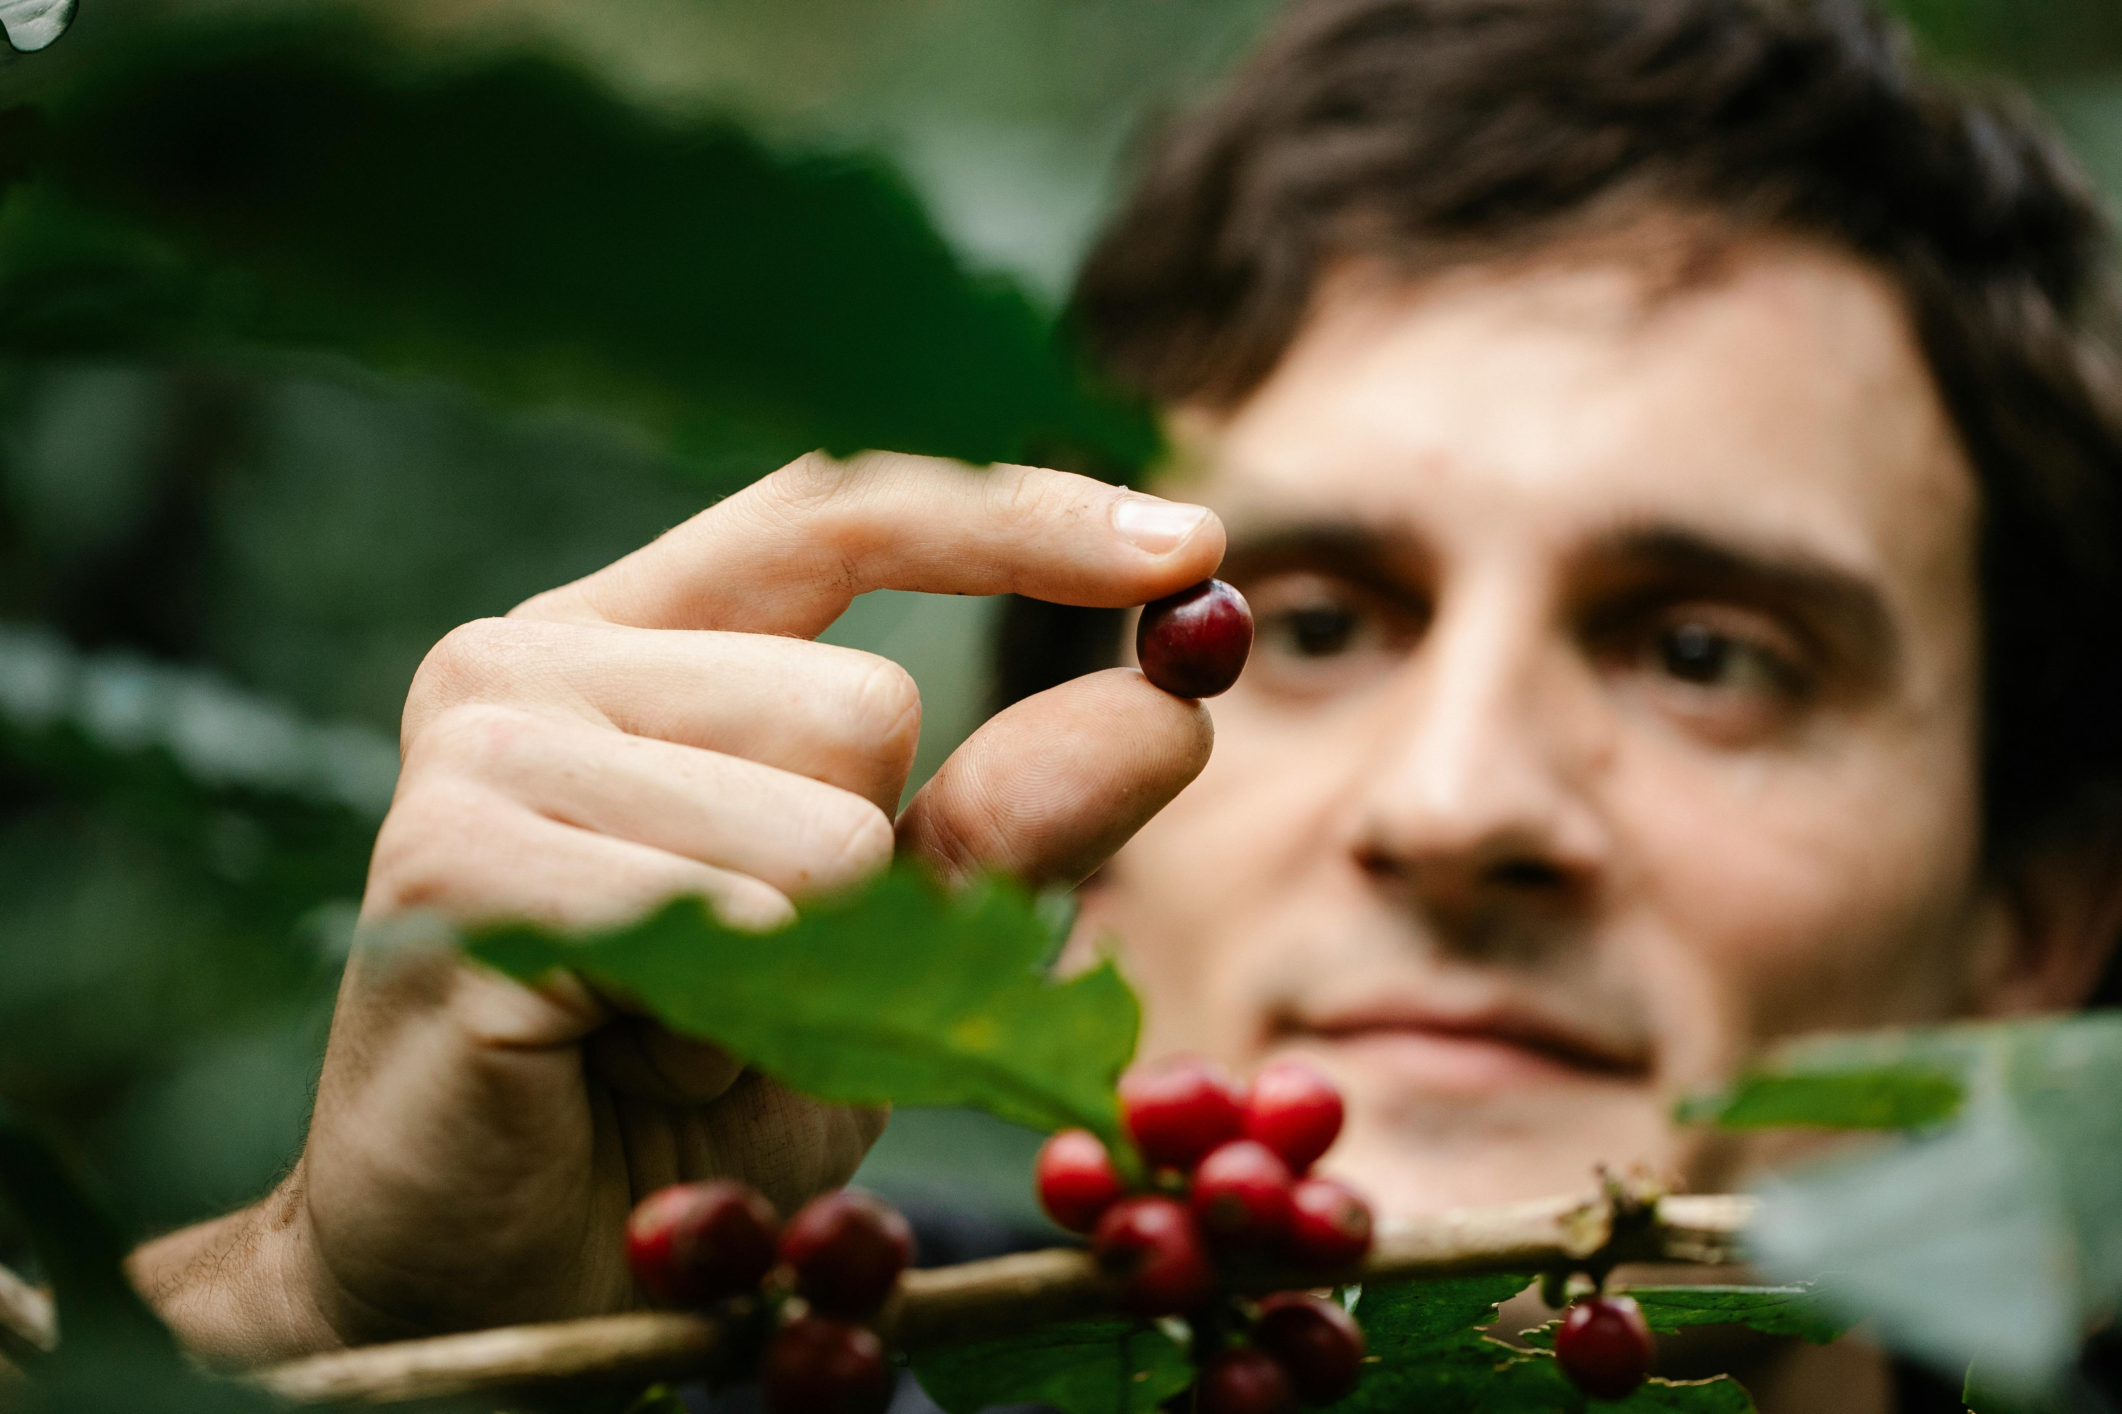
04
Food, Ethics, and Social Justice

Slide 35

Ethical Dimensions of Food Choices
Animal
Welfare
Labour
Rights
Access &
Equity
Ensuring humane
treatment and care
for animals in food
production
Upholding fair and
safe working
conditions for food
producers
Guaranteeing equal
access to safe and
healthy food for all

Slide 36
Ethical Issues in Industrial Farming
1. Animal Welfare
Animals are often kept in high stocking densities, with restricted movement. This can mean confinement in cages or cramped barns. Welfare issues include stress, inability to exhibit natural behaviours, mutilations. While specific EU law regulates some of this, there are still arguments related to the standards not being sufficient.
Transport and slaughter practices can also lead to suffering due to handling, distance, and poor conditions. Even though regulated, the compliance and enforcement can vary.
2. Environmental & Health Impacts that Affect Ethics
Antibiotic use to control disease in high‑density systems can lead to antibiotic resistance, which is a public health, and ethical issue.

Slide 37
Ethical Issues in Industrial Farming
Industrial animal agriculture contributes heavily to greenhouse gas emissions, pollution, and biodiversity loss. These environmental harms affect both animals and human communities.
3. Equity, Social Justice and Workers
Conditions for labour are also a concern. Many workers in industrial systems may face difficult working conditions, exposure to hazardous materials, low pay, and little power to influence practices.
4. Moral Responsibility and Beyond
Industrial farming benefits from large subsidies like the EU CAP programs,
which can perpetuate inefficiencies and environmental harm. However, the public cost is not always reflected in prices.

Slide 38
Benefits of Regenerative Farming
1. Animal Welfare and More Natural Conditions
Regenerative systems tend to use more natural grazing settings, and offer more space for animals to express natural behaviour. Animals are integrated in ways that mimic natural cycles. These practices lead to better welfare, less stress, and often better health.
Because inputs such as medicines and antibiotics are reduced, animals have better immune responses, and more robust health overall.

Slide 39
Benefits of Regenerative Farming
2. Environmental Ethical Alignment
Regenerative agriculture supports soil health, biodiversity, carbon sequestration, cleaner water, less pollution. These environmental goods are tied to ethical concerns that include the welfare of future generations, rights of ecosystems, and non‑human animals.
For example, an EARA report showed regenerative farms use 76% fewer pesticides, less synthetic nitrogen, more plant diversity and soil cover.

Slide 40

Benefits of Regenerative Farming
3. Resilience, Equity and Local Benefit
Regenerative systems often emphasize local feed sources, lower dependency on external inputs, and more resilience to shocks. This can distribute benefits more equitably among farmers, reduce risk for smallholders, and reduce environmental burdens.
Ethical food systems include not only welfare of animals, but also welfare of communities, consumers, and environment.

Slide 41
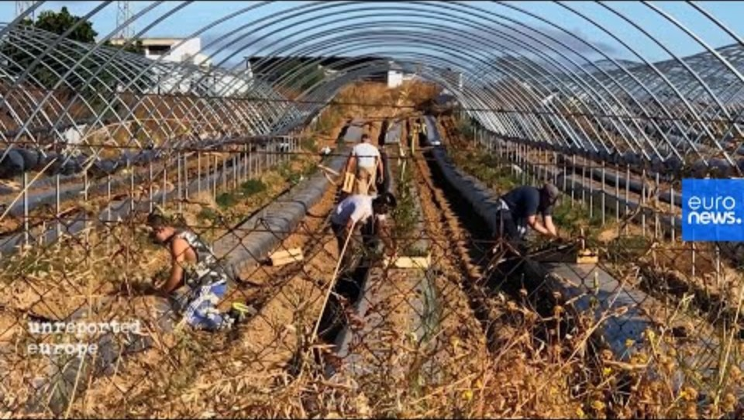
Why Worker’s Rights Matter
This video will help you understand why worker’s rights in agriculture are important in food production.
From Spain, this documentary exposes working conditions of agricultural workers, including wage issues, hours, treatment, and more.
.

Slide 42
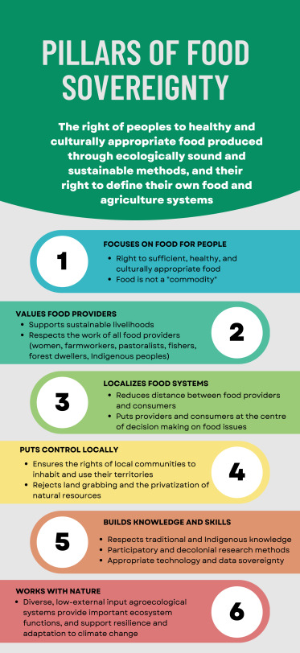

Get to Know Why Plant-Based Diets Benefit Food Sovereignty
This academic document gives you a theoretical and practical link between who controls the food system, what is produced, and how diets can shift.
Click and read for more!

Slide 43
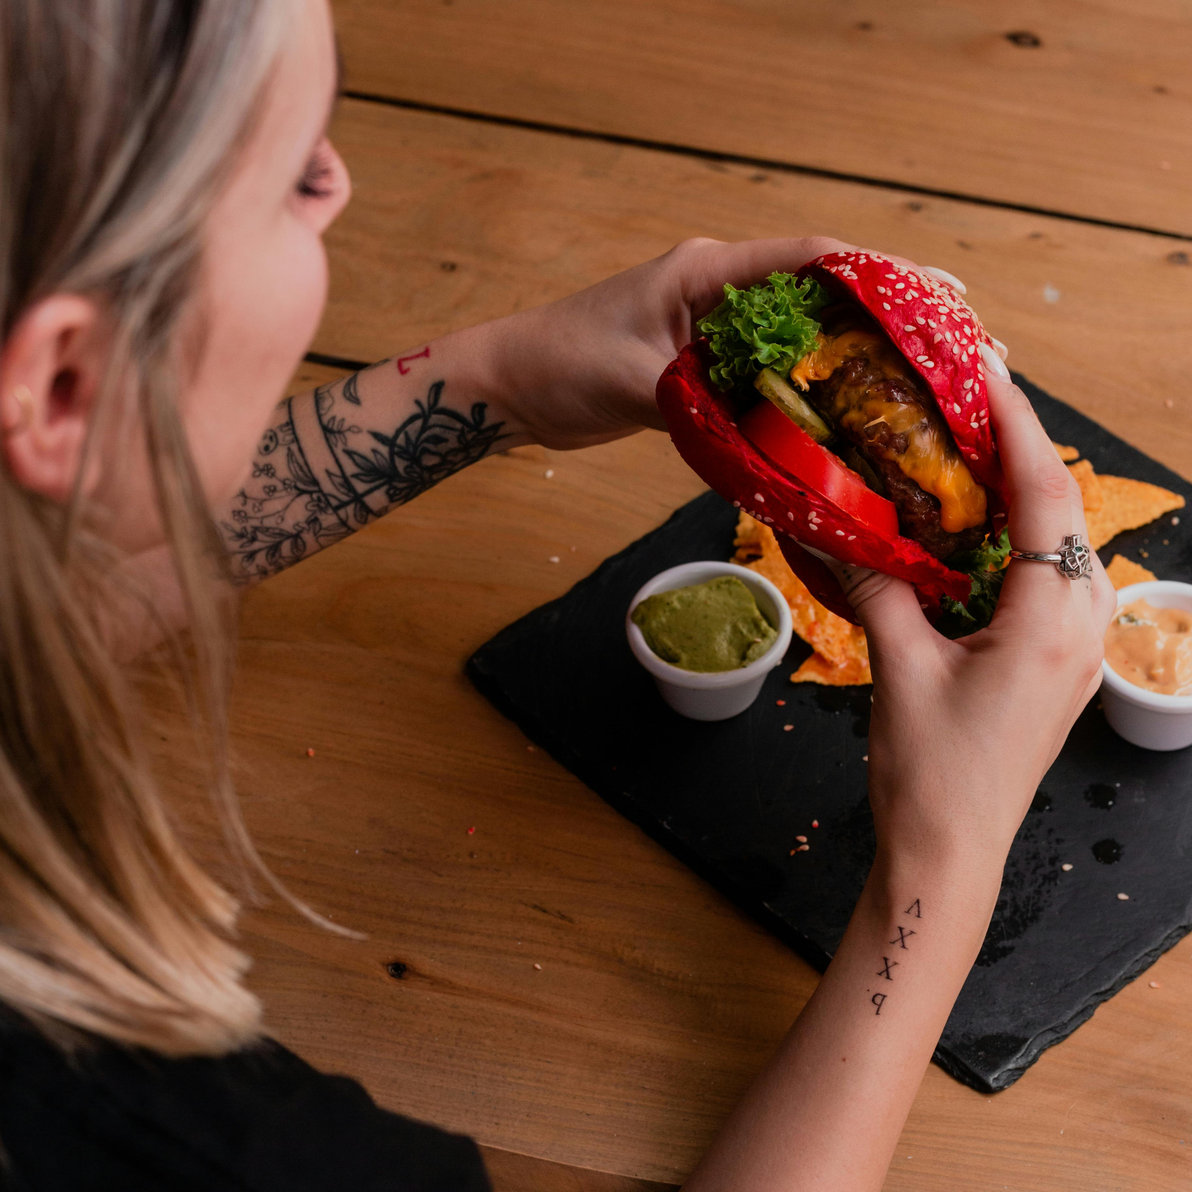
Reflection time!
Write a short essay and focus on what you have learned.
Answer the following question: What does food justice mean to you?

Slide 44
05
Vision: Future Food Systems

Slide 45

What is Futures Thinking?
A systematic exploration of possible and desirable futures to improve decision-making today. It embraces uncertainty, considers multiple pathways, and uses creative and participatory methods such as, scenario planning, foresight, and design fiction.
You explore how current choices shape future outcomes. It is used by EU institutions to support anticipatory governance, sustainability, innovation, and resilience.

Slide 46
How do we define Speculative Design?
It’s a forward thinking, and critical design approach that uses fictional, imagined, or future scenarios to explore what could be. Speculative Design encourages reflection, dialogue, and ethical inquiry.
It is widely used across Europe in public policy, education, and research to envision alternative futures, and stimulate inclusive conversations about change.

Slide 47

Futures Thinking and
Speculative Design Approach
Ethics &
Values
Multiple
Futures
Inclusivity &
Participation
Embeds values and
ethical
considerations
Explores different
plausible future
scenarios
Involves diverse
stakeholders in
envisioning futures
Present
Future
Critical
Reflection
Actionability
Speculative
Artefacts
Steers futures
through policies and
shifts
Examines current
trends and
weaknesses
Provokes thought
with tangible
prototypes

Slide 48

Best Practice: Nordic Harvest (Denmark)
Founded in 2020, this is a vertical farm that uses renewable energy, robotic technology, and various resource‑efficient systems. It’s the largest one in Europe.
What they do:
Their farm structure allows them to produce 200× more greens per square meter compared to conventional farming.
They use less water, nutrients, fertilizers, and recycle many of them.

Slide 49
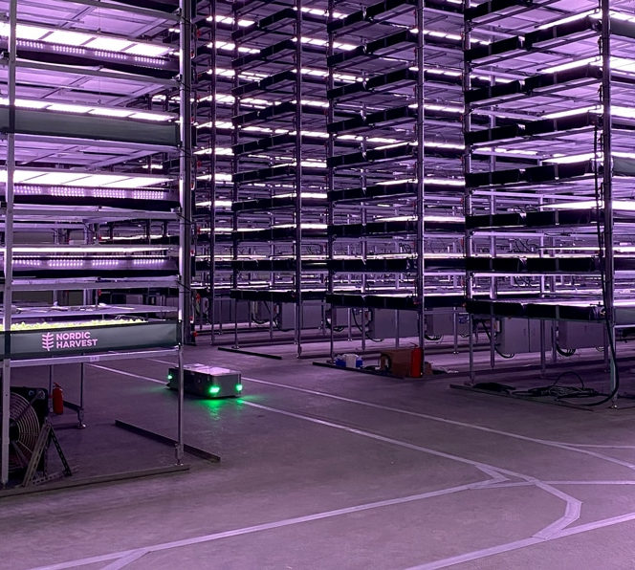
Best Practice: Nordic Harvest (Denmark)
The farm is powered in part by renewable energy and is designed to reduce its dependency on “weather conditions” so production can be steady all year.
Being located in or near urban areas helps cut down transportation emissions, ensures fresher produce, and reduces spoilage or logistic waste.

Slide 50
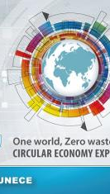

Understand the Circular Economy
Listen to this podcast by the United Nations Economic Commission for Europe (UNECE) to understand this concept.
It explores what a circular economy means in practice while touching on waste, innovation, and natural capital with expert guests.
CLICK ON THE IMAGE

Slide 51
A Zero-Waste System
Zero Waste is a design and management approach that aims to eliminate waste entirely by ensuring that all products, packaging, and materials are reused, repaired, recycled, or composted. It seeks to eliminate burning or sending waste to landfills.
Key Principles:
1. Design Out Waste
Products are designed to be long-lasting, repairable, and recyclable with no unnecessary packaging.

Slide 52
A Zero-Waste System
2. Refuse and Reduce
Avoid creating waste so rejects single-use plastic, thus reducing consumption.
3. Reuse and Repair
Promotes second-hand use, repairability, and systems like refill stations.
4. Recycle and Compost
Ensures any remaining waste is either recycled or composted not incinerated or send to a landfill.
5. Systems Thinking
Focuses on closed-loop systems where “waste” becomes a resource for another process.

Slide 53

Action: Sustainable
Food Pledge
Reflect: Think about what you have learned and your current food habits. What you eat, where your food comes from, how much you waste, and how your choices might affect the environment or others.
Write Your Sustainable Food Pledge: Create a short pledge and action plan to improve the sustainability of your food habits. Use the worksheet or template provided.

Slide 54
Action: Sustainable
Food Pledge
This activity encourages you to reflect on your current food habits and commit to small, meaningful actions that support sustainable, ethical, and plant-forward food systems. Use the template below to write your own pledge and action plan.
Name: ___________________________
Date: ____________________________
Pledge:___________________________

Slide 55
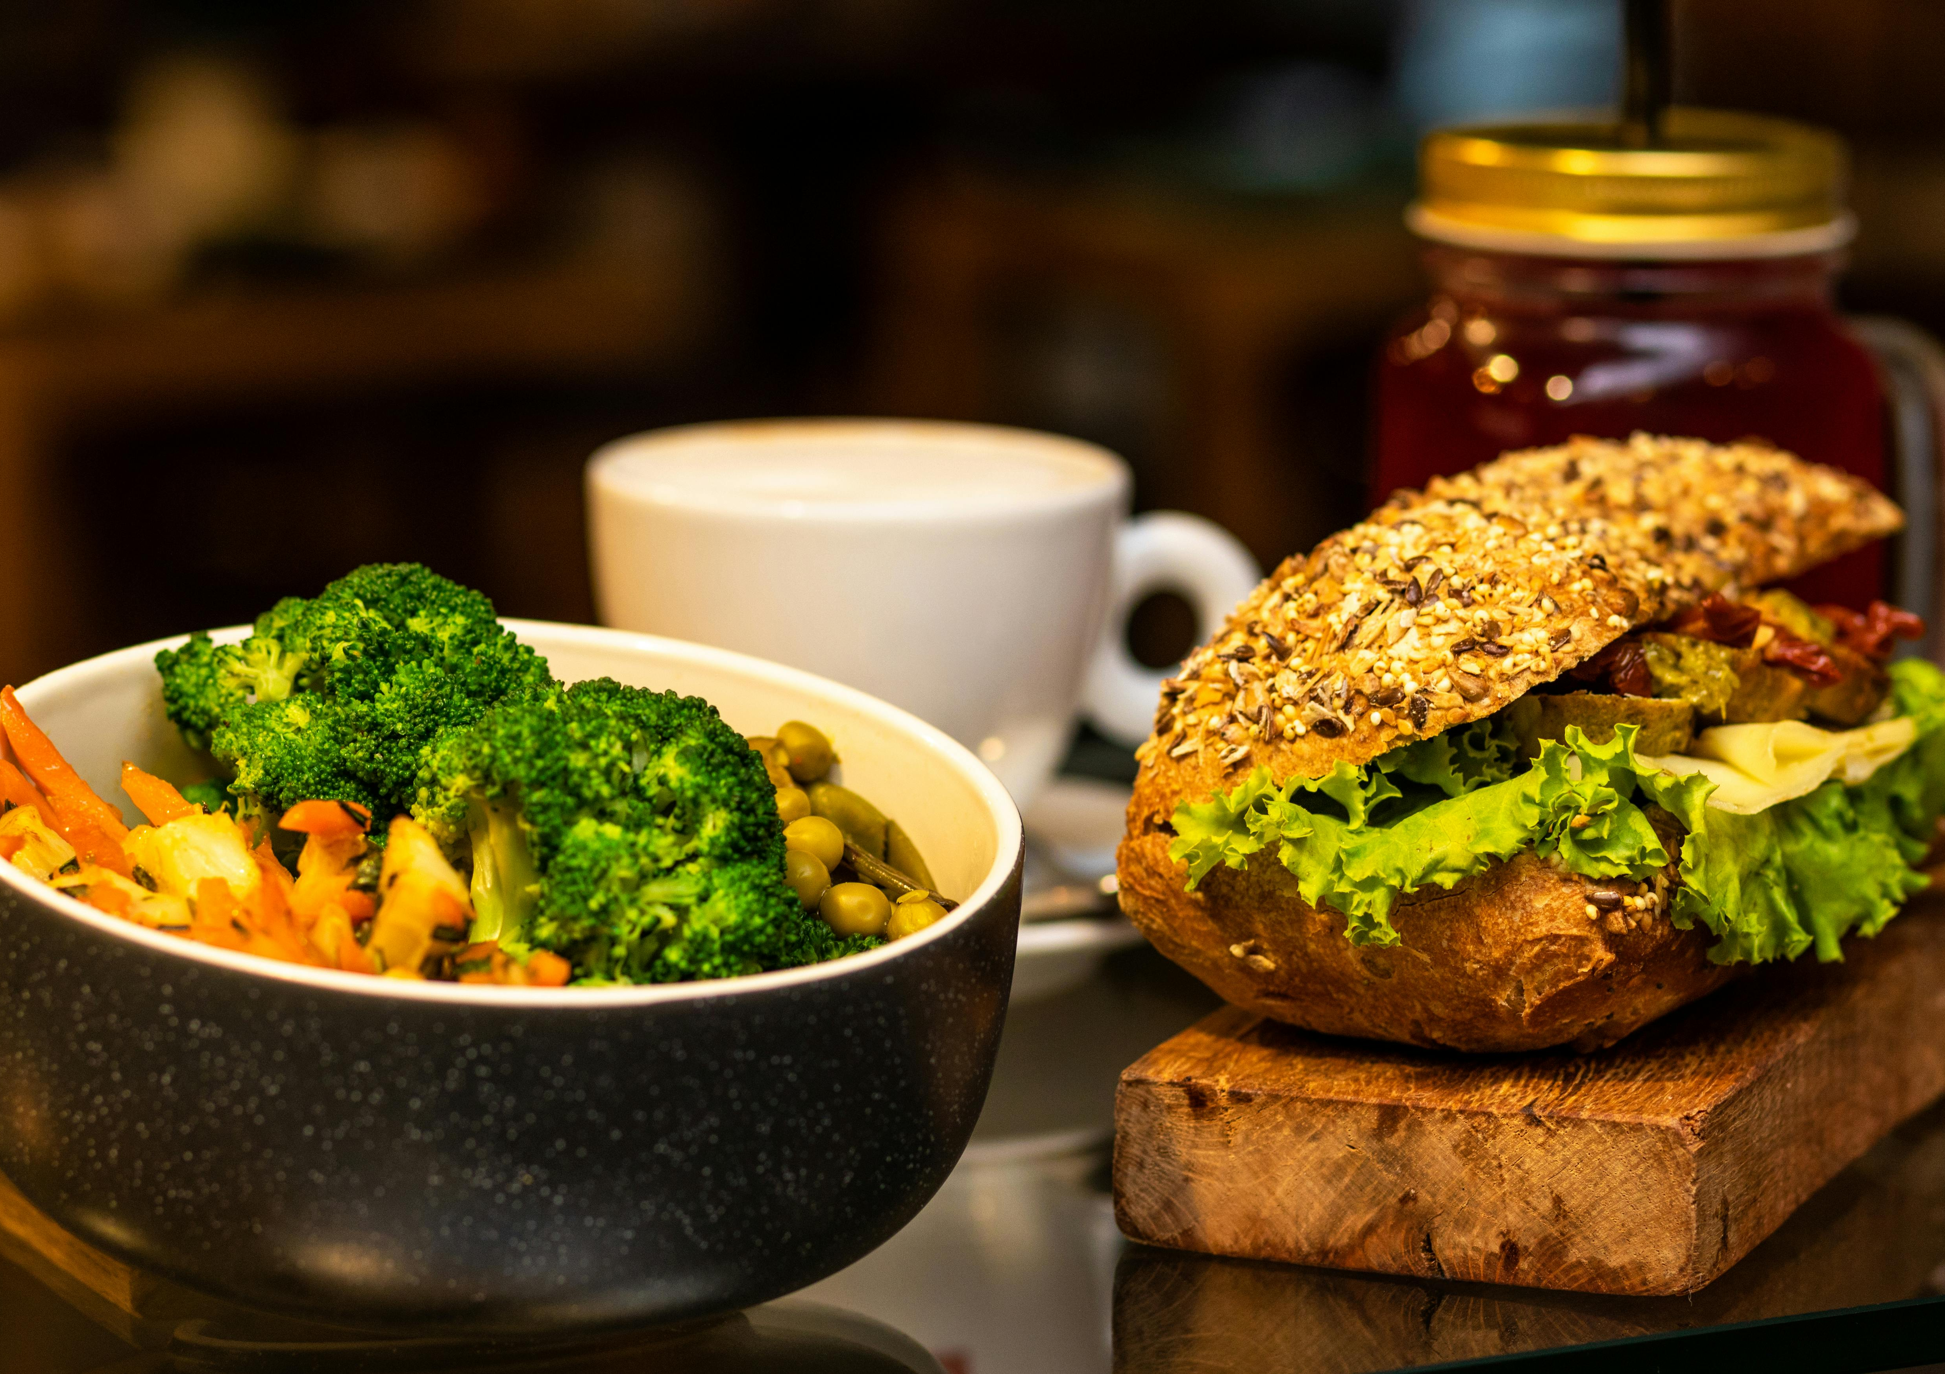
06
Learning Summary

Slide 56
What You Learned:
Global Sustainability and Food Systems
Sustainability in food systems means meeting current food needs without compromising future generations’ ability to do the same.
The UN Sustainable Development Goals (SDGs) emphasise food security, climate action, biodiversity, health, and social equity.
Food production is deeply interconnected with the environment, economy, and society, requiring us to think about systems and inclusive governance.
Inefficiencies like food waste and hunger highlight global inequity. Overproduction and loss coexist with undernourishment.

Slide 57
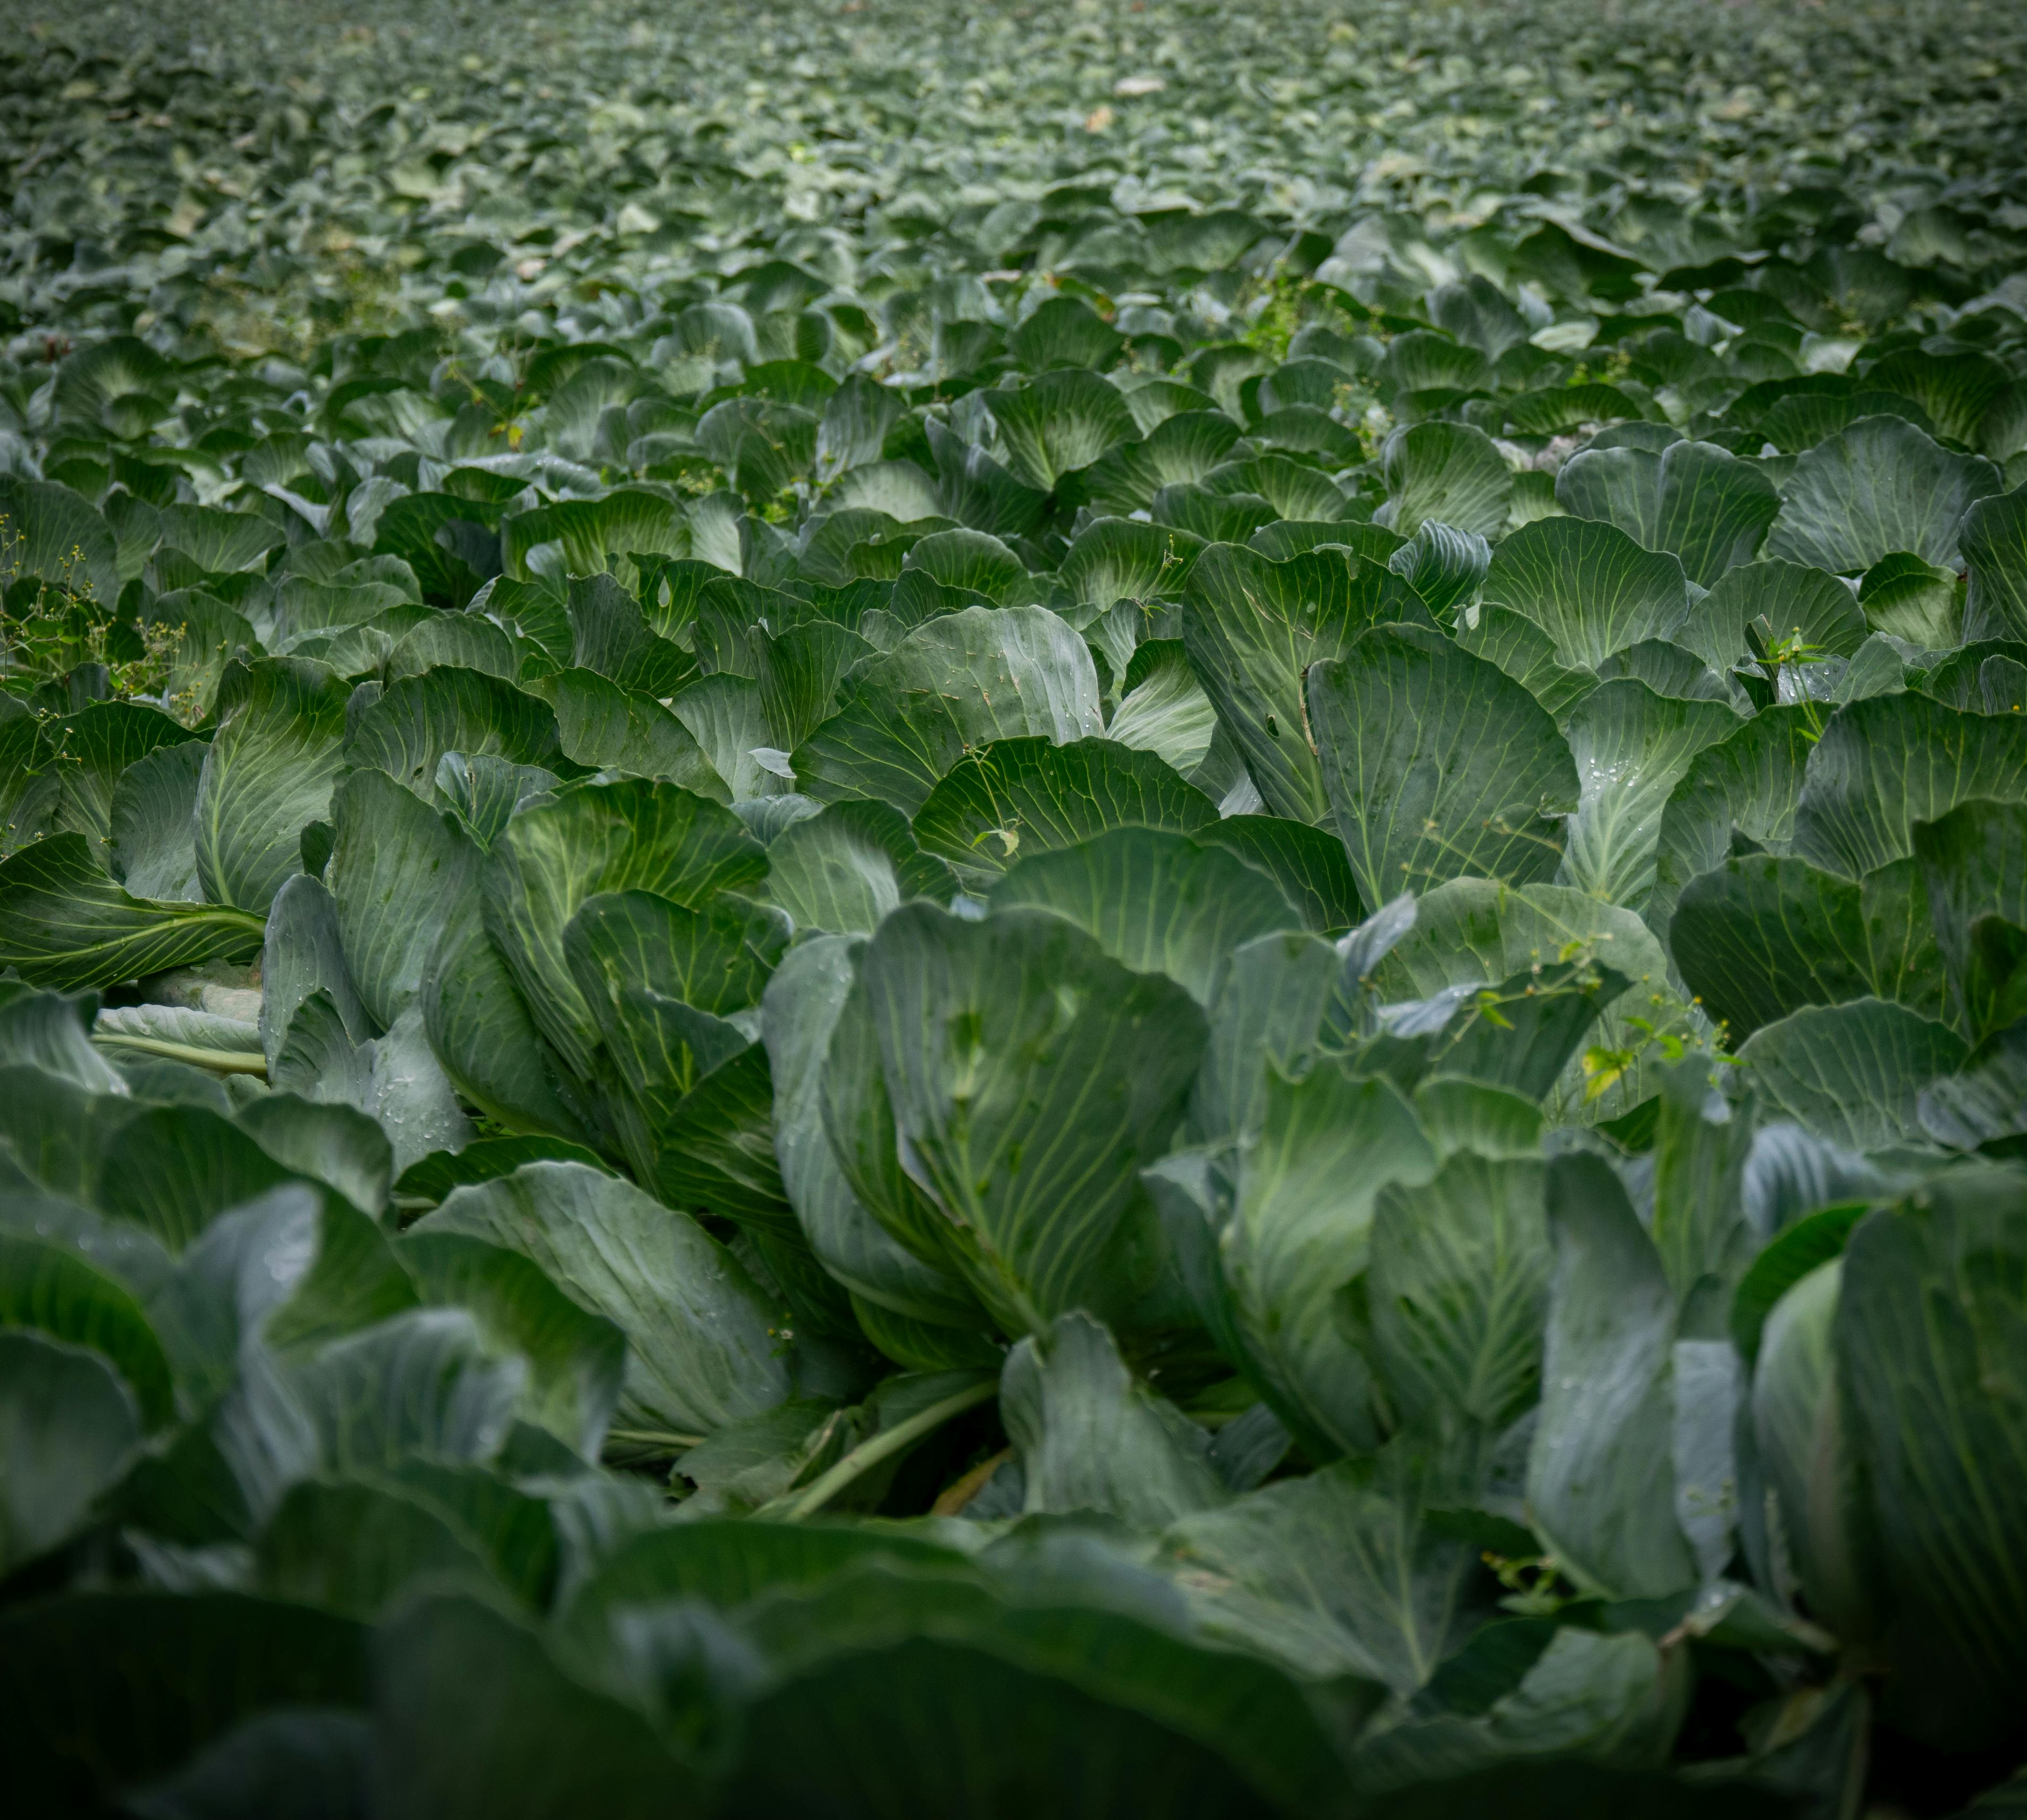
The Case for Plant-Based Diets
Plant-based diets help reduce greenhouse gas (GHG) emissions, land use, water use, and pollution which hare the key drivers of the EU Green Deal goals.
Animal-based foods have higher environmental footprints than plant-based alternatives.
Research shows plant-based diets align with food sovereignty by boosting local production, reducing import dependence, and supporting biodiversity.

Slide 58
Food, Ethics, and Social Justice!
Ethical food systems consider animal welfare, fair labour rights, and equitable access to healthy, affordable food.
Industrial animal farming raises animal ethics issues pertaining to regenerative practices which aim to rebalance ecosystems and animal to human relationships.
Food inequality persists in Europe, and faces barriers to access based on geography, income, or systemic exclusion.
In order to have justice play a role in food systems, we must include empowering small producers, protect workers’ rights, and ensure consumer transparency.

Slide 59
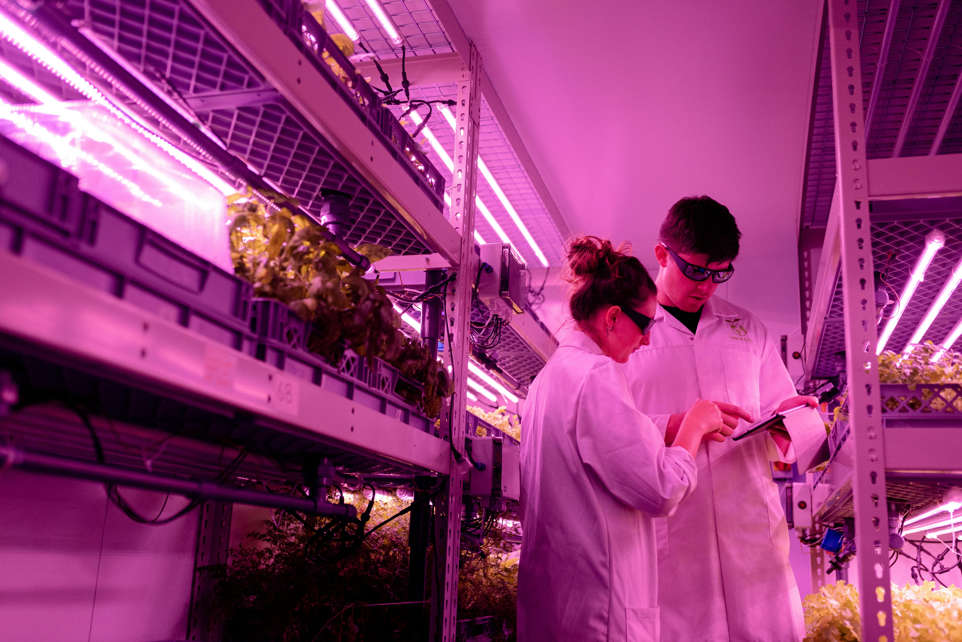
On Future Food Systems
Futures thinking encourages us to explore multiple possible futures rather than predict one outcome.
Speculative design uses imagination and storytelling to provoke critical thought and envision alternatives.
Key principles for the future include resilience, circularity, justice, biodiversity, and inclusion. They’re all tied to how we grow, distribute, and eat food.

Slide 60
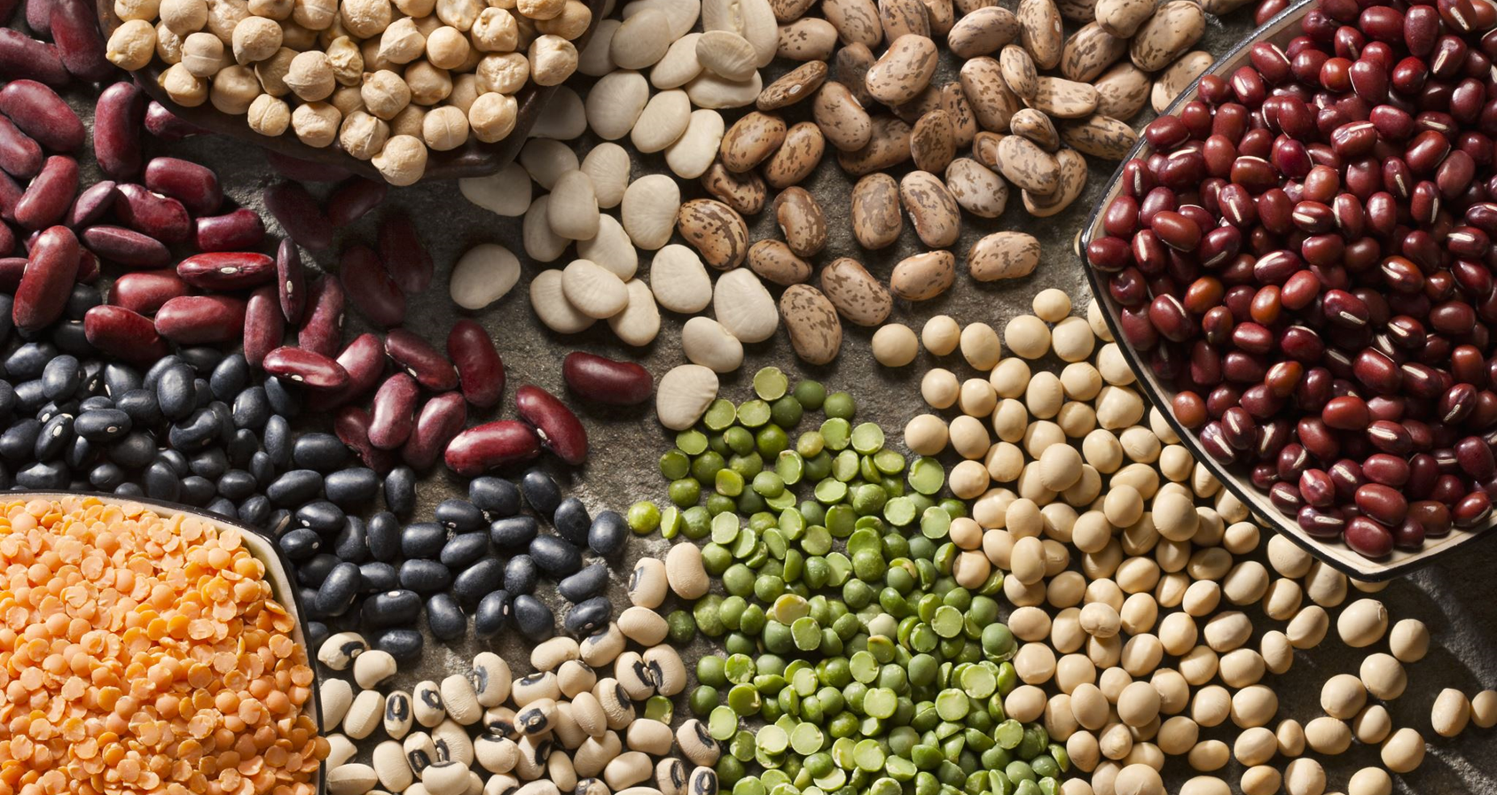
A shift to healthier, more sustainable, affordable and balanced diets is essential for a successful transition to a more sustainable food system, and plant‑based foods are part of the solution.
European Environmental Bureau

Slide 61
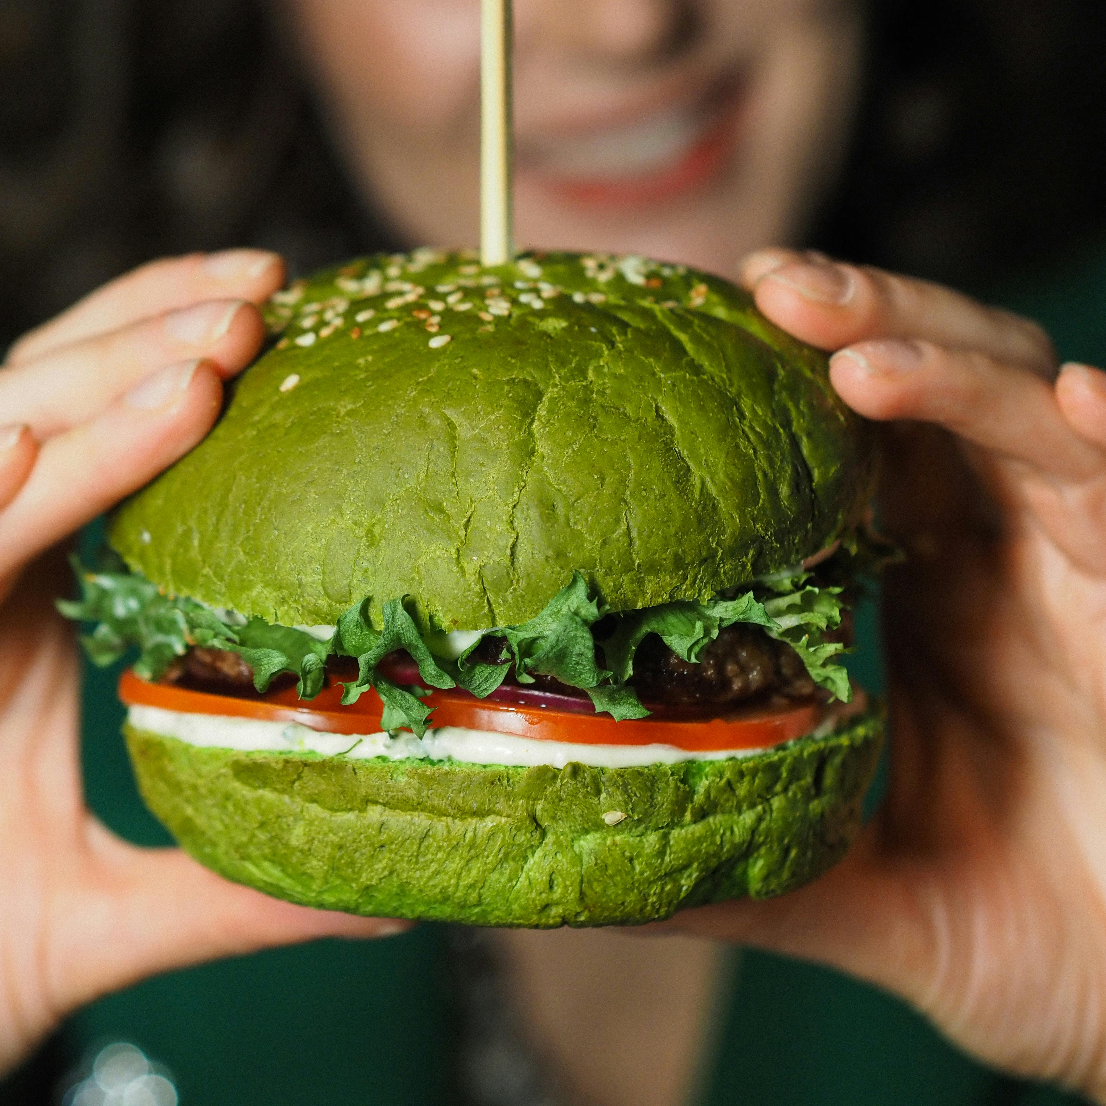
Take Action!
The future of food is not just a technical challenge. It’s a social, ethical, and cultural opportunity for reimagining our relationship with the planet.

Slide 62

Thank you for Completing Module 5 Imagining A Better World Via Plant Power
Supporting Europe’s food sector in adopting plant-based innovation and sustainability.
follow our journey
www.plantpower.eu

