Slide 1
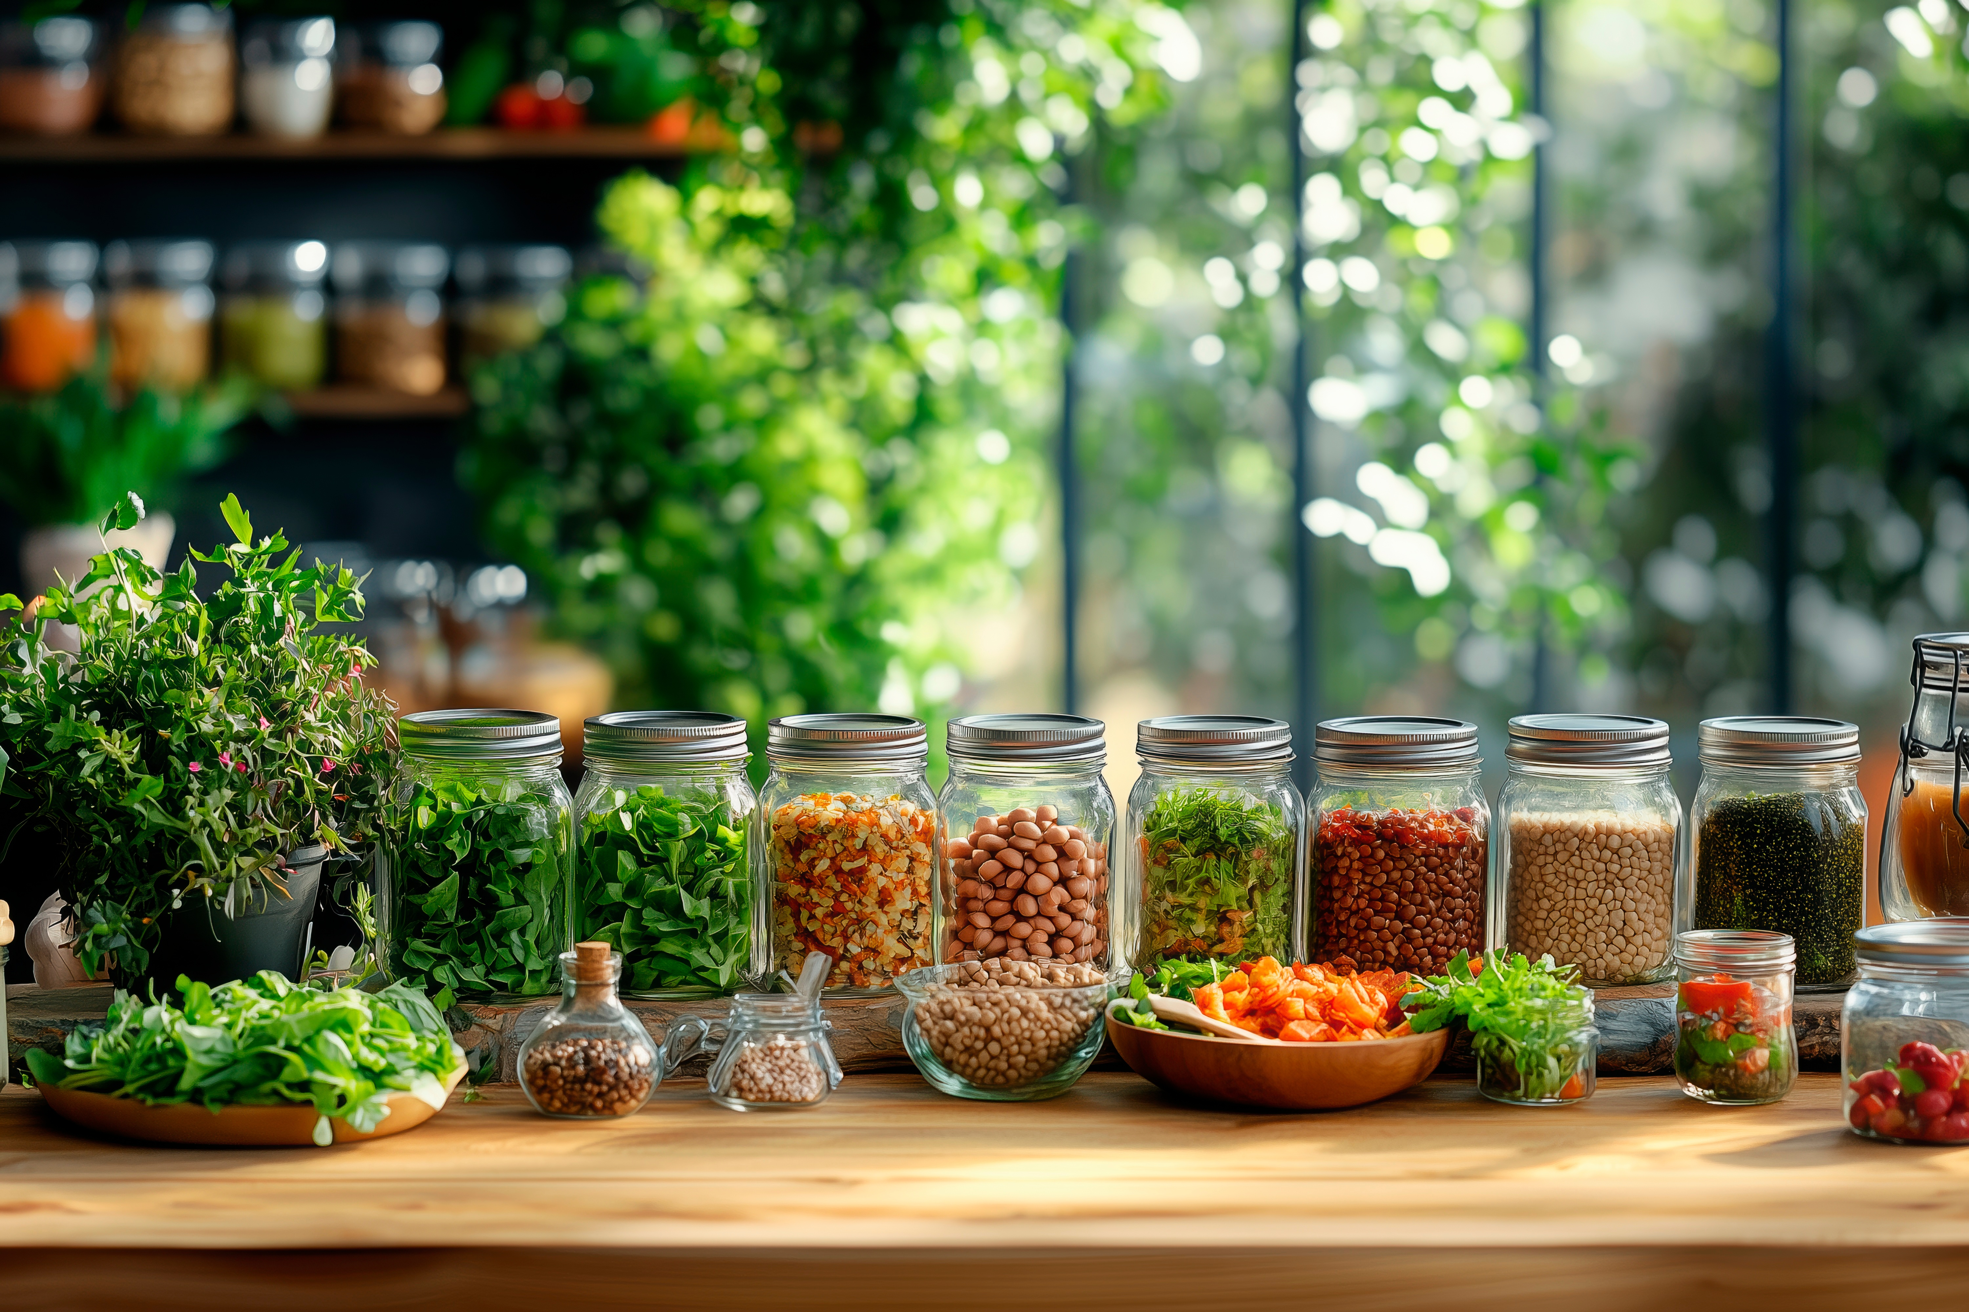

Module 6
Creating Plant-Based Innovations for Food Service Outlets
www.plantpowerproject.eu
Plant Power OERs Modules © 2025 by Plant Power Partnership is licensed under CC BY 4.0. To view a copy of this license, visit https://creativecommons.org/licenses/by/4.0/

Slide 2
Contents
01
Learning Objectives
02
Introduction to Plant-Based Innovation
03
Understanding Food Service Outlets
04
Principles of Sustainable & Innovative Menu Design
05
Creating Plant-Based Recipes & Products

Slide 3
Contents
06
Integrating Innovation into Food Service Operations
07
Learning Summary

Slide 4
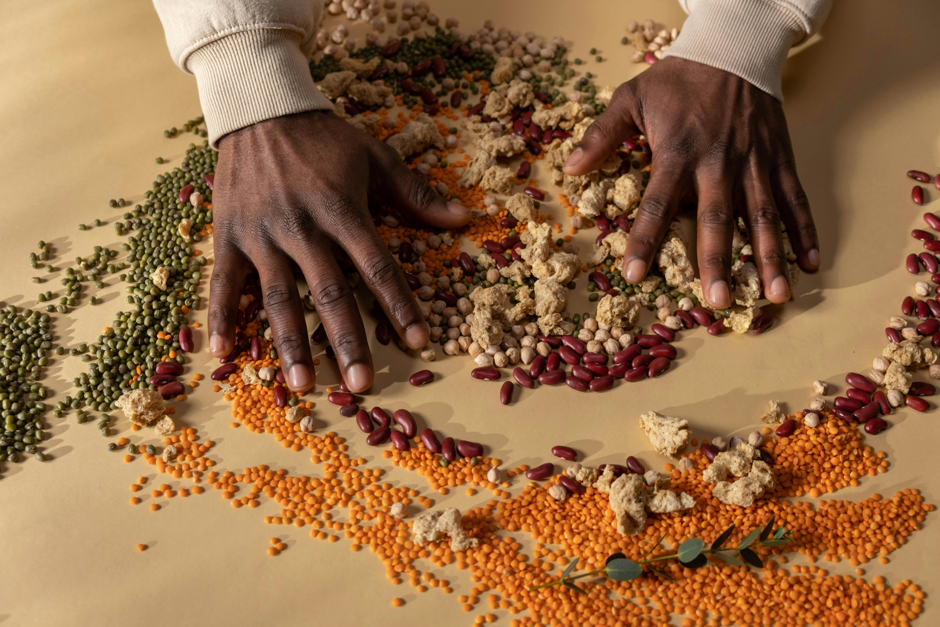
01
Learning Objectives

Slide 5
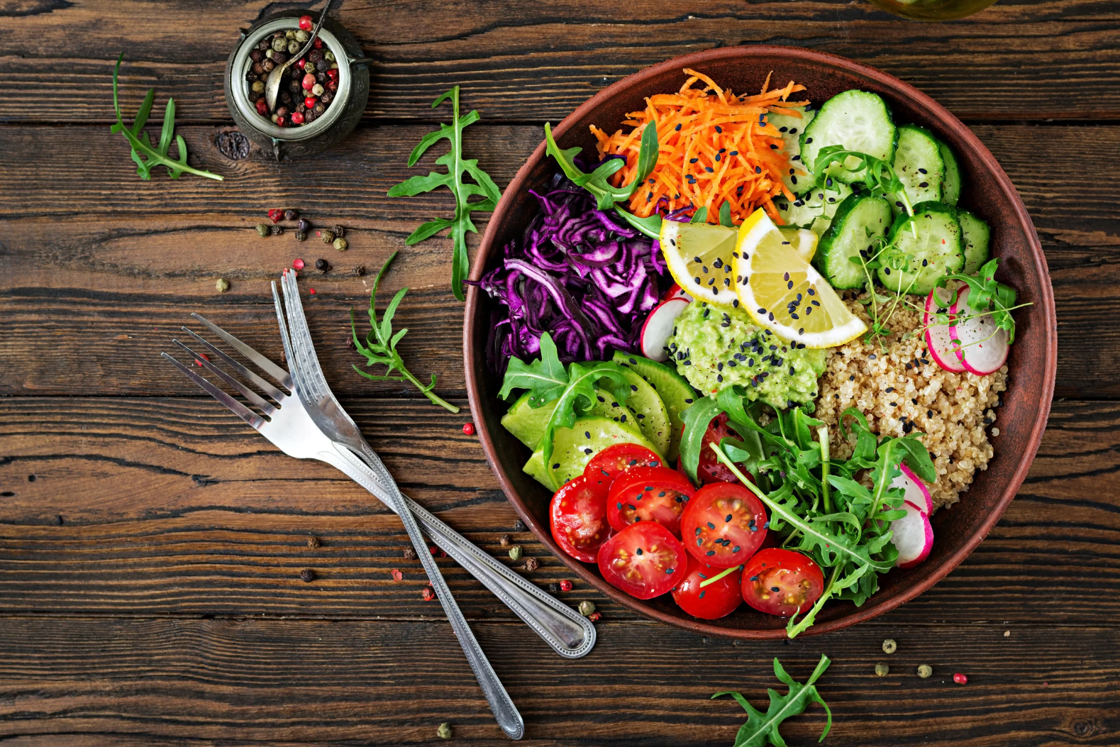
Learning Objectives
By the end of this module, learners will be able to:
Understand the challenges and opportunities of plant-based options
Identify operational requirements for different service outlets
Critically evaluate global trends in the plant-based industry
Comprehend nutritional value of plant-based products
Apply menu planning strategies to develop plant-based recipes

Slide 6
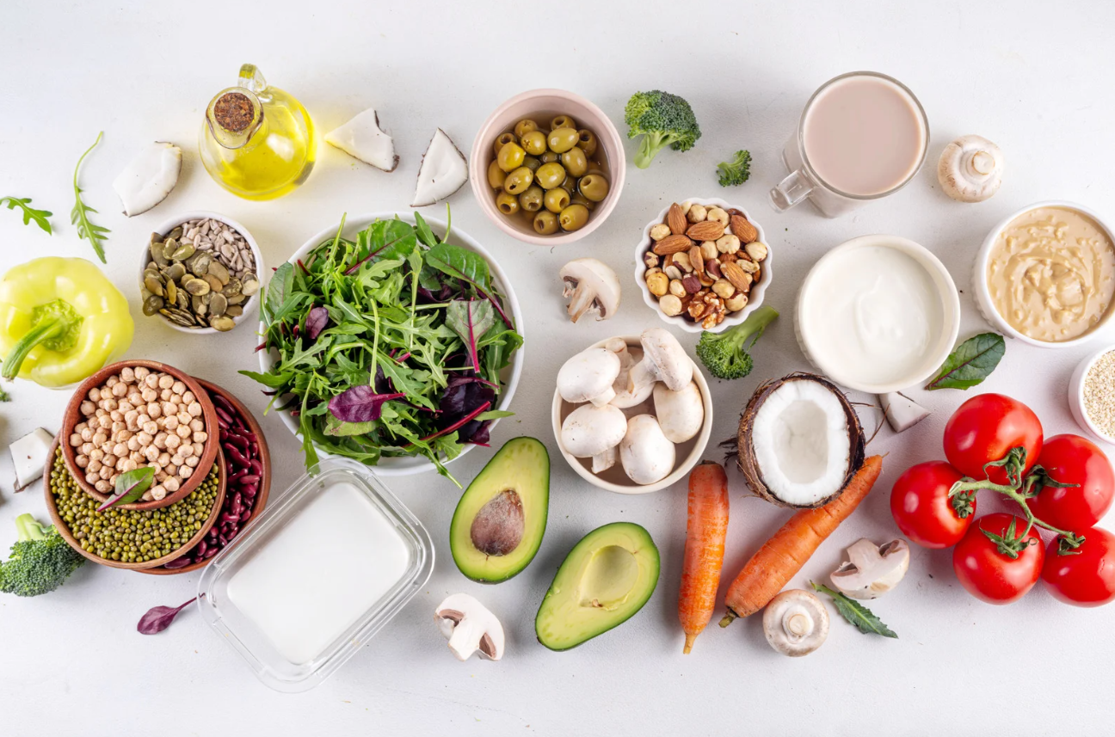
02
Introduction to Plant-Based Innovation

Slide 7
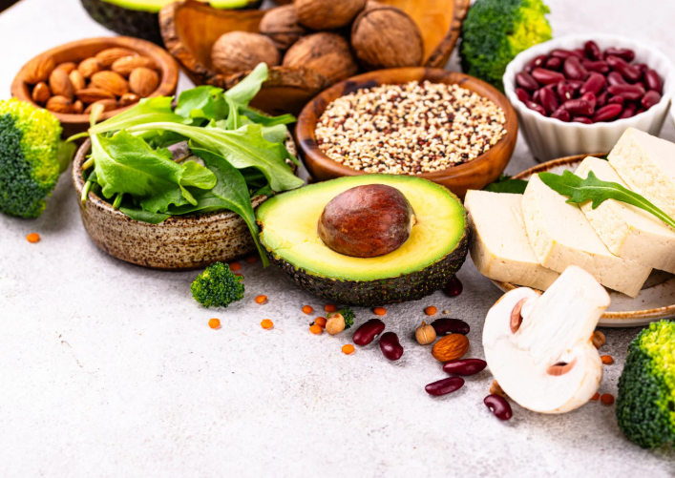
What is Plant-Based innovation?
Plant-based innovation refers to the creation and development of new products and business models based on and inspired by plant-based food.
The goal of plant-based innovation is to promote minimally processed whole foods while also reducing the dependence on and consumption of animal products.

Slide 8




Key Drivers for Plant-Based Innovation
Animal welfare
Climate change
Health and wellness
Consumer demand for sustainable food choices

Slide 9



The Challenges for Plant-Based Options
Culture
Attending social events in cultures where eating meat is part of tradition.
Holidays like Christmas and New Year’s Eve centre around traditional meats.
Consumer Perception
Some consumers perceive plant-based alternatives as inferior in terms of taste compared to their meat equivalents.
There is a preconceived idea that people eat meat alternatives out of necessity rather than for taste and quality.

Slide 10


The Challenges for Plant-Based Options
Nutritional Balance
Plant-based foods often lack key nutrients such as vitamin B12, iron and calcium.
Some plant-based foods are highly processed with added sugar, salt and fat.
Cost
Specialty vegetarian or vegan products can be more expensive than meat equivalents.

Slide 11


The Opportunities for Plant-Based Options
Environment
Plant-based foods produce less greenhouse gases and require less water and land use.
A shift to the plant-based diet could reduce green-house gas production by 70% by 2050¹.
Health
Plant-based diets offer many health benefits such as reduced risk of heart disease due to their low saturated fat content.
Plant-based foods are high in fibre which supports a healthy digestive system.
¹Physicians Committee for Responsible Medicine (2024) A vegan diet: Eating for the environment. Available at: https://www.pcrm.org/good-nutrition/vegan-diet-environment (Accessed 22.08.2025)

Slide 12


The Opportunities for Plant-Based Options
Product Development
Plant-based alternatives offer opportunities for product development such as functional foods with added nutrients.
Market Expansion
There has been increased consumer demand for plant-based food due to environmental and health concerns as well as sustainability in industrial processes.

Slide 13

Pros and Cons of Plant-Based Diets: a Doctor’s Perspective
Watch this video by Dr Sophie where she discusses what is a plant-based diet (flexitarians, pescatarians, vegetarians and vegans), its pros and cons and interesting statistics about the plant industry!
² Dr Sophie GP (2019) The Pros and Cons to a Plant-Based Diet [video]. YouTube. https://www.youtube.com/watch?v=ABIe15DMZRc

Slide 14
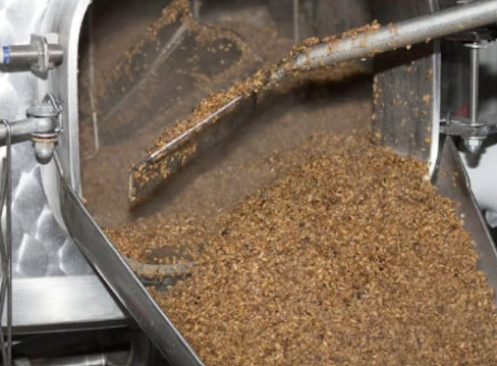
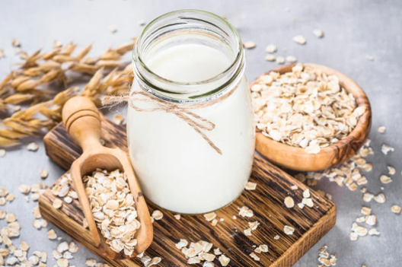
Trending Plant-Based Products
Reimagining spent brewers grain
Companies are getting creative in upcycling food such as spent brewers grain into barley milk
Plant-based milk
Plant-based milk such as oat, rice, almond and soy are becoming a popular alternative to dairy

Slide 15
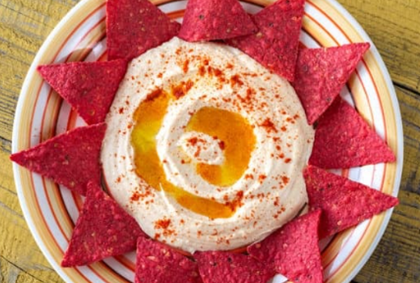

Trending Plant-Based Products
Recent surge in plant-based crisps
Hummus, lentil, seaweed, quinoa and beetroot crisps are becoming increasingly popular
Plant-based water
Coconut water has become increasingly popular as it is a source of electrolytes, providing essential nutrients after exercising

Slide 16



Controversial Topics
France attempted to ban the use of meat-related terms like ‘burger’ and ‘sausage’ for plant-based products through two decrees, one in 2022 and another in 2023. The final court hearing in January 2025 annulled the proposal³.
In November 2023, Italy passed a law banning the use and marketing of meat-related terms to describe plant-based products⁴. However, there are serious concerns as to whether this ban is enforceable in practice⁵.
Those in favour of the law argue using meat-related terms for vegan products can mislead consumers. Those opposed argue the ban stifles innovation in a growing industry.
³Green Queen (January 2025) French ‘Veggie Burger’ Labelling Ban Rejected by Country’s Highest Court. Available at: https://www.greenqueen.com.hk/france-vegan-labelling-plant-based-meat-banned-veggie-burger/ (Accessed 19.09.2025)
⁴Good Food Institute Europe (November 2023) Italy Bans Cultivated Meat, Cutting itself off from Innovation and Blocking Sustainable Development. Available at: https://gfieurope.org/blog/italy-ban-on-cultivated-meat-cuts-itself-off-from-innovation-and-blocks-sustainable-development/ (Accessed 19.09.2025)
⁵Good Food Institute Europe (February 2024) Italian Government ‘open’ to Reconsidering Ban on Meaty Terms. Available at: https://gfieurope.org/blog/italian-government-open-to-reconsidering-ban-on-meaty-terms/ (Accessed 01.12.2025)

Slide 17
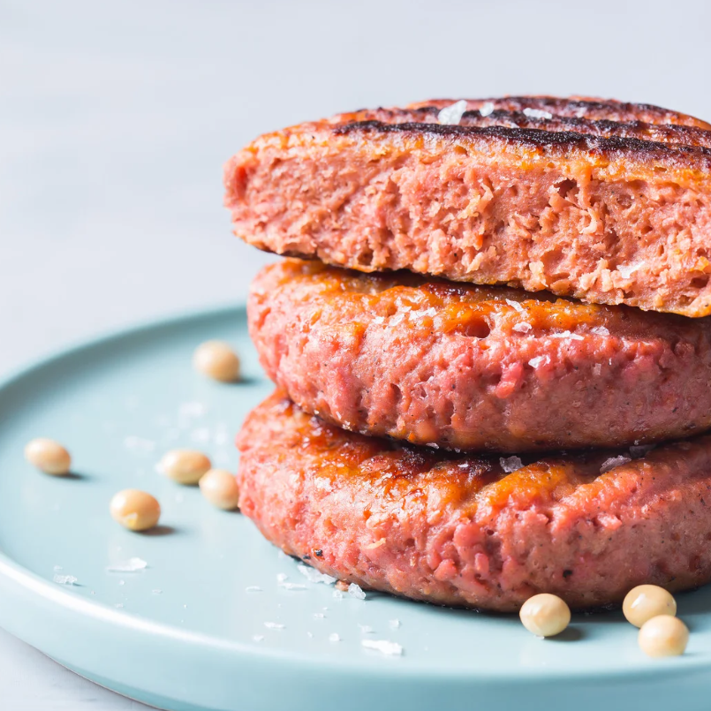

Learners’ Exercise
Are you for or against the proposal to ban the labelling of plant-based products with animal terms?
Discuss the pros and cons and share your opinion with your group.

Slide 18
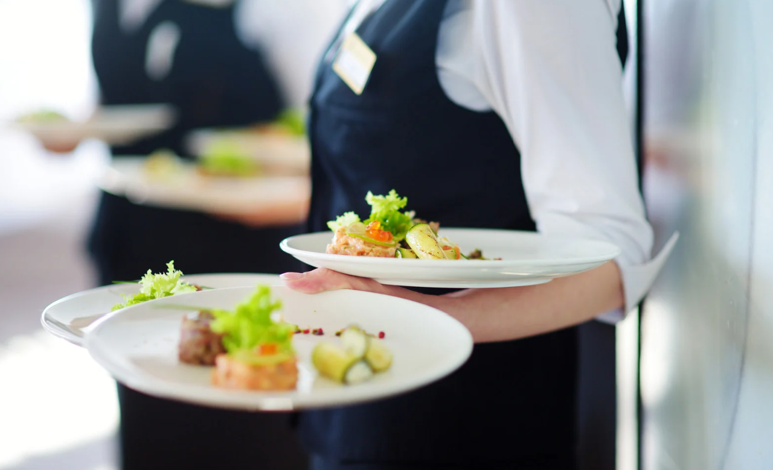
03
Understanding Food Service Outlets

Slide 19
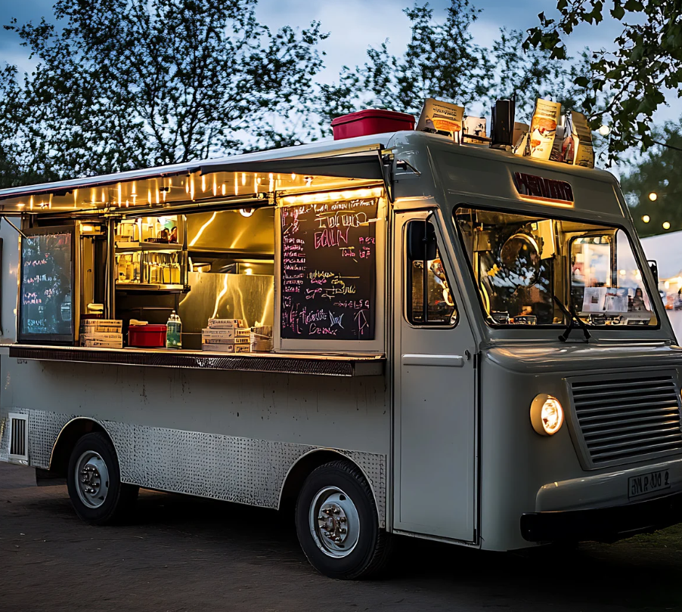
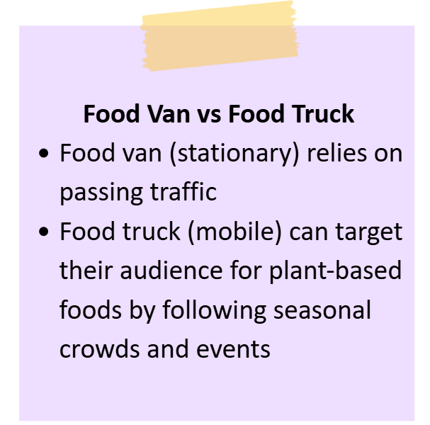
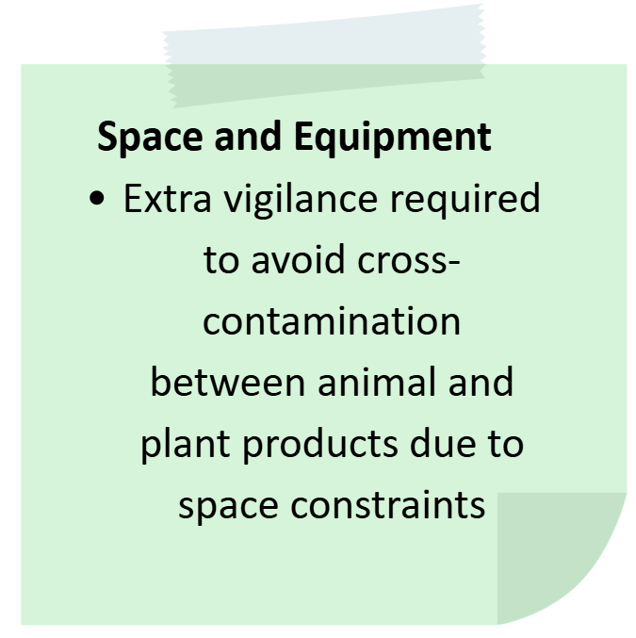
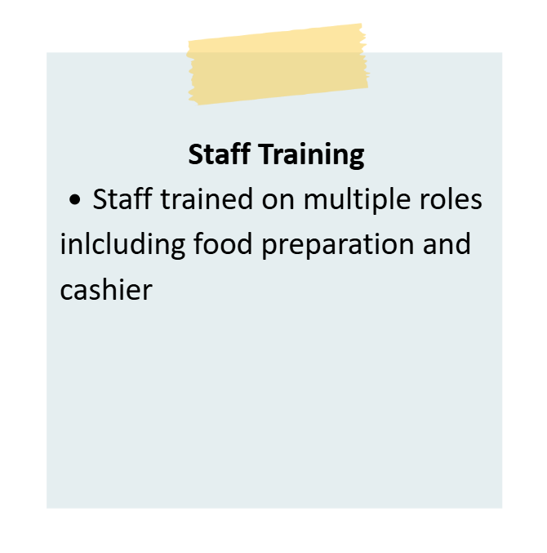
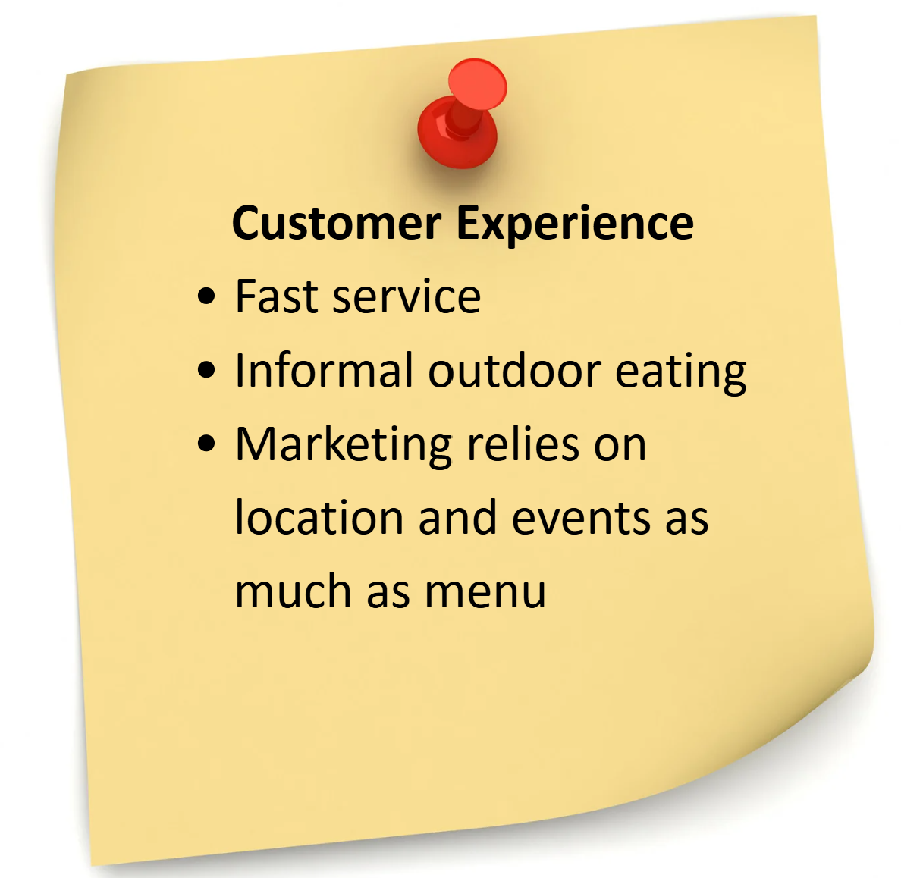
Service Outlets and Operational Needs
Food Vans and Food Trucks
Notes:
Canva link for translation: https://www.canva.com/design/DAGzb25_Lok/ld8oGRfOMV9-8GXfDeStpw/edit?utm_content=DAGzb25_Lok&utm_campaign=designshare&utm_medium=link2&utm_source=sharebutton

Slide 20
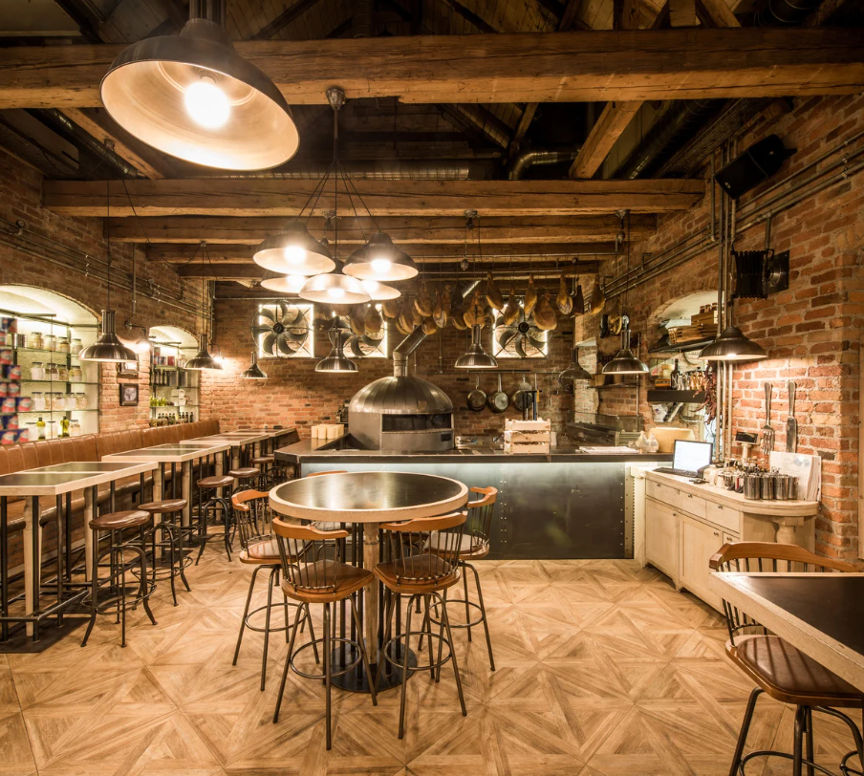
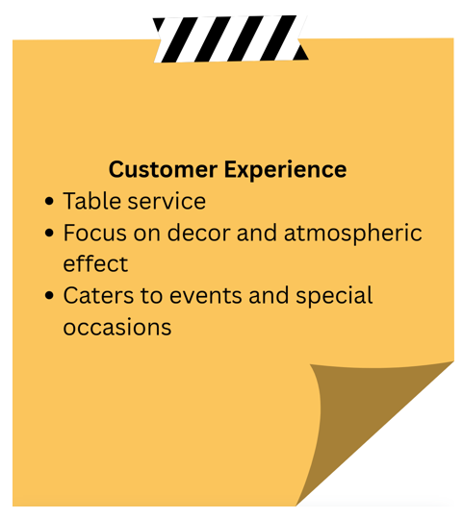
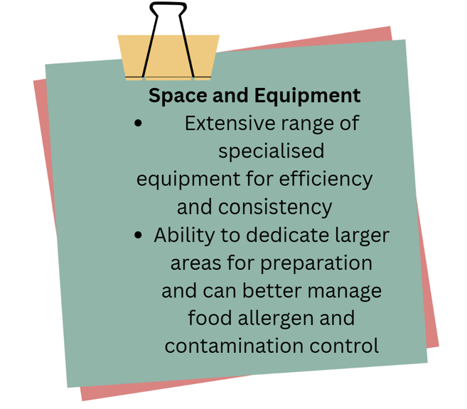
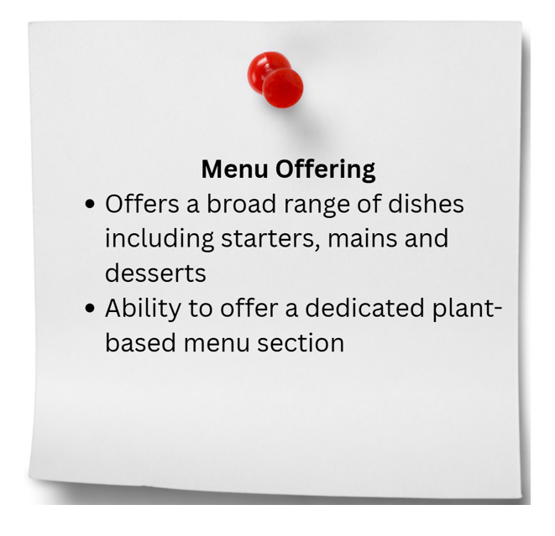
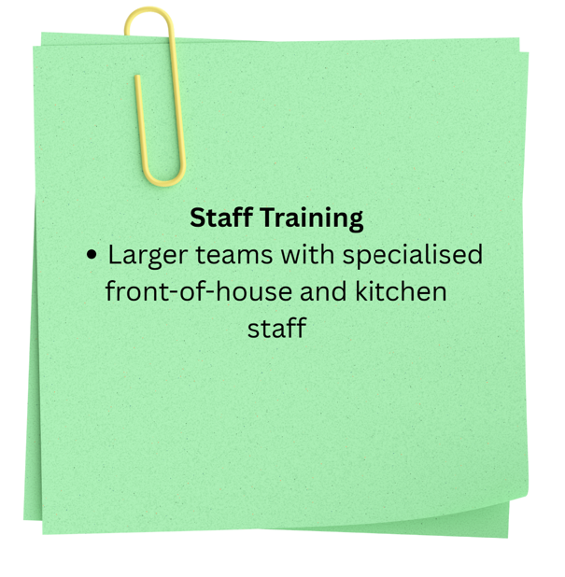
Service Outlets and Operational Needs
Restaurant
Notes:
Canva link for translation: https://www.canva.com/design/DAGzb25_Lok/ld8oGRfOMV9-8GXfDeStpw/edit?utm_content=DAGzb25_Lok&utm_campaign=designshare&utm_medium=link2&utm_source=sharebutton

Slide 21
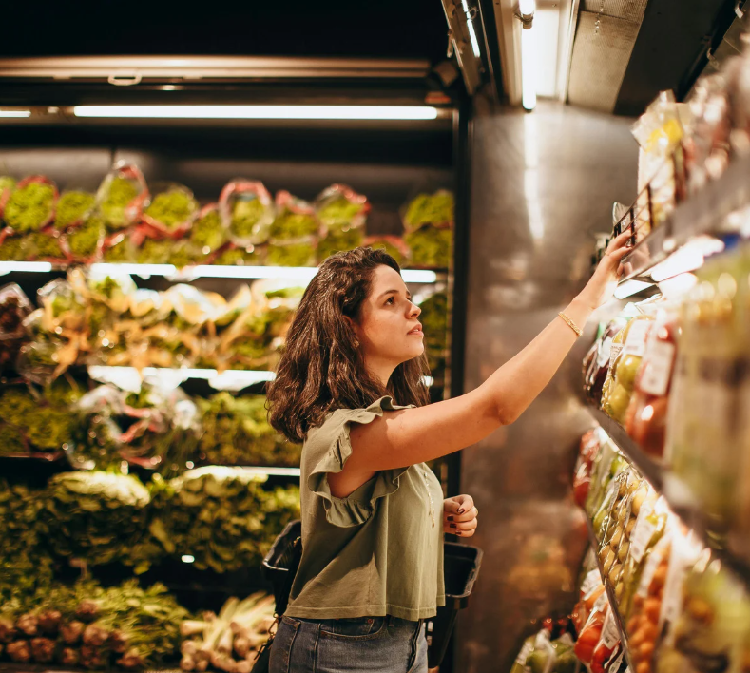


Consumer Requirements for Plant-Based Options
Quality
Consumer perception is shifting from associating plant-based products as inferior alternative meat options to seeing them as quality, tasty products
Ethical Sourcing
There is a growing demand for social enterprises that produce quality products while having a positive social and environmental impact

Slide 22
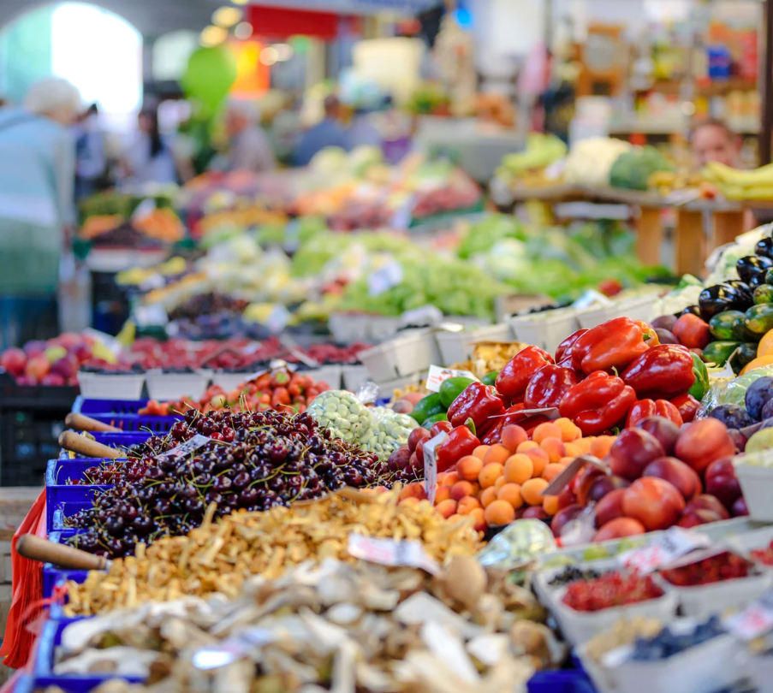


Consumer Requirements for Plant-Based Options
Health and Wellness
Plant-based options are growing in popularity as they are rich in fibre, vitamins, minerals and antioxidants and can help reduce the risk of heart disease and cholesterol with lower saturated fat content compared to meat
Animal Welfare
Growing concerns regarding animal welfare are motivating consumers to switch to sustainable, plant-based options

Slide 23


Meal Planning for Plant-Based Options
Focus on protein sources such as beans, lentils, tofu, nuts or seeds.
If you’re trying to eat more plant-based foods, start by preparing one vegetarian meal a week and increase as you master new recipes.
Choose healthy fats such as olive oil, olives, avocados, nuts or seeds.
Experiment by building a meal around salad, choose rice or couscous as the carbohydrate then garnish with dressing or add hummus.
Set time aside to devise 7 breakfast, lunch and dinner options and alternate throughout the week to facilitate meal planning and ensure variety.
Plan your meals according to categories or themes such as salad, soup, pasta or rice to facilitate decision-making.

Slide 24
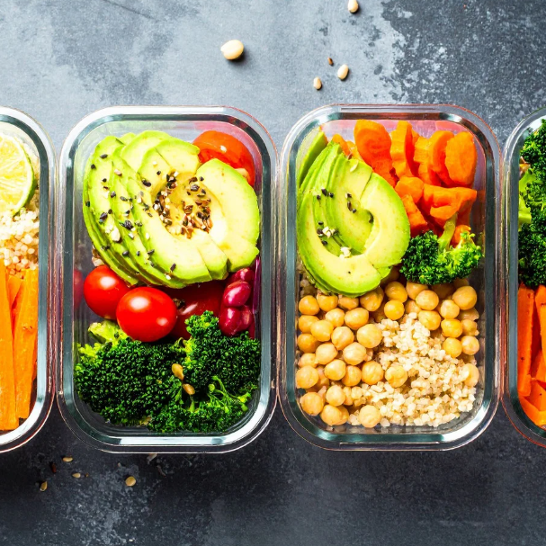
Learners’ Exercise
Draft your own plant-based meal plan
Create a sample plan for the week using the tips provided. Share your recipe ideas with your group!

Slide 25
04
Principles of Sustainable & Innovative Menu Design

Slide 26

Cost Considerations
The rising popularity of the vegetarian diet has contributed to plant-based options moving beyond their previous status as expensive, niche products to widely accepted, commercial staples.
From a restaurant perspective, several factors influence the cost of plant-based options including:
Cost of raw materials
Labour costs
Consumer perception
Cultural influence from global cuisine
The dining experience

Slide 27
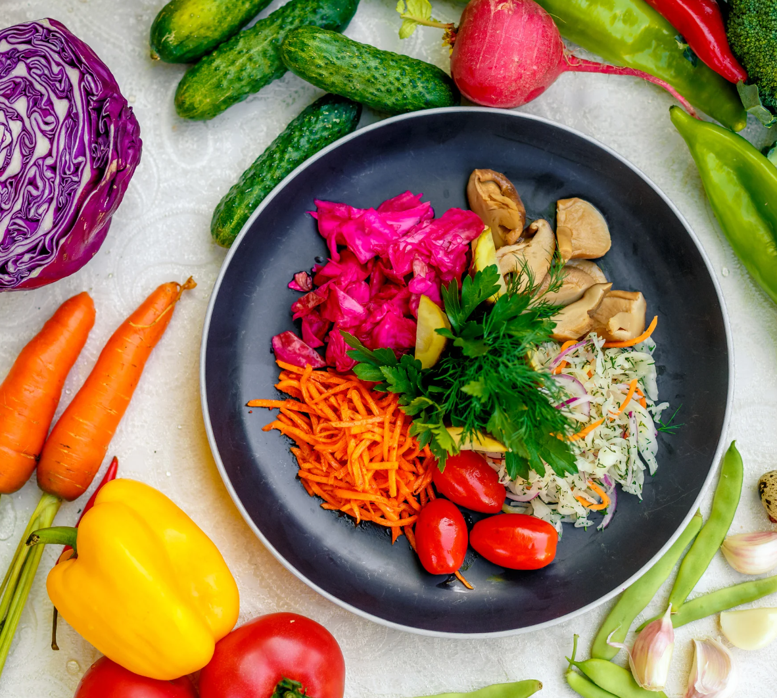
Menu Economics
A common complaint from the vegetarian community is the cost of plant-based dishes. There are many contributing factors to this phenomenon, namely consumer perception. There is a widespread preconception of vegetable dishes offering less value for money than their meat alternatives. Marketing has a big impact on this consumer conception, with vegetable dishes sometimes listed as a side rather than a main. Let’s look at menu economics to explain why plant-based options are priced similarly to meat dishes.
Should vegetarian and vegan dishes cost the same as meat dishes in restaurants?

Slide 28
Menu Economics
Labour Costs
A good vegetarian dish should include several vegetables prepared in a variety of ways to add colour, texture and taste to the dish. Consequently, plant-based dishes take longer to prepare as all vegetables must be individually cleaned, peeled and chopped. Meat, on the other hand, often takes less time to prepare, especially when cooked whole, such as a leg of lamb or roast chicken.
Should vegetarian and vegan dishes cost the same as meat dishes in restaurants?

Slide 29
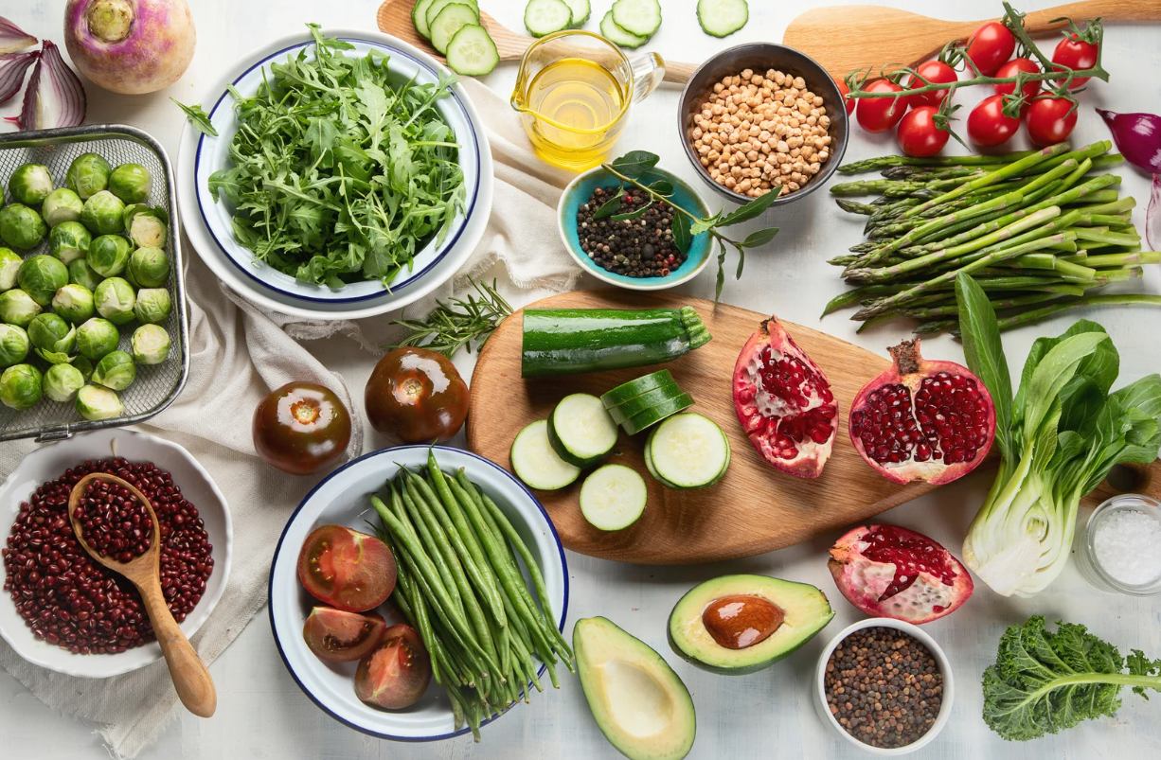
Menu Economics
Cost of Ingredients
Quality vegetables are not cheap, especially locally sourced. Restaurants could source cheaper vegetables from mass producers, but this would directly affect the overall quality of the dish. The cost-quality balance is particularly prevalent for restaurants who pride themselves on supporting local producers and serving quality dishes.
Should vegetarian and vegan dishes cost the same as meat dishes in restaurants?

Slide 30
Menu Economics
Premium Ingredients
Premium ingredients that contribute to the dining experience are also expensive. Wild mushrooms such as chanterelles are considered a delicacy and are not widely available which contributes to their high cost.
Should vegetarian and vegan dishes cost the same as meat dishes in restaurants?
Overhead
Restaurants need to charge an average amount for plant-based and meat dishes alike to account for rent, utilities and other operating costs of running a restaurant.

Slide 31


Menu Economics
Should vegetarian and vegan dishes cost the same as meat dishes in restaurants?
The Dining Experience
People dine out for more than just good food; excellent hospitality and customer service play an important role in the dining experience and also add to the overall cost⁶.
⁶ Serious Eats (10 August 2018) Why Is My Vegan Entrée as Expensive as the Meat? Available at: https://www.seriouseats.com/menu-pricing-vegan-vegetarian-meat (Accessed 01.10.2025)

Slide 32
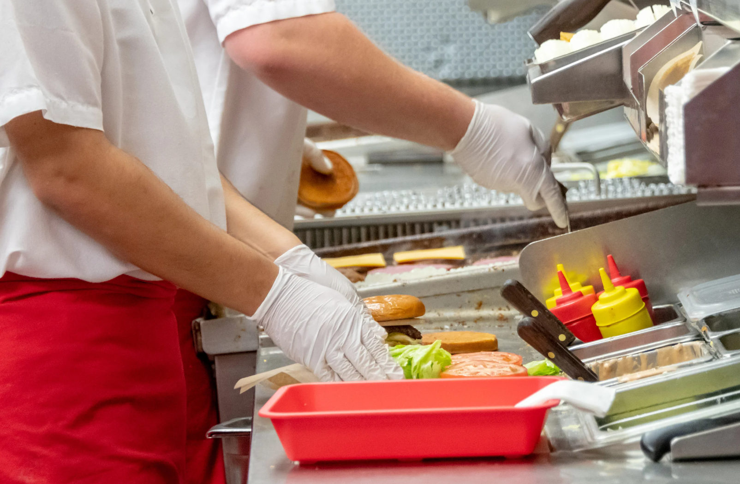
Fast Food Chains
Fast food chains are responding to evolving consumer preferences. Where once plant-based options were exclusive to vegan or vegetarians, there has been a rise of ‘flexitarians’ and health-conscious consumers. Fast food chains are offering plant-based burgers, salads and bowls. The fast-food giant McDonalds offer their vegan burger option the ‘McPlant’⁷.
The addition of plant-based options to mainstream fast-food chains shows that these offerings are moving beyond their previous status as expensive, niche products and are becoming a widely accepted, commercial staple.
Cost Considerations
Food Service Outlets’ Perspectives
⁷ McDonald’s Ireland (2025) McPlant. Available at: https://www.mcdonalds.com/ie/en-ie/product/mcplant.html (Accessed the 01.10.2025)

Slide 33
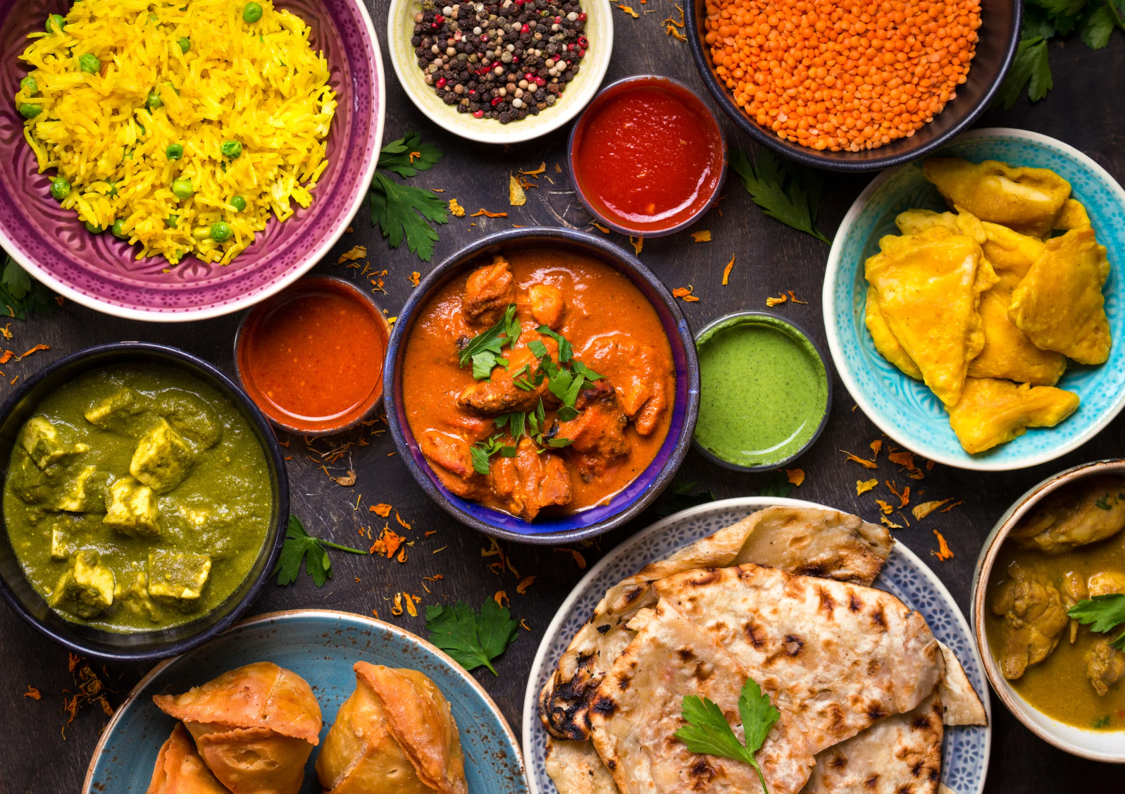
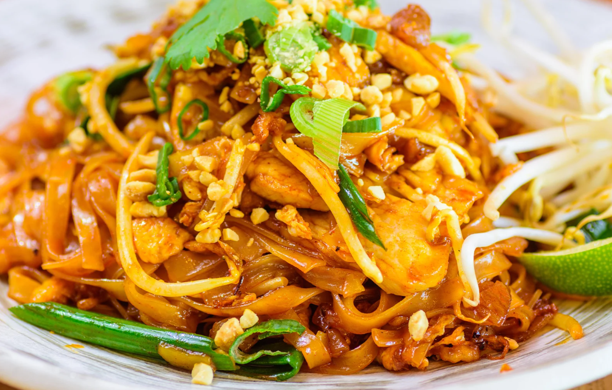
Cost Considerations
Food Service Outlets’ Perspectives
Global Cuisine Restaurants
The growing popularity of diverse global cuisines has significantly increased the availability and variety of plant-based dishes. Indian cuisine is rooted in vegetarian tradition due to cultural and religious practices and offer a rich variety of dishes. Similarly, Asian restaurants provide abundant vegetarian options in their cuisine.

Slide 34



European Outlook
What are Europe’s best countries to be vegetarian?
Switzerland is voted the friendliest vegetarian country in Europe! It boasts the highest density of vegetarian restaurants with 165.94 per 100,000 people.
# 3
# 1
Norway takes third place with their low annual meat consumption of 66kg per person⁸.
Finland ranks second place with 67.69 vegetarian-friendly restaurants per 100,000 people.
# 2
⁸ The Eco Experts (2022) Switzerland Named Vegetarian Hotbed of Europe. Available at: https://www.theecoexperts.co.uk/news/best-country-to-be-vegetarian-europe (Accessed 01.10.2025)

Slide 35


European Outlook
What are Europe’s best countries to be vegetarian?
# 4
# 5
The UK has the second highest concentration of vegetarian-friendly restaurants with 80.02 per 100,000 people but their high annual meat consumption offsets their overall score. Nevertheless, the rising number of vegetarian-friendly restaurants indicates the growing popularity of the plant-based diet⁹.
Sweden boasts fourth place with 58.43 vegetarian-friendly restaurants per 100,000 people.
⁹ Ibid

Slide 36


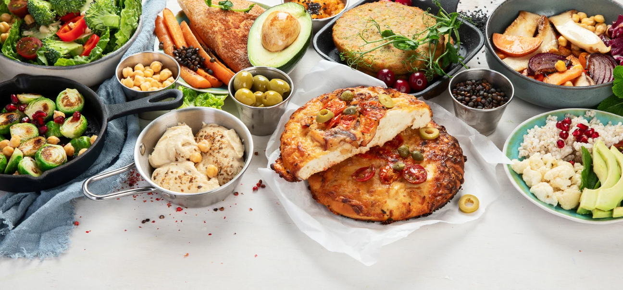
Case Study
Haus Hiltl, Switzerland
Voted # 1 vegetarian friendly country in Europe
Haus Hiltl, established in 1898, located in Zurich, Switzerland, is the oldest vegetarian restaurant in the world.
It holds the Guinness World Record for the oldest continuously opened vegetarian restaurant in the world.
The restaurant spans over two levels and operates a buffet-style service with around 100 dishes on offer¹⁰.
¹⁰ Lorraine Elliott Not Quite Nigella (2025) Haus Hiltl: The Oldest Vegetarian Restaurant in the World. Available at: https://www.notquitenigella.com/2025/09/20/haus-hiltl/ (Accessed 01.10.2025)

Slide 37
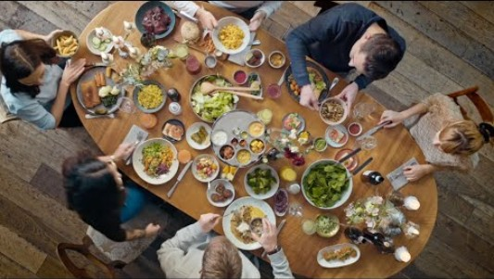
Case Study: Haus Hiltl, Switzerland
Watch this video to learn about the fascinating history, traditions and values of the Hiltl restaurant 👉
¹¹ Switzerland (2022) The Story of Hiltl Switzerland Tourism [Video]. YouTube. https://www.youtube.com/watch?v=mhDgQ4r3o64

Slide 38
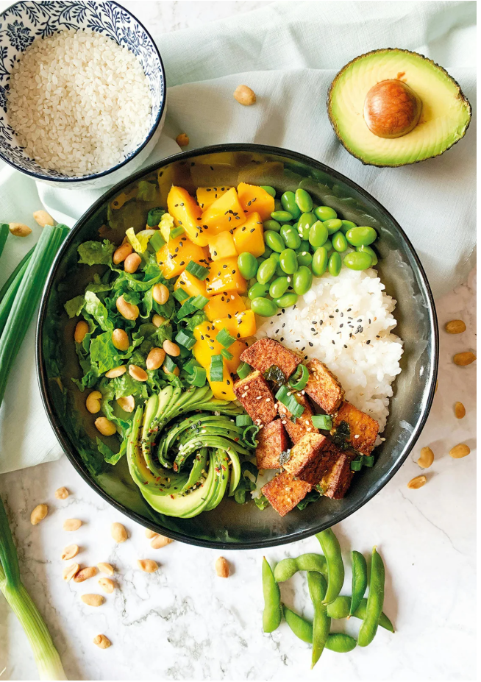
Nutritional Balance and Taste
How to Build a Balanced Meal
The Vegan Plate Method
Dedicate ½ of the plate to vegetables such as broccoli, cabbage, mushrooms, leafy greens or onions as a source of fibre and vitamins.
Dedicate ¼ of the plate to fibre-rich carbs such as whole grain and sweet potato to regulate blood sugar and provide energy.
Dedicate ¼ of the plate to plant-based protein such as tofu, beans and lentils¹².
¹² Claiborne, J. (2025) Build a Balanced Meal with the Vegan Plate Method. Available at: https://sweetpotatosoul.com/vegan-plate-method/ (Accessed 01.10.2025)

Slide 39
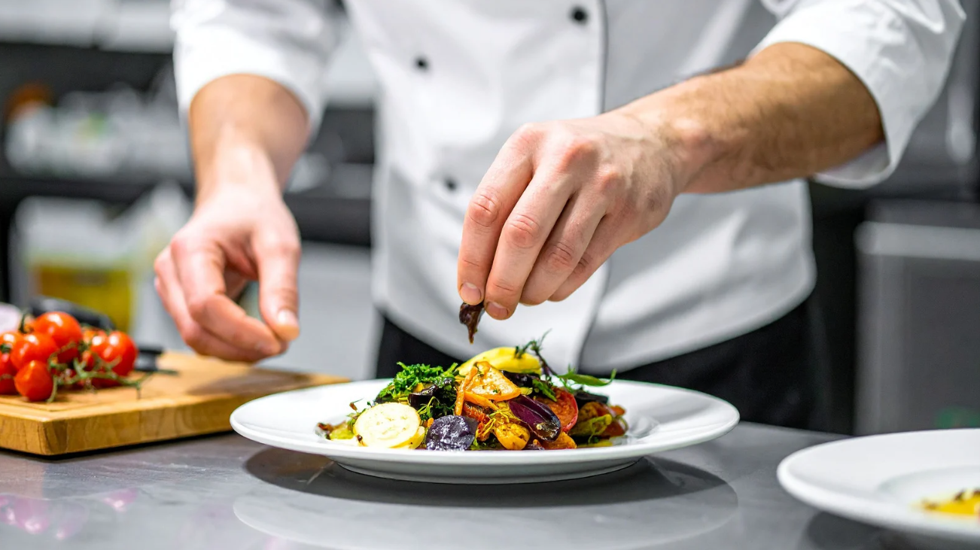
Presentation and Appeal: Tips and Tricks
Use a variety of fruit and vegetables to highlight natural colours.
Combine different textures to add interest and depth.
Stack ingredients in layers for visual interest.
Select garnishes for colour and flavour such as herbs or edible flowers.
Use beet or avocado puree to paint colourful strokes on the plate for visual appeal¹³.
¹³ Restaurantware (2025) Serving Plant-Based Dishes: Presentation Tips and Tools. Available at: https://www.restaurantware.com/blogs/kitchen-and-cooking-tips/serving_plant-based_dishes-_presentation_tips_and_tools (Accessed 01.10.2025)

Slide 40
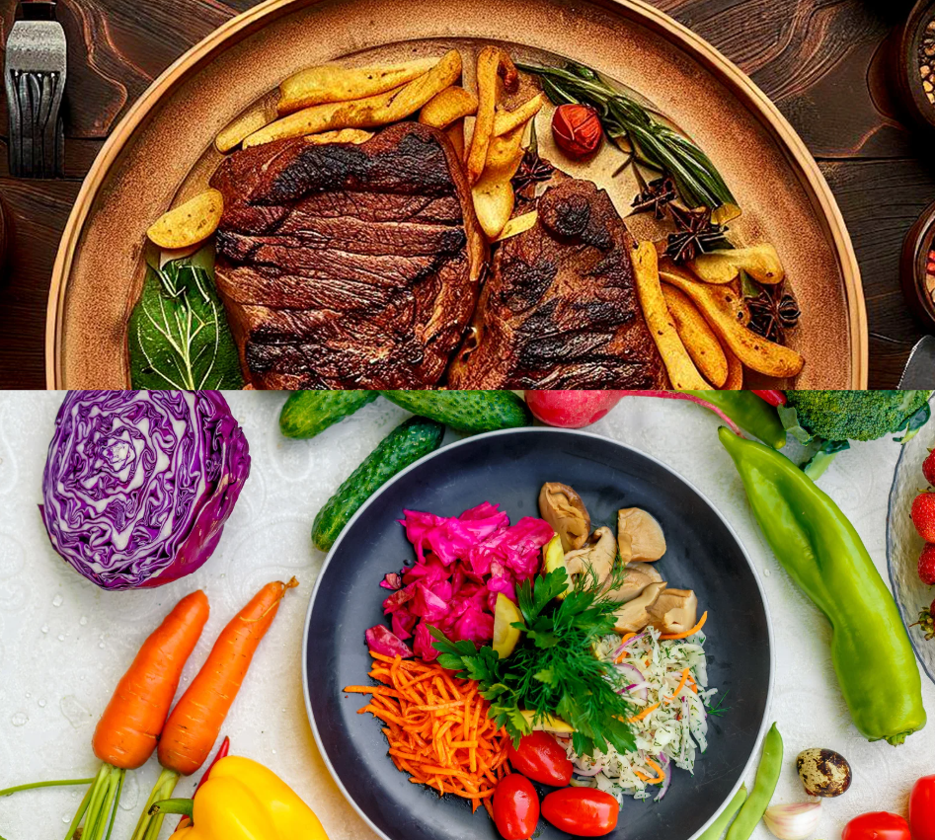
Learners’ Exercise
Do you think plant-based meals should cost the same as meat options?
Divide the group into ‘for’ and ‘against’ and share your opinions!

Slide 41
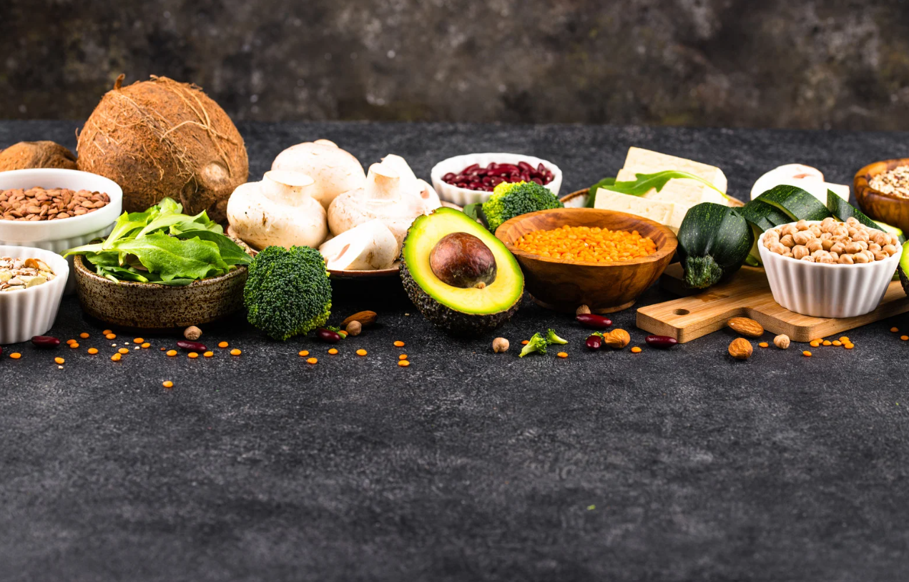
05
Creating Plant-Based Recipes & Products

Slide 42
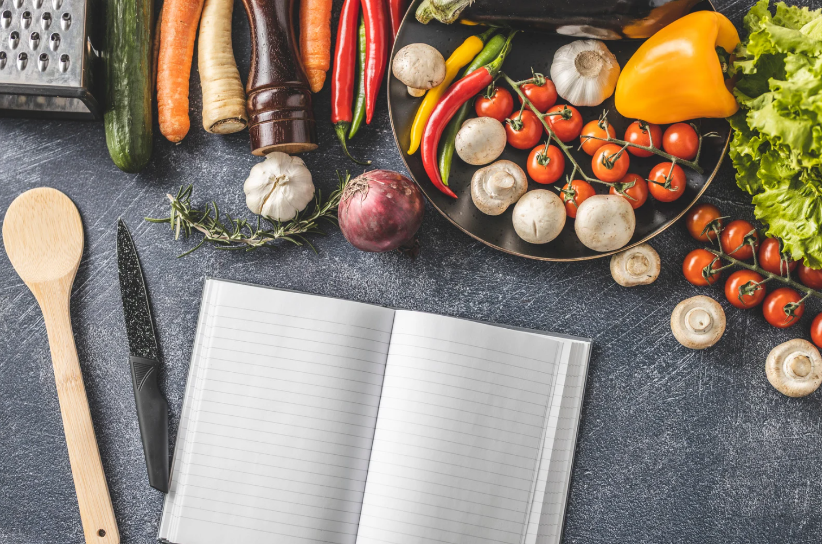
Developing Recipes for Commercial Kitchens
1. Scale up production
Make large batches of key ingredients such as sauces.
2. Take measurements
List the weight measurement unit (such as grams or ounces) for each ingredient to ensure consistency in the dish. Avoid approximate measurement units such as tablespoons or teaspoons¹⁴.
¹⁴ Wills, K. (2021) Converting a Kitchen Recipe to a Commercial Formula. Available at: https://www.canr.msu.edu/news/converting-a-kitchen-recipe-to-a-commercial-formula (Accessed 02.10.2025)

Slide 43
3. Do a practice run
Record the cooking process and refine your method as required for efficiency.
4. Prepare test batches
Taste test with your team first. If you’re happy, try your recipe with customers.
5. Iteration is key
Refine your product in line with customer feedback to perfect the finished result¹⁴.
Developing Recipes for Commercial Kitchens
¹⁵ Ibid

Slide 44
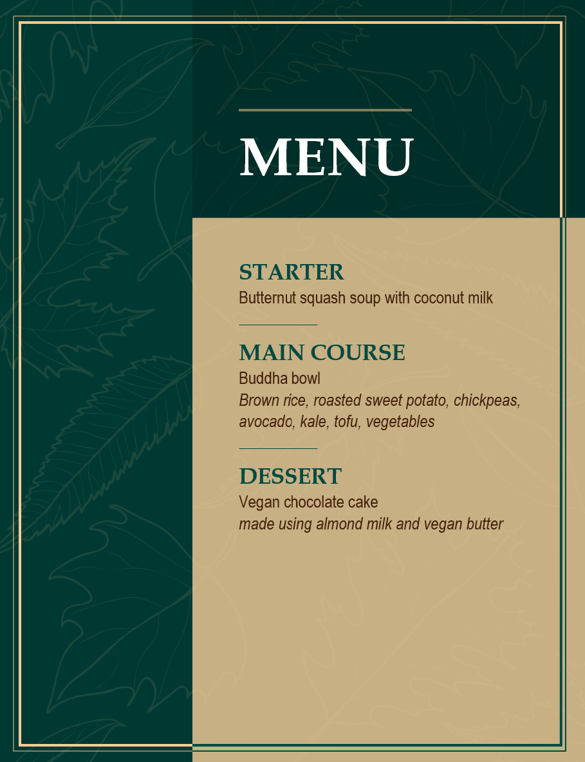
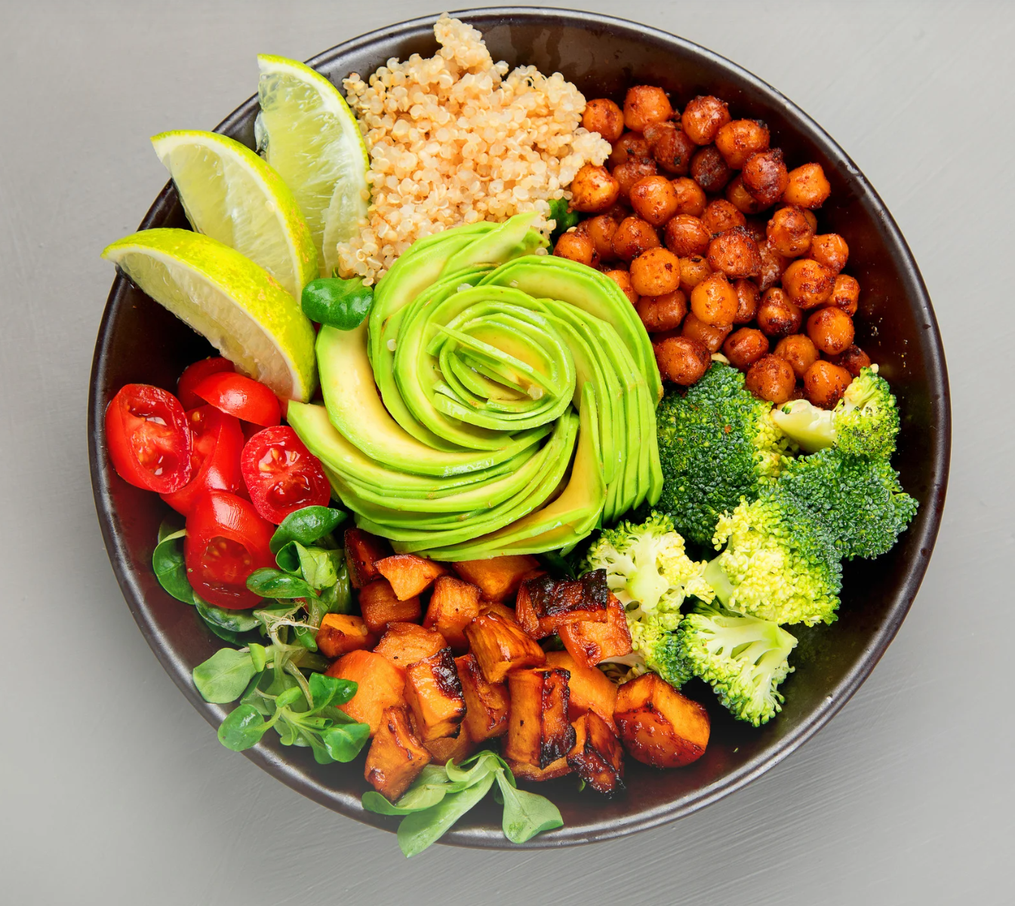
Working with Plant-Based and Dairy Alternatives
Sample Menu
Notes:
Link for translation: https://biainnovatorcampus-my.sharepoint.com/:w:/g/personal/elaine_donohue_biainnovatorcampus_ie/EX3VSmKdrv1PrbmQsW9xqP4BFs0tUQSxd_KQXgcChEXV5w?rtime=WarVoVkG3kg

Slide 45
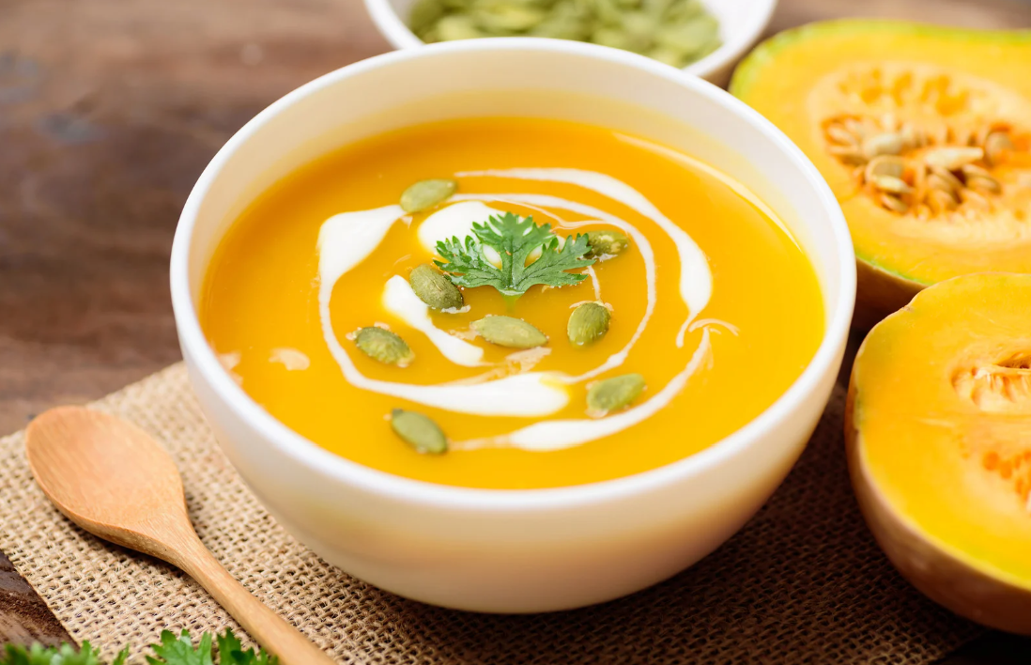
Working with Plant-Based and Dairy Alternatives
Sample Menu
Starter
Why it works: this is a satisfying vegetable soup starter that doesn’t compromise on creaminess traditionally sourced from milk or cream.

Slide 46
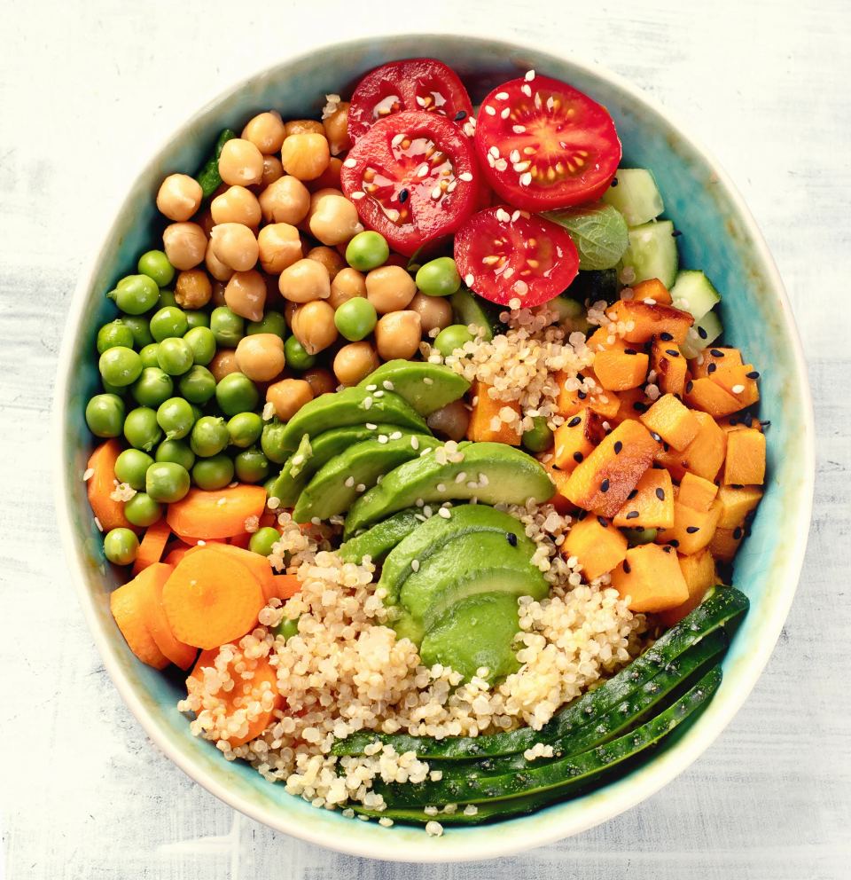
Working with Plant-Based and Dairy Alternatives
Sample Menu
Main
Why it works: This is a highly versatile dish. The ingredients can be swapped and substituted depending on personal taste. It allows for creativity as ingredients can be mixed and matched to provide satisfying flavour combinations. This is a satisfying alternative to traditional meat-based stir-fry. It is visually appealing due to the variety of colours from the vegetables and can be served as a lunch or dinner option.

Slide 47

Working with Plant-Based and Dairy Alternatives
Sample Menu
Dessert
Why it works: this plant-based recipe of a popular dessert choice delivers unrivalled taste for a no-compromise alternative.

Slide 48
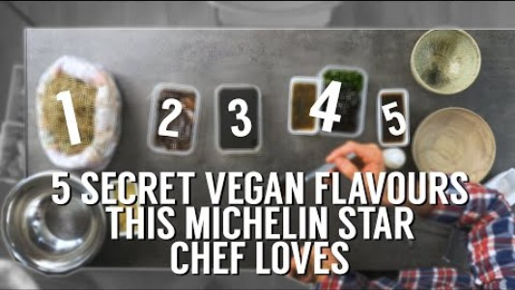
Case Study: The Happy Pear
Established in 2004, The Happy Pear is an Irish company offering plant-based vegan products, recipes and courses.
In this video, The Happy Pear meet Irish Michelin Star Chef JP McMahon to discover 5 secret vegan flavours. Watch the video to learn more!
¹⁶ The Happy Pear (2020) 5 SECRET VEGAN FLAVOURS THIS MICHELIN STAR CHEF LOVES 2020 [Video]. YouTube. https://www.youtube.com/watch?v=P5iDMkLq3s4

Slide 49
Food Science Considerations
Extrusion
Extrusion Definition
Extrusion is a common food manufacturing process. It involves thermal and mechanical manipulation (mixing ingredients at high temperatures) to modify its structure. This manufacturing process is used to produce Textured Vegetable Protein (TVP) to create meat analogues. There are two types of extrusion: low and high moisture extrusion.
Low-Moisture Extrusion (LME) |  | High-Moisture Extrusion (HME)
Uses less than 40% moisture | Moisture Content | Uses above 50% moisture
Products are dry and crunchy | Texture | Products are fibrous and meat-like
Need to be rehydrated before consumption | Preparation | No rehydration required, ready for consumption
May lose heat sensitive nutrients due to high cooking temperature | Nutritional Impact | Better nutrient retention due to lower cooking temperature
Plant-based chunks or nuggets, cereals, snacks | Products | Plant-based chicken fillets and strips ¹⁷
¹⁷ Ozturk, O. K., Hamaker, B. R. (2023) Texturization of Plant-Based Meat Alternatives: Processing, Base Proteins, and Other Constructional Ingredients. Future Foods, Volume 8, 100248. https://www.sciencedirect.com/science/article/pii/S2666833523000345

Slide 50
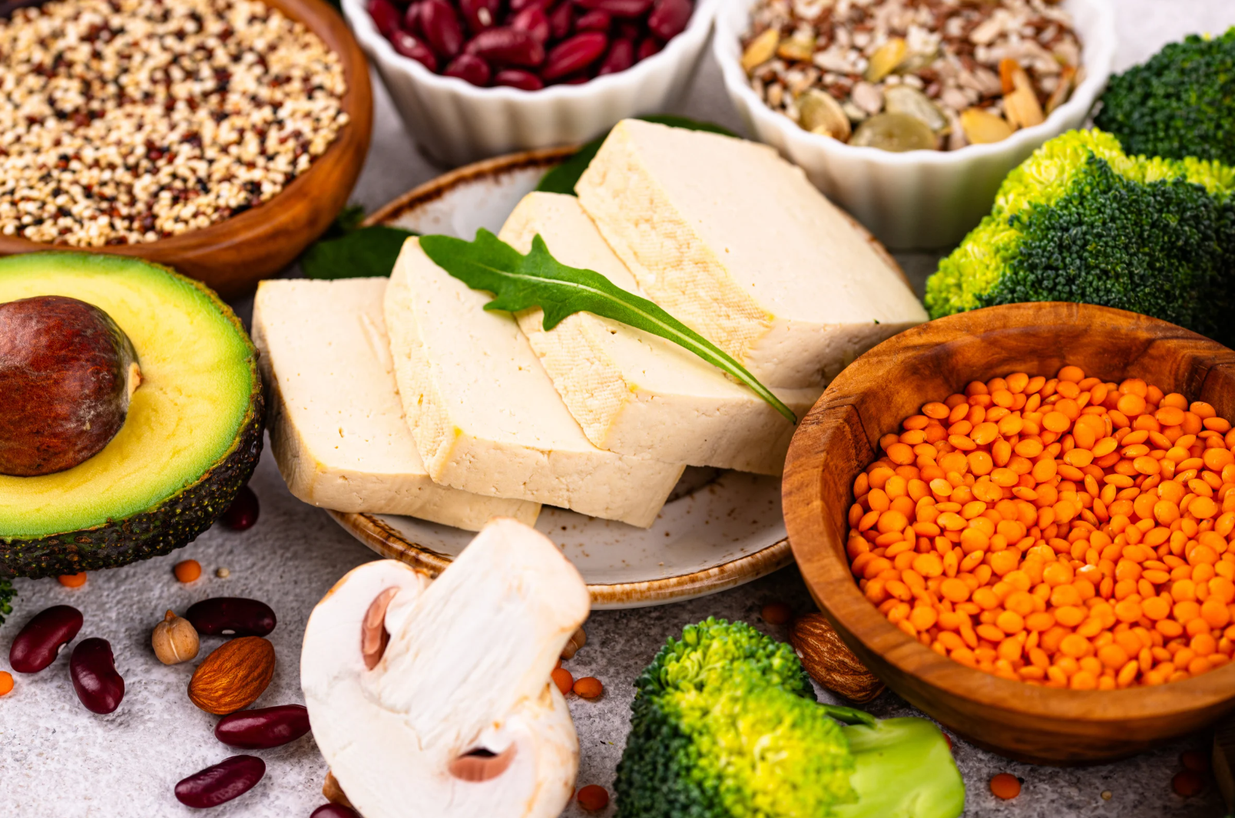
06
Integrating Innovation into Food Service Operations

Slide 51
Design-Thinking Principles - Plant-Based Menu Design
Design thinking is a human-centred approach to creating innovative solutions to business problems. This strategy is modelled around the designer’s mindset; it harnesses the power of creativity to solve problems. Design thinking is just as much a philosophy as a methodology.
Design thinking shares many core concepts with the food and hospitality sector. Both fields focus on the needs of the end-user, they share a similar process of designing, testing and refining and they are both rooted in creativity.
The five stages of design thinking are empathise, define, ideate, prototype and test. Let’s explore design thinking in the context of menu design.

Slide 52




Design-Thinking Principles - Plant-Based Menu Design
Define
This phase involves determining the problem based on the insights acquired during the empathise phase. In this context, the challenge is creating satisfying alternatives to meat options without comprising quality, taste or texture.
Empathise
The core principle of design thinking is empathising with users to create a tailored solution that meets their needs. Designing a plant-based menu requires knowledge and understanding of consumer’s dietary requirements to create a varied menu offering.

Slide 53



Design-Thinking Principles - Plant-Based Menu Design
Ideate
The ideate phase involves coming up with potential solutions to the problem identified in the previous step. This phase draws on the designer’s creative toolkit for crafting innovative solutions and transforming ideas into a working prototype.

Slide 54


Design-Thinking Principles - Plant-Based Menu Design
Prototype
The prototype phase involves building a product based on your ideas. This is arguably the most challenging phase as it involves brining ideas to life. There is a great deal of experimentation required to build an innovative prototype.
This phase may have to be revisited as new insights emerge. Design thinking is a non-linear process of building and refining in response to feedback from end-users, similarly to menu design which also requires modifications to create the best offer for consumers.

Slide 55



Design-Thinking Principles - Plant-Based Menu Design
Test
Testing is the final phase of both design thinking and product development. This phase is about gathering feedback from users on the prototype. This step is inherently human-centred as it involves direct engagement with users. Iteration may be required to refine the product in line with consumer feedback.

Slide 56



Plant-Based Diet
Facts & Figures
Top reasons for following a plant-based diet:
57% due to animal welfare
52% for physical health
48% for the environment
(The Vegan Society, 2025)
(GlobeScan and EAT, 2024, p.6)

Slide 57
Plant-Based Diet
Facts & Figures
(The Vegan Society, 2025)

Slide 58


Plant-Based Diet
Facts & Figures
Millennials are leading the way with respects to plant-based consumption. In the US, millennials make up 40% of the vegan population, compared to 21% of boomers and Gen X (Strategic Market Research, 2023). According to a survey conducted in Finland, 41% of millennials regularly consume meat alternatives, while 43% have tried plant-based products (Knaapila et al, 2022).
According to a survey conducted in the UK by The Vegan Society, 3.60% of women identify as vegan or have a plant-based diet compared to 1.89% of men (2025). Similarly, findings from research conducted in Finland revealed 16.1% of women identify as flexitarian compared to 6.7% of men (Knaapila et al, 2022).

Slide 59
Plant-Based Diet
Facts & Figures
(GlobeScan and EAT, 2023, p.4)

Slide 60
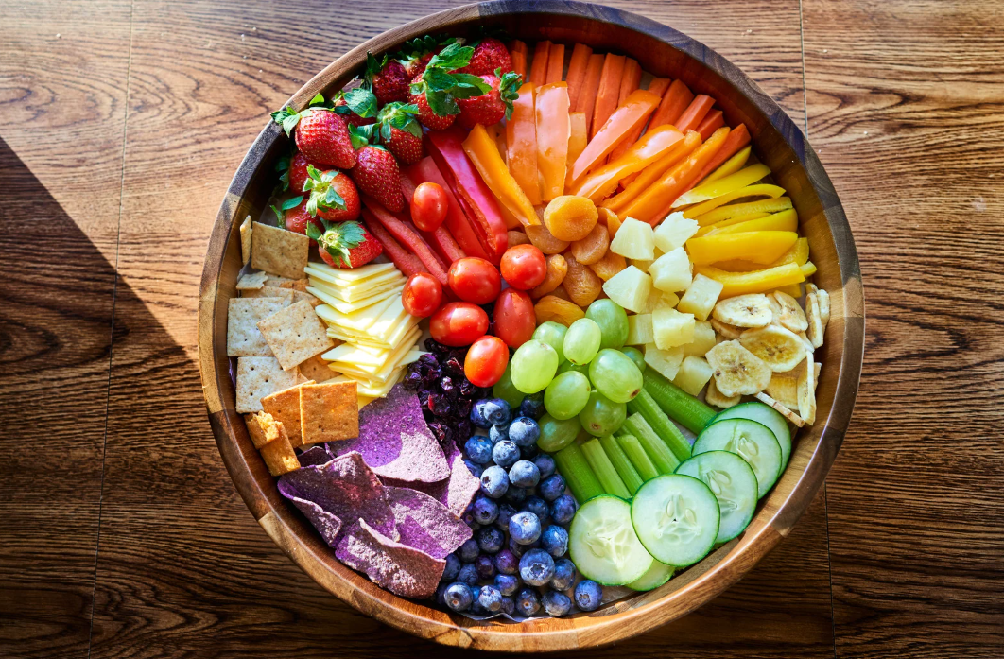
Learners’ Exercise
Key takeaways
Animal welfare is a significant motivation for following a plant-based diet.
Price is one of the top barriers to eating more plant-based food.
Younger generations are eating more plant-based food compared to older generations.
Reflection exercise
Do you agree and/or identify with the above statements? Explore your relationship with plant-based food, jot down your thoughts or discuss in groups!

Slide 61
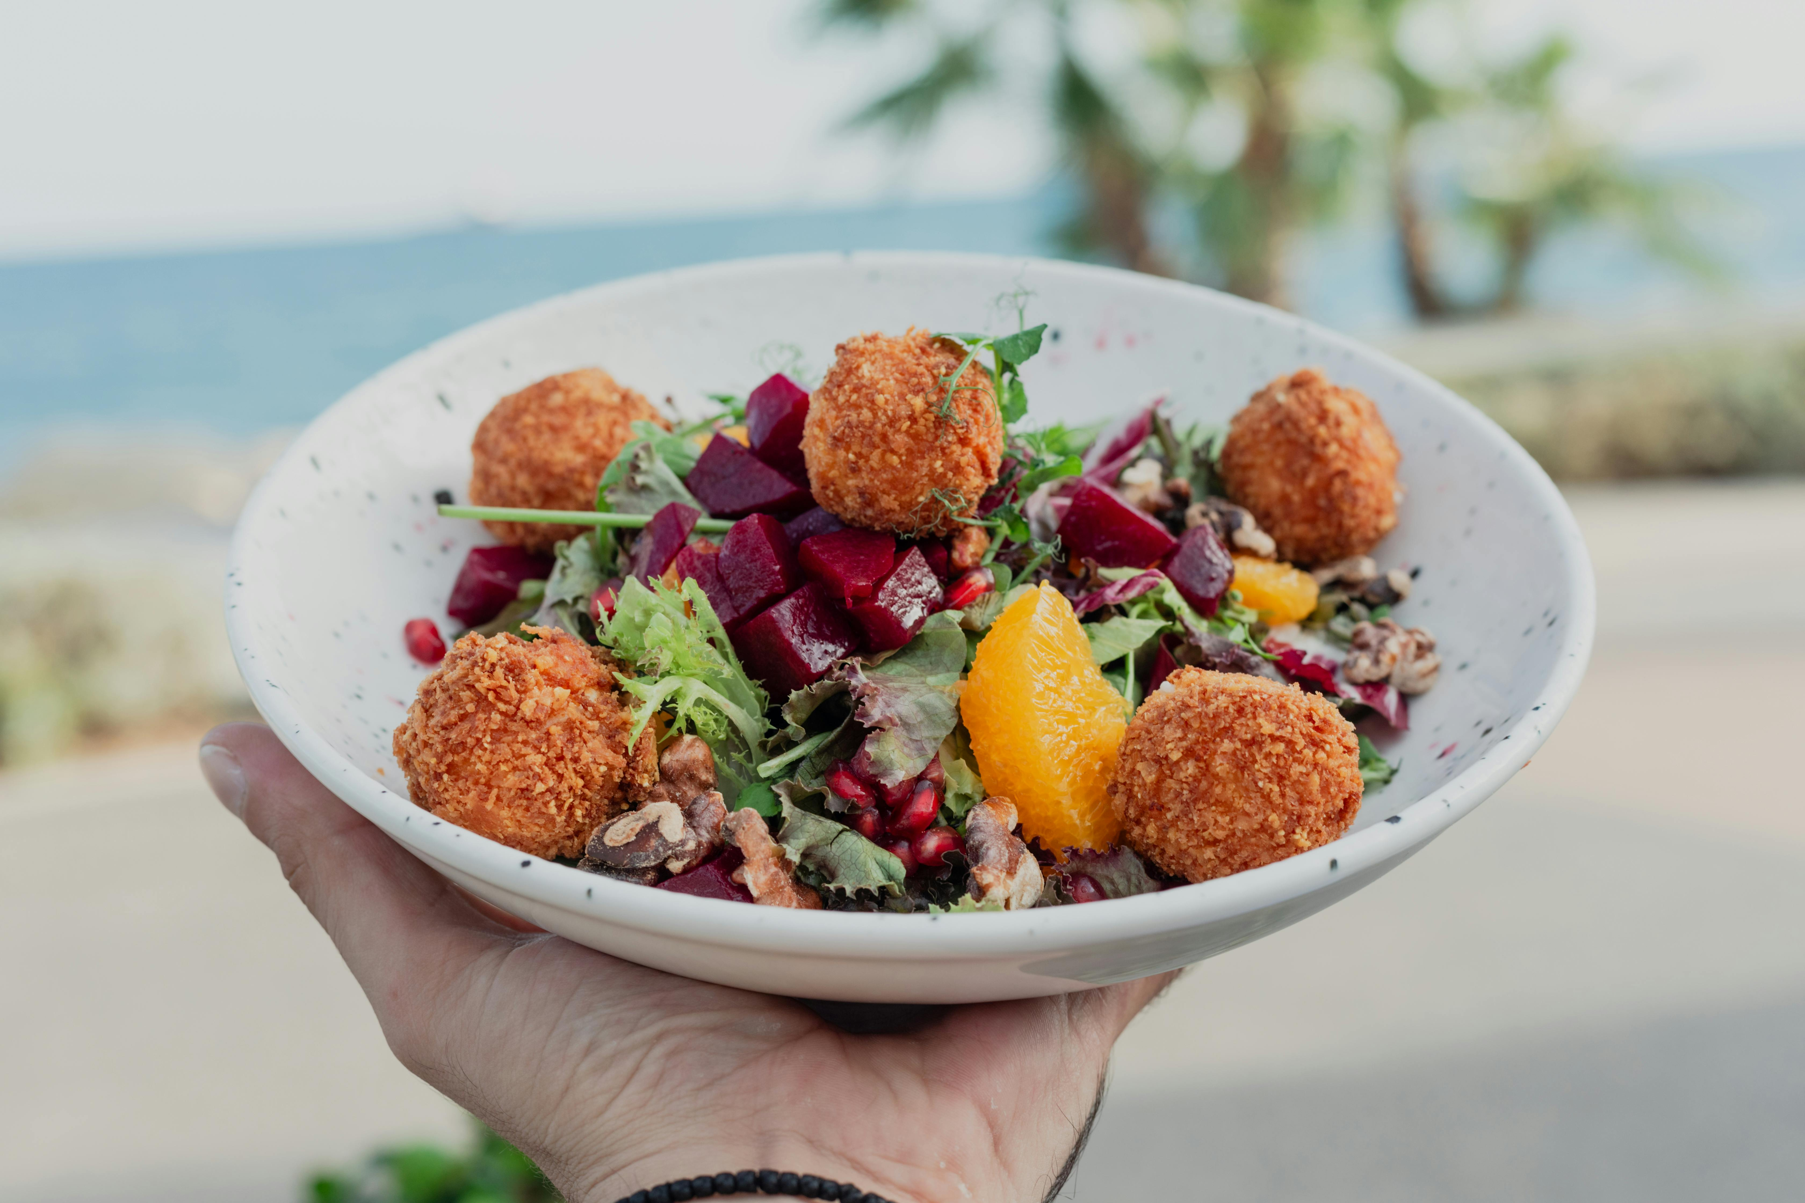
07
Learning
Summary

Slide 62
Learning Summary
This module explores how plant-based innovation can be successfully applied within food service outlets, including restaurants, cafés, food trucks, and fast-food chains. It examines the drivers, challenges, and opportunities of offering plant-based options, focusing on consumer perception, nutritional balance, cost, sustainability, and market demand. Learners gain insight into menu planning, pricing, and sustainable menu design, understanding why plant-based dishes may be priced similarly to meat-based options. The module also covers recipe development for commercial kitchens, highlighting scaling, consistency, testing, and iteration, alongside the use of plant-based and dairy alternatives.

Slide 63
Learning Summary
Through design-thinking principles, learners are encouraged to adopt a human-centred approach to creating appealing, nutritious, and commercially viable plant-based menus. Case studies, trends, and European market perspectives demonstrate how plant-based foods are moving from niche offerings to mainstream choices in food service, supporting health, sustainability, and innovation goals

Slide 64
Bibliography
Claiborne, J. (2025) Build a Balanced Meal with the Vegan Plate Method. Available at: https://sweetpotatosoul.com/vegan-plate-method/ (Accessed 01.10.2025)
Dr Sophie GP (2019) The Pros and Cons to a Plant-Based Diet [video]. YouTube. https://www.youtube.com/watch?v=ABIe15DMZRc
EAT & GlobeScan (2023) Global Consumer Research on Healthy and Sustainable Food Systems, Grains of Truth 2023. Available at: https://globescan.wpenginepowered.com/wp-content/uploads/2024/01/EAT-globescan_grains-of-truth_2023_v1.6.pdf
EAT & GlobeScan (2024) Taste Price Optimism & Obstacles Habit Convenience Health, Grains of Truth 2024. Available at: https://globescan.wpenginepowered.com/wp-content/uploads/2025/01/EAT-globescan_grains-of-truth_2024.pdf
Good Food Institute Europe (November 2023) Italy bans cultivated meat, cutting itself off from innovation and blocking sustainable development. Available at: https://gfieurope.org/blog/italy-ban-on-cultivated-meat-cuts-itself-off-from-innovation-and-blocks-sustainable-development/ (Accessed 19.09.2025)

Slide 65
Bibliography
Good Food Institute Europe (February 2024) Italian Government ‘open’ to Reconsidering Ban on Meaty Terms. Available at: https://gfieurope.org/blog/italian-government-open-to-reconsidering-ban-on-meaty-terms/ (Accessed 01.12.2025)
Green Queen (January 2025) French ‘Veggie Burger’ Labelling Ban Rejected by Country’s Highest Court. Available at: https://www.greenqueen.com.hk/france-vegan-labelling-plant-based-meat-banned-veggie-burger/ (Accessed 19.09.2025)
Knaapila, A., Michel, F., Jouppila, K., Sontag-Strohm, T., Piironen, V. (2022) Millennials’ Consumption of and Attitude toward Meat and Plant-Based Meat Alternatives by Consumer Segment in Finland, Foods, 3; 11 (3): 456. Available at: https://pmc.ncbi.nlm.nih.gov/articles/PMC8834568/
Lorraine Elliott Not Quite Nigella (2025) Haus Hiltl: The Oldest Vegetarian Restaurant in the World. Available at: https://www.notquitenigella.com/2025/09/20/haus-hiltl/ (Accessed 01.10.2025)
McDonald’s Ireland (2025) McPlant. Available at: https://www.mcdonalds.com/ie/en-ie/product/mcplant.html (Accessed 01.10.2025)

Slide 66
Bibliography
Ozturk, O. K., Hamaker, B. R. (2023) Texturization of Plant-Based Meat Alternatives: Processing, Base Proteins, and Other Constructional Ingredients. Future Foods, Volume 8, 100248. https://www.sciencedirect.com/science/article/pii/S2666833523000345
Physicians Committee for Responsible Medicine (2024) A vegan diet: Eating for the environment. Available at: https://www.pcrm.org/good-nutrition/vegan-diet-environment (Accessed 22.08.2025)
Restaurantware (2025) Serving Plant-Based Dishes: Presentation Tips and Tools. Available at: https://www.restaurantware.com/blogs/kitchen-and-cooking-tips/serving_plant-based_dishes-_presentation_tips_and_tools (Accessed 01.10.2025)
Serious Eats (10 August 2018) Why Is My Vegan Entrée as Expensive as the Meat? Available at: https://www.seriouseats.com/menu-pricing-vegan-vegetarian-meat (Accessed 01.10.2025)
Strategic Market Research (2023) Plant Based Food Statistics – Size & Growth 2023. Available at: https://www.strategicmarketresearch.com/blogs/plant-based-food-statistics (Accessed 08.10.2025)
Switzerland (2022) The Story of Hiltl Switzerland Tourism [Video]. YouTube. https://www.youtube.com/watch?v=mhDgQ4r3o64

Slide 67
Bibliography
The Eco Experts (2022) Switzerland Named Vegetarian Hotbed of Europe. Available at: https://www.theecoexperts.co.uk/news/best-country-to-be-vegetarian-europe (Accessed 01.10.2025)
The Happy Pear (2020) 5 SECRET VEGAN FLAVOURS THIS MICHELIN STAR CHEF LOVES 2020 [Video]. YouTube. https://www.youtube.com/watch?v=P5iDMkLq3s4
The Vegan Society (2025) Nationwide Trends Highlight Growing Shift Toward Plant-Based Diets. Available at: https://www.vegansociety.com/news/news/nationwide-trends-highlight-growing-shift-toward-plant-based-diets (Accessed the 6th of October 2025)
Wills, K. (2021) Converting a Kitchen Recipe to a Commercial Formula. Available at: https://www.canr.msu.edu/news/converting-a-kitchen-recipe-to-a-commercial-formula (Accessed 02.10.2025)

Slide 68

Thank you
follow our journey
Any questions?
www.plantpowerproject.eu

