Slide 1

MODULE 1
Opportunities in Innovation for SMEs
& the Power of Digitalisation and Innovative Technology
www.plantpower.eu

Slide 2
Contents
01
Purpose and Objectives
02
Innovation in SMEs – Basics and Importance
03
Why Innovate?
04
Digital Business – Digitized Sales and Communication Channels for SMEs
05
Practical applications in plant-based SMEs

Slide 3
Contents
06
EU Policies Supporting Innovation and Digitalisation
07
Overview

Slide 4

01
Purpose and Objectives

Slide 5
Purpose
This module provides an introduction to current trends in innovation for SMEs, with a focus on leveraging digitalisation, technology, and innovation for growth and sustainability in the plant-based sector. The module is connected to real-world examples and uses accessible language to explain how SMEs can innovate their processes and products, increase efficiency, become more sustainable, and better respond to market demands.

Slide 6
Objectives
By the end of the module, learners will be able to:
Explain key concepts related to innovation and digitalisation in SMEs.
Identify main areas where SMEs can apply technology and innovation.
Recognise the opportunities of digital tools such as e-commerce, automation, or blockchain for food traceability.
Gain an overview of sustainable and smart technologies for processing and selling plant-based products.
Connect theory with practice through case studies and interactive activities.

Slide 7

02
INNOVATION IN SMEs – BASICS AND IMPORTANCE

Slide 8
What are SMEs and why are they important?
Small and Medium-sized Enterprises (SMEs) are defined by the European Commission as businesses with fewer than 250 employees and an annual turnover not exceeding €50 million. They represent 99% of all enterprises in the EU, providing two-thirds of private sector jobs and contributing over half of Europe’s GDP. In many regions, particularly rural and semi-rural areas, SMEs are the primary engines of employment, innovation, and local development.

Slide 9
What are SMEs and why are they important?
In the food and agri-food sector, SMEs include a broad range of businesses, from family farms, food processors, and artisans to new-generation foodtech startups and local service providers. Their smaller scale, flexibility, and adaptability make them ideal platforms for testing and implementing innovative solutions, especially in response to rapidly changing consumer demands and sustainability challenges.

Slide 10
What are SMEs and why are they important?
SMEs play a critical role in ensuring food diversity, supporting circular economy principles, and preserving traditional know-how while also embracing modern techniques. Moreover, SMEs are often more embedded in their communities than large corporations, meaning their innovations can have direct, meaningful impacts at the local level — from sustainable sourcing and eco-packaging to the development of novel plant-based products.

Slide 11
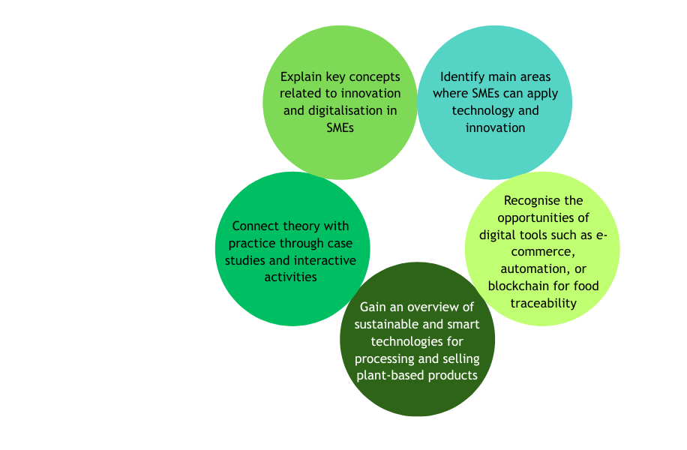

Characteristics of innovation in SMEs
Notes:
the link for the graphic’s translation https://www.canva.com/design/DAG4rdK9qWQ/qjjltVL9wVWl11LBylzmzw/edit?utm_content=DAG4rdK9qWQ&utm_campaign=designshare&utm_medium=link2&utm_source=sharebutton

Slide 12
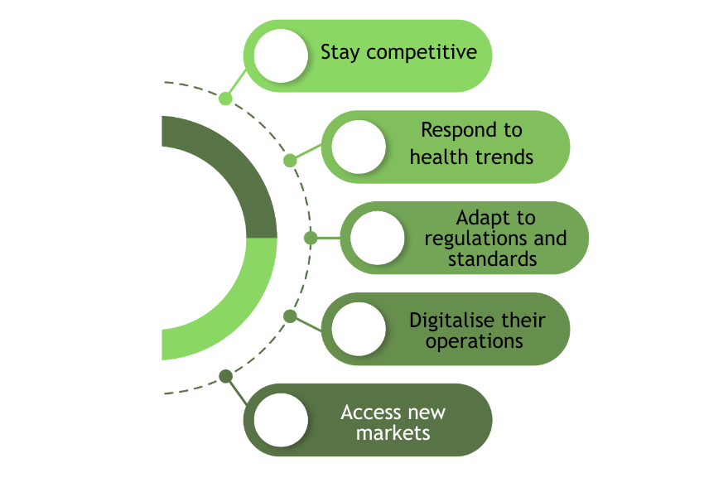
Why is innovation critical in the food sector?
The food and agri-food sector faces some of the most pressing challenges of our time: climate change, biodiversity loss, global population growth, changing dietary patterns, and increasing pressure on water, land, and energy resources. Innovation is not a luxury — it is a necessity for achieving both economic viability and sustainability goals.
Notes:
the link for the graphic’s translation https://www.canva.com/design/DAG4rdK9qWQ/qjjltVL9wVWl11LBylzmzw/edit?utm_content=DAG4rdK9qWQ&utm_campaign=designshare&utm_medium=link2&utm_source=sharebutton

Slide 13
Innovation types relevant to SMEs
Product Innovation – Developing new plant-based foods, functional ingredients, or alternative protein sources.
Process Innovation – Introducing more efficient, safer, or more sustainable production methods (e.g., cold-pressing, upcycling by-products).
SMEs in the food sector can benefit from many forms of innovation, not only in products but also in processes, business models, and customer experience. Key types of innovation include:

Slide 14
Innovation types relevant to SMEs
Packaging Innovation – Using biodegradable, compostable, or reusable packaging solutions.
Organisational Innovation – Implementing circular economy principles, lean production, or new supply chain strategies.
Marketing Innovation – Using storytelling, transparency, and digital tools to connect with conscious consumers.
SMEs in the food sector can benefit from many forms of innovation, not only in products but also in processes, business models, and customer experience. Key types of innovation include:

Slide 15
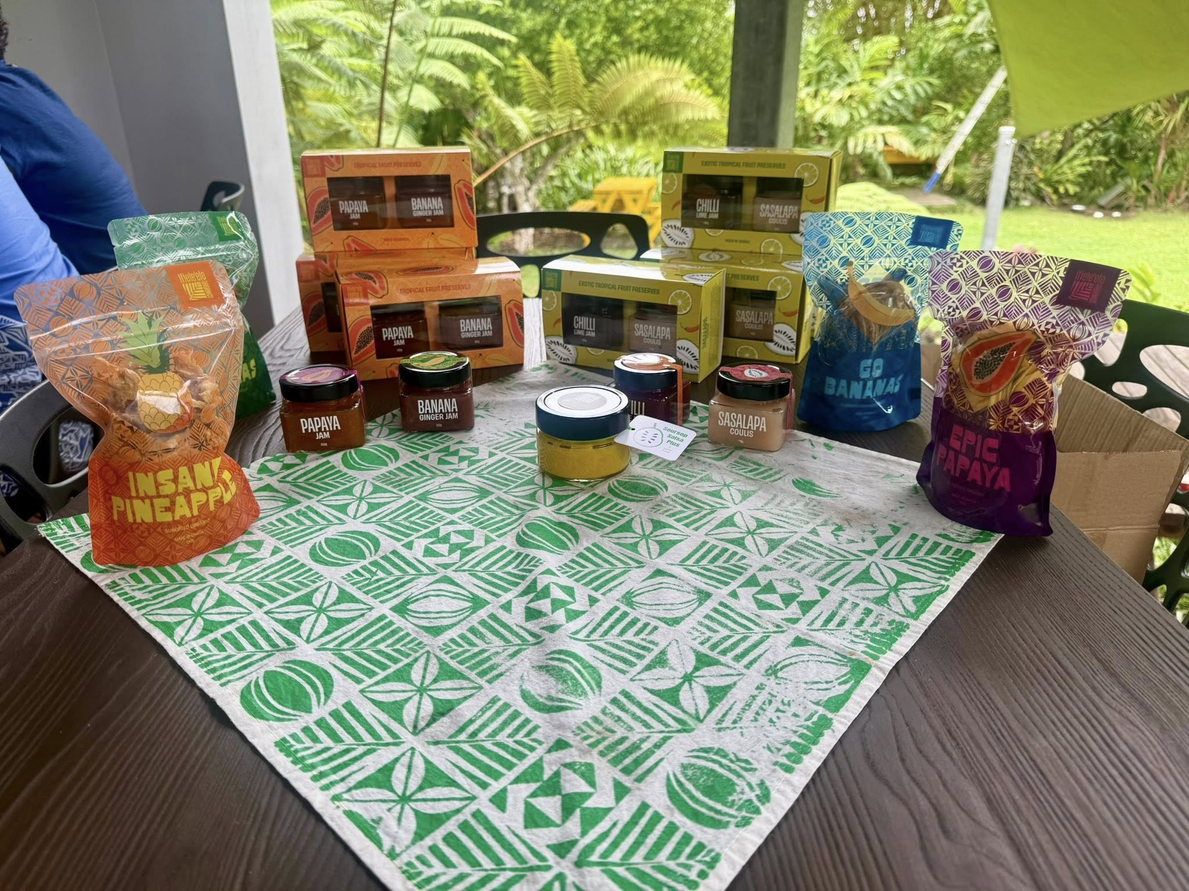
Innovation challenges for SMEs
Despite their potential, SMEs often face barriers to innovation, including:
Limited financial resources to invest in R&D, digital tools, or certifications.
Lack of specialised staff or innovation managers.
Insufficient access to market intelligence or consumer insights.
Regulatory complexity, especially when dealing with novel foods or exports.
Low awareness of funding opportunities, such as EU or national support schemes.

Slide 16
Innovation challenges for SMEs
For this reason, many innovation support programmes — such as Horizon Europe, Erasmus+, and national development funds — specifically target SMEs with training, mentoring, infrastructure access, and networking. It is also why the Plant Power project puts strong emphasis on building the innovation capacity of food SMEs through tailored Open Education Resources and stakeholder engagement.

Slide 17

03
Why Innovate?

Slide 18
Product innovation
1
This innovation refers to the development of new or significantly improved goods or services. In the food sector, this might include new recipes for vegan cheeses, gluten-free bakery items, or protein-rich snacks made from pulses.
Forms of Innovation
Process innovation
2
Process innovation involves improvements in the production or delivery method. This can include the adoption of energy-efficient cooking systems, the use of AI-driven quality control mechanisms, or the integration of cold-chain logistics to reduce spoilage.
Marketing innovation
3
Marketing innovation focuses on new packaging designs, product placement strategies, or communication techniques. The use of QR codes for transparency, eco-labels, or social media storytelling are common examples.

Slide 19
Organisational innovation
4
Organisational innovation refers to changes in business models, partnerships, or internal processes. For example, shifting to circular business models, co-creating products with customers, or using flexible team structures.
Forms of Innovation

Slide 20
Digitalization vs. Digital Transformation
Digitalization and digital transformation are often confused, yet they represent very different stages of technological progress.
Digitalization focuses on converting analogue tasks into digital ones to improve efficiency—such as replacing paper-based farm records with spreadsheets or using a digital calendar to manage planting schedules. These changes streamline work, reduce errors, and make data easier to retrieve, but they do not fundamentally alter how an SME operates. They enhance access to information and support better organisation, but the core business model remains the same.

Slide 21
Digitalization vs. Digital Transformation
Digitalization and digital transformation are often confused, yet they represent very different stages of technological progress.
Digital transformation goes much further, reshaping how value is created and delivered by integrating advanced digital technologies across the entire business. In agriculture, this could mean using IoT sensors, AI-driven tools, and automated irrigation systems that respond to real-time soil and weather data. Such systems reduce resource use, increase yields, and generate environmental metrics that can be shared with consumers to enhance transparency and trust. Digital transformation does not simply improve existing processes—it redefines them, enabling SMEs to innovate, strengthen their market position, and align with sustainability expectations in the evolving plant-based food ecosystem.

Slide 22
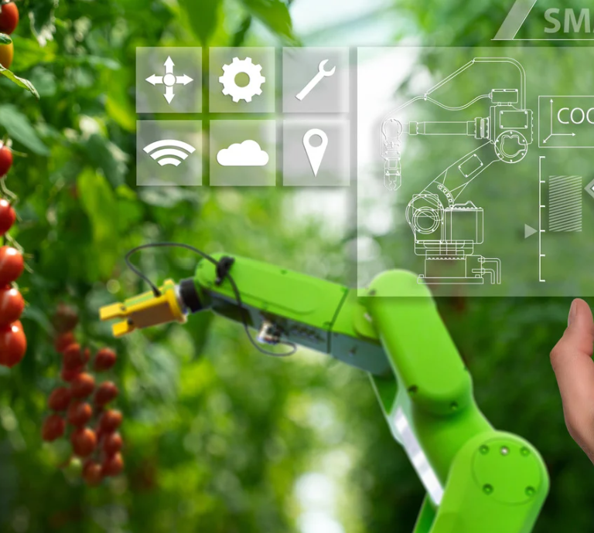
Digital Farm vs. Digital Business: Practical Tools for SMEs
The digital revolution has created an entirely new layer of possibilities for innovation. However, it is important to distinguish between two key domains where SMEs can apply digital tools:
Digital Farm (focusing on production)
Digital Business (focusing on sales and communication).

Slide 23
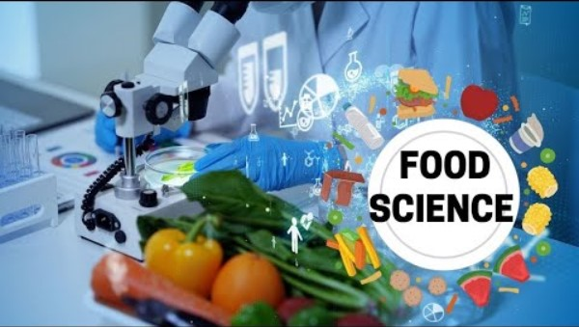
Digital Transformation in the Plant Food Industry
Through watching this video explore the fascinating world of food technology and discover how technology is revolutionising the food industry. From vertical farming to lab-grown meat, robotics to blockchain, learn about the latest advancements in food production and sustainability.

Slide 24

04
Digital Business – Digitized Sales and Communication Channels for SMEs

Slide 25
Business and Digital Transformation
Digital transformation in the food sector extends far beyond production. It reshapes how small and medium-sized enterprises (SMEs) sell their products, communicate with customers, and manage internal operations. By embracing digital tools, these businesses can streamline sales through e-commerce platforms, target niche audiences with tailored marketing messages, and reduce administrative burdens using accounting software, CRM systems, or collaborative online workspaces. In the plant-based market, this transformation is especially visible in digital campaigns that promote health, sustainability, and ethical values, building consumer trust through storytelling and influencer engagement.

Slide 26
Business and Digital Transformation
Successful transformation relies on a digitally literate workforce capable of adapting to new tools and continuously improving processes. When properly implemented, digital transformation enables even the smallest enterprises to compete with larger companies, driving innovation, customer satisfaction, and long-term growth.

Slide 27

Digital Farm – Tools Supporting Production Efficiency
The digital revolution has introduced new opportunities for innovation across the entire agri-food value chain. For small and medium-sized enterprises (SMEs), it is useful to distinguish between Digital Farm and Digital Business, as each area focuses on different aspects of growth and efficiency.
Digital Farm refers to the use of digital tools that support production, resource management, and on-farm decision-making.
Digital Business focuses on how enterprises digitise their sales, communication, and internal operations. E-commerce platforms, social commerce, and digital storefronts allow SMEs to reach customers beyond local markets.
Animal Welfare

Slide 28
Digital Farm – Tools Supporting Production Efficiency
Basic digital tools
Environmental monitoring using soil sensors and weather stations
Automated irrigation systems
Digital farm management tools
Drones and remote sensing
Digital marketing and e-commerce
Building a digital storefront
Using digital marketing tools
Implementing cloud-based tools for inventory management andaccounting,
Animal Welfare

Slide 29
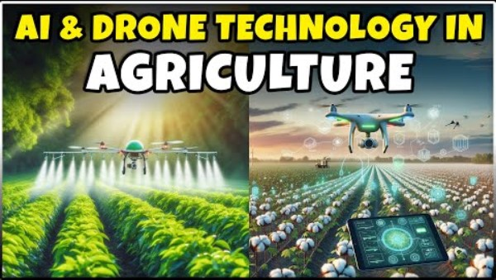
How Drones and Artificial Intelligence Are Transforming Agriculture
Join us as we explore the endless possibilities and benefits of Revolutionizing Farming with Precision Agriculture and Drone AI Technology. From increased productivity to sustainability, this video dives deep into how these advanced tools are shaping the future of agriculture.
Don't miss out on being part of this
agricultural revolution!

Slide 30

What Is E-Commerce and how the digital marketing can change the agricutlure?
Agriculture is no longer just about growing crops! it’s about connecting with consumers in a digital world. From social media branding to e-commerce platforms, digital marketing is transforming how farmers and agribusinesses sell their products.

Slide 31
From Digitalization to Digital Transformation
Digitalization refers to the adoption of digital tools to perform existing processes more efficiently.
Digital transformation, by contrast, implies a more strategic shift that redefines business models, processes, and customer interactions.

Slide 32
From Digitalization to Digital Transformation
Key Digital Tools for SMEs
Cloud services (e.g., Google Workspace, Dropbox): Enable secure storage, sharing, and access to business documents anytime and from anywhere. They support collaboration, version control, and reduce dependency on physical archives.
Customer Relationship Management (CRM) systems: Tools like HubSpot or Zoho CRM allow SMEs to track customer interactions, manage contact databases, streamline communication, and automate sales processes. This results in better customer retention and more targeted marketing.

Slide 33
From Digitalization to Digital Transformation
Key Digital Tools for SMEs
Digital accounting software (e.g., iDoklad, QuickBooks): Simplifies invoicing, expense tracking, payroll, and financial reporting. It reduces administrative burden and improves financial transparency, especially for small teams without dedicated accounting staff.

Slide 34
E-Commerce and Digital Marketing
Launching an e-shop:
Platforms like Shopify or WooCommerce allow SMEs to easily set up an online store, manage product catalogs, and integrate payment and delivery options.
Social media promotion:
  Platforms such as Facebook, Instagram, and TikTok provide opportunities to build communities, share content (e.g., recipes, product news), and engage directly with customers. Visual storytelling is especially effective in the food sector.

Slide 35
E-Commerce and Digital Marketing
Targeted advertising:
  Tools like Meta Business Suite and Google Ads Express enable even small businesses to run efficient ad campaigns with limited budgets. These tools use demographic, interest-based, and geographic filters to increase the return on investment.

Slide 36

05
Practical Applications in Plant-based SMEs

Slide 37
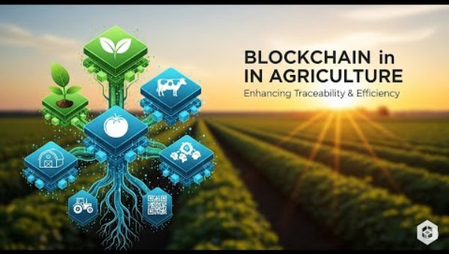
Blockchain and Traceability Technologies
Blockchain is a type of distributed ledger technology that records transactions in a way that is transparent, secure, and tamper-proof. In the context of food production, blockchain helps guarantee the authenticity and traceability of ingredients.

Slide 38
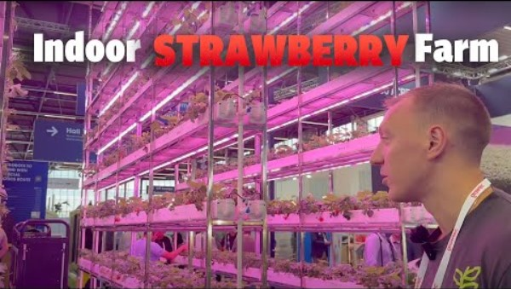
Vertical Farms and Smart Greenhouses
As urban populations grow and space becomes limited, controlled-environment agriculture (CEA) has emerged as a sustainable solution.
Smart greenhouses automate lighting, temperature, humidity, and CO₂ levels for optimal growth.

Slide 39

Vertical Farms and Smart Greenhouses
Meanwhile, vertical farming involves growing crops in vertically stacked layers, often using hydroponics or aeroponics.

Slide 40

Hausnatura – Indoor Vertical Farming in Bratislava
Location: Bratislava, Slovakia
Company: Hausnatura
Founder: Matej Papánek
Year established: 2021
Hausnatura is one of the first vertical farms in Slovakia focused on hydroponic indoor cultivation of leafy greens and herbs. Located in Bratislava, the farm operates entirely indoors using vertical racks and controlled-environment agriculture technologies.

Slide 41
Simple AI Tools for SMEs
Chatbots
Recommendation engines
Automated image editing
Market trend analysis
Product description generators
Practical tools include:

Slide 42
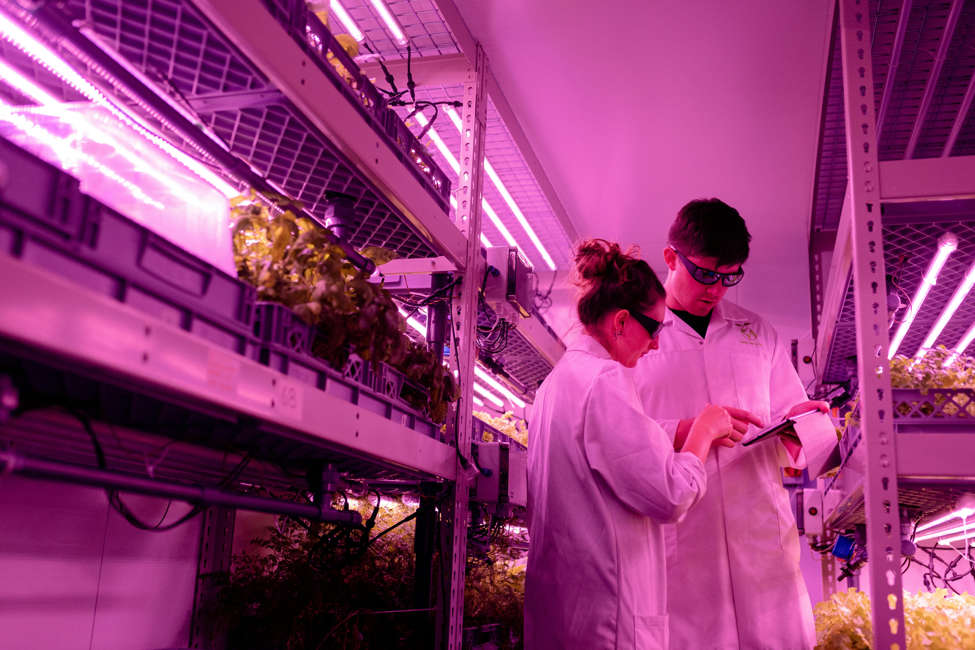

06
EU Policies Supporting Innovation and Digitalisation

Slide 43
EU Policies Supporting Innovation and Digitalisation
Several EU-level strategies shape how SMEs access innovation, digitalisation, and sustainability opportunities.
The European Green Deal supports climate-neutral and resource-efficient business models, offering incentives for eco-packaging, circular production, renewable energy, and waste reduction.
The Digital Decade 2030 sets clear digitalisation targets, such as widespread adoption of cloud computing, AI, and big data, and ensures that over 90% of SMEs reach a basic level of digital readiness through digital innovation hubs and upskilling programmes

Slide 44
EU Policies Supporting Innovation and Digitalisation
In addition, major EU programmes provide funding and collaboration opportunities.
Horizon Europe supports R&I projects in areas such as food sustainability, circular economy, and AI;
EIT Food accelerates innovation in the agri-food sector through grants, start-up support, and co-creation activities;
and Erasmus+ funds digital skills development, VET innovation, and entrepreneurship through cooperation partnerships.
Together, these initiatives create a strong ecosystem that enables SMEs to transform their processes, collaborate internationally, and stay competitive in a rapidly changing market.

Slide 45
Support Instruments for SMEs
The EU provides a wide range of practical support instruments that help SMEs innovate and grow, including:
grants,
incubators,
advisory networks,
and Digital Innovation Hubs.

Slide 46
Support Instruments for SMEs
Financial tools:
EU-backed grants,
cascade funding,
and programmes like the former SME Instrument (now part of the EIC Accelerator)
enable companies to adopt clean technologies, upgrade digitally, or scale breakthrough ideas.

Slide 47

Sustainability and innovation are no longer separate paths — in the modern food sector, they lead to the same destination.

Slide 48
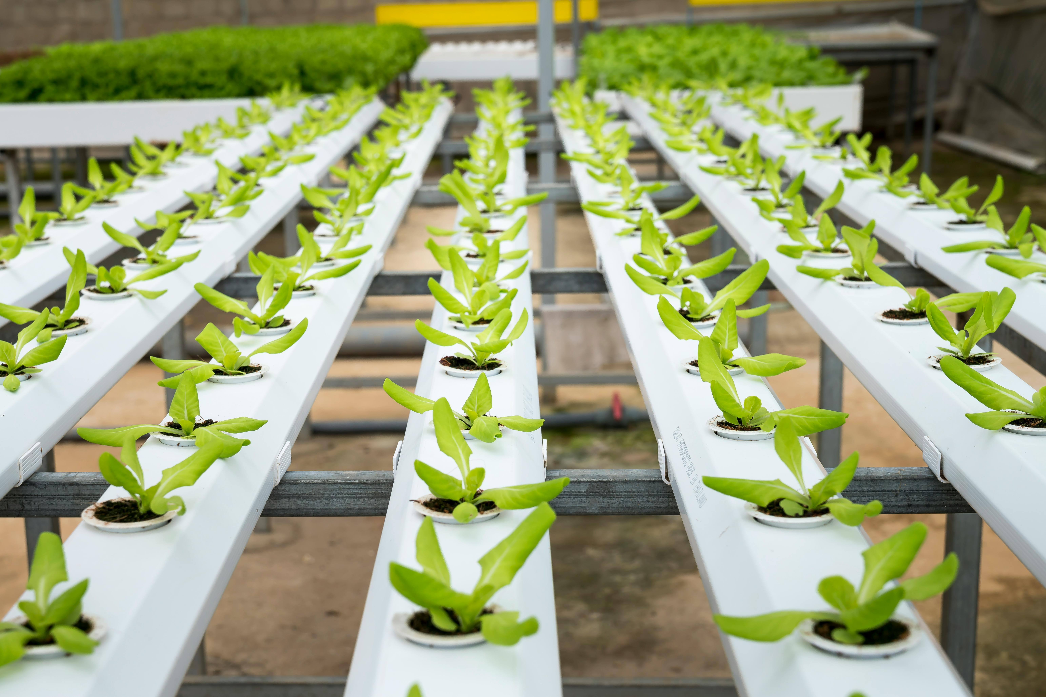
07
Learning
Summary

Slide 49
Learning Overview
This module explores how innovation and digitalisation can support the growth, sustainability, and competitiveness of small and medium-sized enterprises (SMEs) in the plant-based food sector. Learners will gain an understanding of why innovation is essential in addressing challenges such as sustainability, changing consumer demands, and limited resources. The module introduces key types of innovation which include product, process, marketing, and explains how each can be applied in food and agri-food SMEs. A clear distinction is made between digitalisation, which improves efficiency by digitising existing tasks, and digital transformation, which fundamentally reshapes business models through advanced technologies.

Slide 50
Learning Overview
Learners are introduced to practical digital tools for both production (Digital Farm) and sales and communication (Digital Business), including e-commerce platforms, digital marketing, cloud services, CRM systems, AI tools, and blockchain for traceability. Real-world examples, such as vertical farming and smart greenhouses, illustrate how innovation can be implemented in practice. Finally, the module highlights EU policies and funding programmes that support innovation, digital skills development, and sustainable business practices.
Overall, learners should be able to identify innovation opportunities, understand relevant digital tools, and recognise how sustainability and digital transformation can create long-term value for plant-based SMEs

Slide 51

Thank you for completing Module 1 Opportunities in Innovation for SMEs & the Power of Digitalisation and Innovative Technologies
Supporting Europe’s food sector in adopting plant-based innovation and sustainability.
follow our journey
www.plantpower.eu

